Slide 1
Age-specific housing in Australia are low income people adequately served: A provider and policy perspective
Catherine Bridge¹; Laura Davy^{1;} Bruce Judd¹; Paul Flatau²; Alan Morris^{1;} & Peter Phibbs³.
AHURI UWS/UNSW Research Centre
University of New South Wales; ²Murdoch University; ³University of Western Sydney
IFA 11th Global Conference on Ageing ‘Ageing Connects’
Housing and the living environment: Elder housing
Wednesday 30.5.2012

Slide 2
Research questions
The research questions that directed this project were:
What is the nature of the age-specific housing market in Australia at present?
What factors have influenced the provision of particular types of age-specific housing products?
Should policies and regulations be modified to create more suitable age-specific housing options and, if so, what changes should be made?

Slide 3
Research design
This research project was divided into five stages:
Literature review and policy review of the Australian age-specific housing market.
Quantitative profile of the housing market and its consumers.
Questionnaire survey of age-specific housing providers and older residents of age-specific housing.
107 qualitative interviews with older people in age-specific housing, housing providers, and key policy stakeholders.
Public engagement via 3 public forum across 3 States (NSW, Victoria and Western Australia).

Slide 4
Definitions
Age specific housing: accommodation or dwellings that have been specifically constructed for, modified for, or allocated to older people.
Focusing on those housing types that include a rental component.
Older people: over 60 years.
Three age cohorts: 60 to 74, 75 to 84, and 85+.
Low to moderate income: up to 120 per cent of the median household income in Australia (includes people who rely on full Age Pension and those that receive part pension plus income up to 120%).

Slide 5
Background to research
There is a growing need for housing that can adequately encompass the care requirements of Australia’s ageing population.
Rising housing costs particularly in town centres and capital cities.
Undersupply of social housing.
Capped supply of Commonwealth residential aged care beds.
Decline of affordable rental options.

Slide 6
Background to research Cont…
Just over 20% of Australians 65 years or older do not own their own homes (ABS 2006). 74% of all people aged 65 or older rely on government income supplementation (ABS 2008).
Older persons with no savings and little or no superannuation to draw on often have minimal capacity to cover any increase in housing and living costs, particularly if they are not outright home owners.

Slide 7
Little consensus on what constitute age-specific housing
Few academic studies that provide a comprehensive overview or typology of housing types in the age-specific housing market.
Unregulated manner in which private developers have entered the age-specific housing market has compounded comparison problems.
Age-specific housing in Australia is provided by an assortment of for profit and not for profit organisations, funded through a range of private, charitable and government funded means. It comprises a variety of accommodation models, including some service integrated ones.

Slide 8
Age-specific housing models in Australia
Retirement villages
  not-for-profit
  for profit.
Assisted living villages.
Community housing (includes housing co-operatives, congregate housing, housing associations, aged rental options).
Mobile home communities (includes manufactured home villages, residential parks and caravan parks).
Boarding houses/Rooming houses.

Slide 9
Projected tenure for population aged 65+
1996–2051, Australia
Source: ABS custom data, 2011

Slide 10
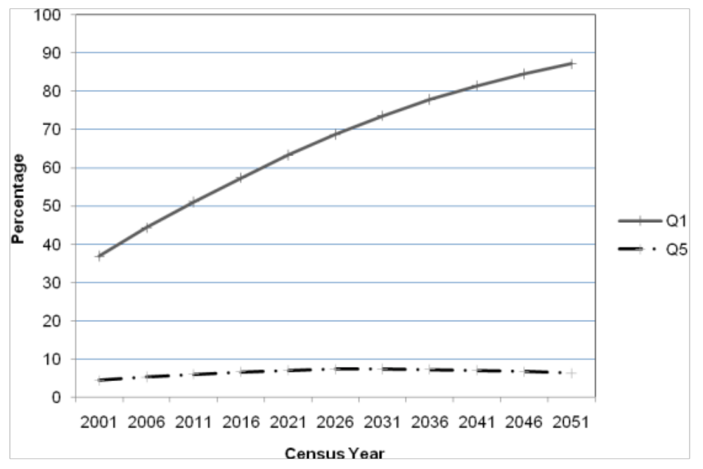
Projected income for population aged 65+
2006–2051, Australia
Q5= highest income quintile
Q1= the persons in the lowest income quintile come to represent the majority of aged 65 and over in 2051 (87%)
Q5
Q1
Source: ABS custom data, 2010

Slide 11
Accommodation Providers Survey Results

Slide 12
Accommodation Providers: Finance arrangements
financial models were extremely varied and are described below:
The simplest was community rental where residents paid a fixed percentage of their income in rent (between 25-30%) and a bond as directed by their local Residential Tenancies Act (which are State based). The residents usually paid for their own utilities.
Residents of Independent Living Units (not in retirement villages) often paid an up-front non-refundable donation and then paid a proportion of their income in rent (again usually between 25-30%). They also usually paid for their own utilities.
In the mobile home sector, some residents paid a weekly rental, whilst other owned their own mobile home and paid an administration fee to the managers of their establishment.

Slide 13
Retirement villages most financially complex
Leases: the resident is given a long-term lease for a fixed term in return for payment of an upfront lump sum, often referred to as an in-going contribution.
Licenses: the resident is given the right to occupy the unit for a fixed term in return for payment of a lump sum, or in-going contribution. The in-going contribution is repayable, subject to deductions, when the resident leaves the village or dies.
Body corporate units and strata titles: The resident purchases the unit/property and contributes to the maintenance of the common areas.
Company titles: the resident buys shares in a company whose articles of association permit them to live in the unit.
Unit trusts: the trustee is the legal owner of the property and the resident buys a unit trust in return for being allowed to occupy the property.

Slide 14
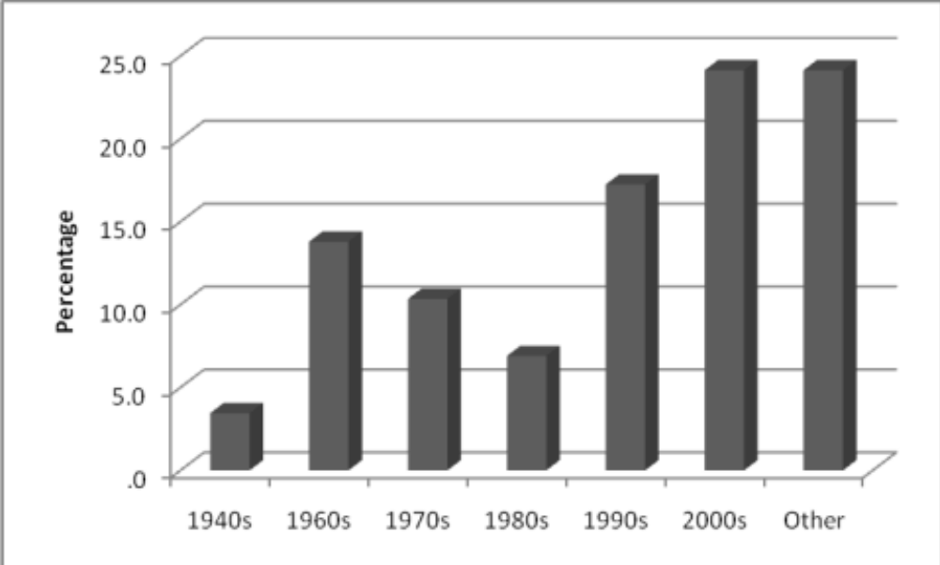
Age of dwelling stock

Slide 15
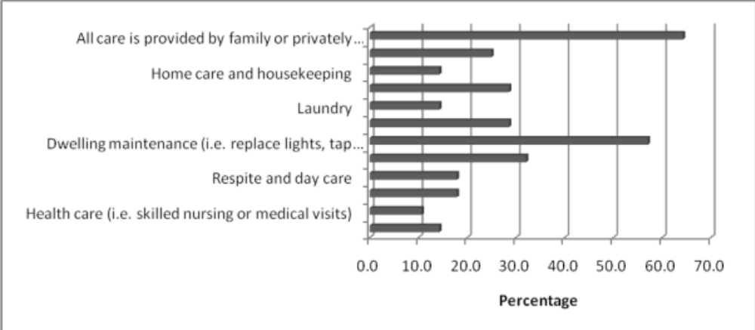
Accommodation Providers: Provision of care services

Slide 16
Accommodation Providers:
Responses to care needs
Care arrangements are managed separately from accommodation arrangements.
No care available so no strategy in place.
Our units are for residents who can live independently. If this is not possible we ask the family to assist to relocate the resident.
Community nursing is available as recognised by residents own doctors and families
Care is normally provided by the immediate family.
Residents are put in touch with Community Care providers, including our own Community Care section
Community Aged Care Packages; Domestic assistance etc.

Slide 17
Transition for residents of retirement villages to residential care
“Nobody can do that. It's not legal. Residential aged care places are allocated on a needs basis. There's nothing to do with where you come from. The government assesses those needs and approves applicants, so you can't make that guarantee. That said, people feel like because the village that you're in has got the residential aged care facility than that's a good security thing. The likelihood is that when you need it you probably will be able to move into there but you can't guarantee it.” (PR4)

Slide 18
Residential aged-care
Issues about residential aged-care directly impact age-specific accommodation supply by:
Providing profits used to subsidise residential care;
The current regulatory regime in residential care makes it difficult to innovate so providers are moving from residential care into age-specific housing instead;
Scale is required to run residential care facilities efficiently so some are being converted to age-specific housing.

Slide 19
Policy Interviews

Slide 20
Barriers to adequate housing
“For renters in the private sector obviously affordability and suitability are the difficulties. And housing design… a lot of older social housing stock is probably not always suitable.”
The lack of [social housing] stock in appropriate places is certainly an issue.
“Even with rental assistance and the Commonwealth subsidies and so on, it’s quite hard for people to get the sort of housing they want in the location they want.”
“A very high proportion of [low income older people] are spending well in excess of 30% of their income on rent

Slide 21
Social and community housing
There will be increased demand for social housing for older people.”
“Older people generally are more reliant on the social housing sector than other groups in the population. We have a high representation of older people in social housing, particularly Aboriginal people”
“This country historically has not clearly addressed social housing. It's gone backwards since the mid '80s. The levels of stock have diminished. The amount of direct funding has gone backward. It's not a vote winner... I think we're in for a bleak time in the next five years.”

Slide 22
Integration and coordination
“Low to middle income earners need infrastructure. They need local shops, they need local parks, they need places that they can get to easily either by a very short accessible bus route or that they can walk to. [They need] medical centres and hospitals.”
“To what extent do you provide housing in older persons communities, and then how do you make sure that people remain connected to the wider community?”
“It isn’t just about bricks and mortar. It’s about accessibility; it’s about lifestyle; it’s about nutrition; it’s about medical; it’s about home care service; it’s about… the capacity for lower to middle income older people to access these services.

Slide 23
Summary
Much of the current supply of age-specific housing is quite old, poorly maintained, of variable quality and not particularly suitable for older people who wish to age-in-place;
Older people, especially non-homeowners and/or those on the basic pension, experienced considerable difficulty in finding appropriate housing, particularly when they required subsidised housing or lived in a regional location;
Demand for affordable, age-specific rental housing is considerable, but housing providers are struggling to meet that demand;

Slide 24
Want more information?
For more information about this research, the following publications are available:
  Positioning Paper
  Summarises literature and policy context
  Final Report
  Summarises policy findings and conclusions
  Research and Policy Bulletin
Visit http://www.ahuri.edu.au/publications/projects/p70589/

Slide 25

ahuri.edu.au

