Slide 1
Older People’s Commissioner for Wales
The role of independent Commissioners and the UN Principles for Older Persons

Slide 5
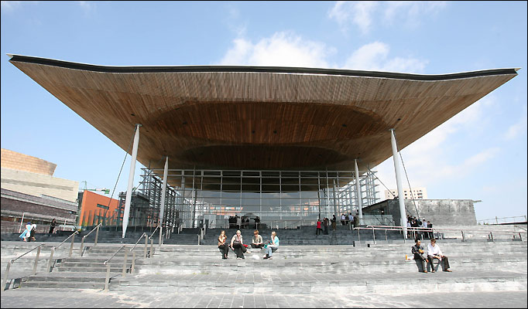
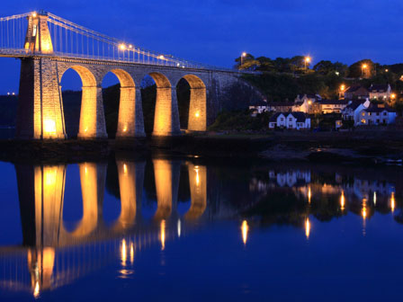
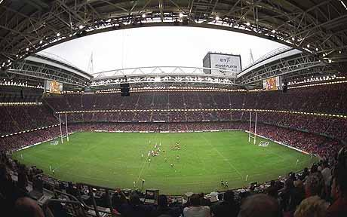
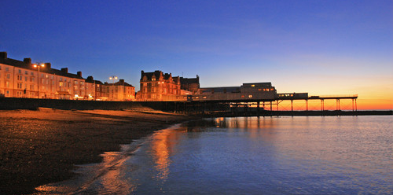

Slide 6
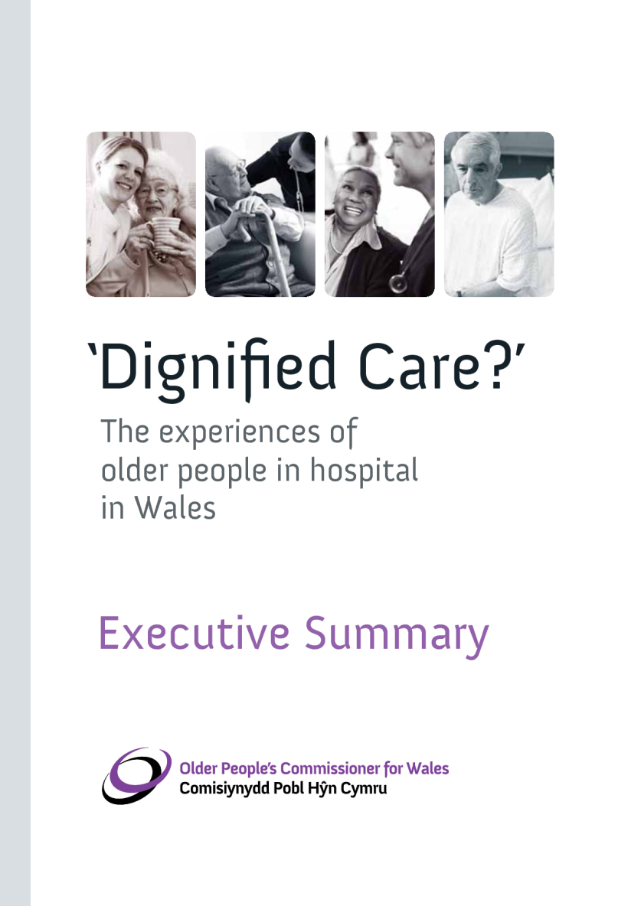

Slide 7
Older people in Wales
Population of all ages: 3m
Over 700,000 people aged over 60
Nearly one in four people are aged over sixty, higher than in England, Scotland or Northern Ireland
Life expectancy is 77 for men, 81 for women

Slide 8
Older People in Wales
5 out of 10 people between the ages of 60 and 85, and 8 out of 10 people over 85 have a limiting long-term illness, higher than in England.
people aged over 60 are more likely to use inpatient services: the over 70s are twice as likely to use them as the under 60s.

Slide 9
Older people in Wales
Over-65s in Wales made a net contribution of over £1 billion to the Welsh economy in 2010. The value of childcare provided by grandparents in Wales is £259 million and value of volunteering by older people in Wales is £469 million

Slide 10
Background
The 2004 Welsh Government Advisory Group report said that the establishment of the role of Commissioner would:
Enhance and help to implement a programme of citizenship for older people
Would ‘help to protect the small minority of older people who for reasons of severely deteriorating health, may need support to articulate their needs and preferences’

Slide 11
Role of the Older People’s Commissioner for Wales
The Commissioner is set up as a Corporation Sole with statutory authority
The role of Commissioner was established by Act of Parliament: the Commissioner for Older People (Wales) Act 2006
The Commissioner must have regard to the UN Principles for Older Persons

Slide 12
Objectives
Promote awareness of the interests of older people in Wales and the need to safeguard those interests
Promote the provision of opportunities for, and the elimination of discrimination against, older people in Wales
Encourage best practice
Keep under review the adequacy and effectiveness of the law

Slide 13
Tools
Representation
Review
Reports
Assistance
Examination
Research
Mainstreaming the UN Principles in all our work

Slide 14
Establishment of the OPCW
April 2008: First Commissioner takes up post
2009-10: interim plan establishes the organisation
2010-2013: 3 year strategic plan
2010-2011: First Review carried out
2011-2012: Second Review carried out
June 2012: Second Commissioner takes up post

Slide 15
Activity
Representation: to decision makers in Wales and at a UK level on for example poverty, age discrimination, quality of care and the promotion of rights
Review into the treatment of older people in hospitals in Wales in relation to dignity and respect

Slide 16
Activity
Review into the adequacy of advocacy arrangements in care homes
Assistance to individuals
Research on for example care home closure (and formally issuing a report), transport, home care, age discrimination

Slide 17
UN Principles
They provide a ‘principled’ basis within which states or regions can formulate their laws
Commissioner for Older People (Wales) Act 2006 – ‘have regard’ to UNP
Commissioner for Older People Act (Northern Ireland) 2011 – ‘have regard’
Is making the UNP work a better way forward than a new international convention??

Slide 18
Case for an international convention on the rights of older people
The challenge to the international community of the growth in the number of older people
Evidence that despite existing international commitments, older people throughout the world are still marginalised and discriminated against – existing provision has failed!

Slide 19
Case against an international convention on the rights of older people
The distraction cost – lets make existing law work
Would it be ageist? Why are older people not protected by existing provision?
What is ‘older age’?
Could a single Convention embrace the global diversity of ‘older age’?
Treaty fatigue? Too much law!

