Slide 1
„EMPLOYMENT AND DEVELOPMENT OPPORTUNITIES FOR OLDER ADULTS IN RUSSIA:
DO POLICIES COMPLY AND REALITY CORRESPOND TO THE MADRID INTERNATIONAL PLAN OF ACTIONS ON AGEING?“
Gulnara Minnigaleeva, PhD, Research fellow
Centre for Studies of Civil Society and Nonprofit Sector
State University Higher School of Economics
Moscow, Russia
CEO, Organization of Retired persons Wisdom Ripening
Tuymazy, Bashkortostan

Slide 2
Geography of the research

Slide 3
USSR
Russian
Federation

Slide 4
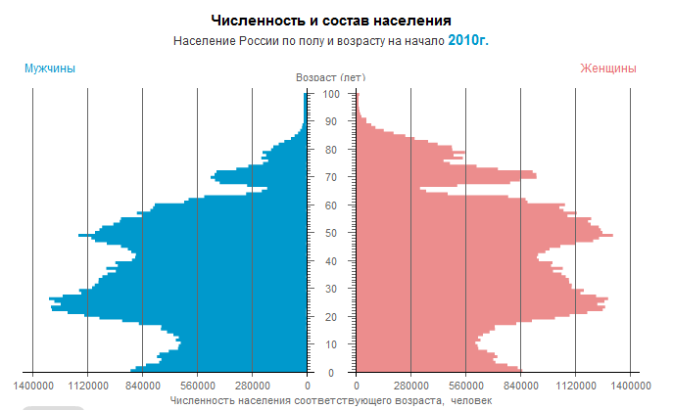
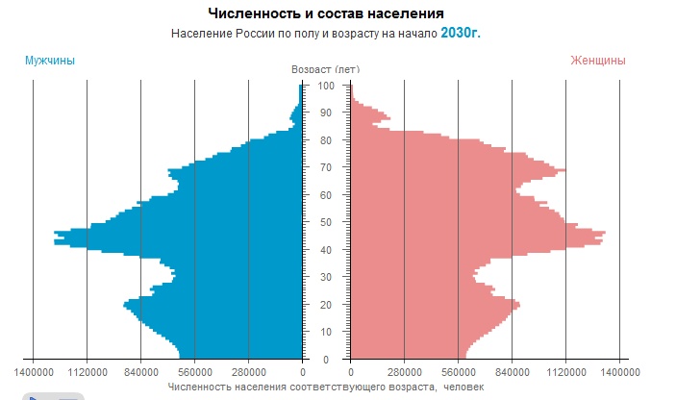

Slide 5
Facts
Population: 141,904,000 (73% urban)
160 ethnic groups
Education:
90% secondary education
60 % professional and higher education
«High income» country according to the World Bank ranking
Minimum pension 150 Euros

Slide 7
Who is an older person in Russia?
Pensionable age
55 Women
60 Men
Life expectancy (2008)
Women 73
Men 62
Number of older persons 30mln

Slide 8
What are the opportunities and actions taken?

Slide 9
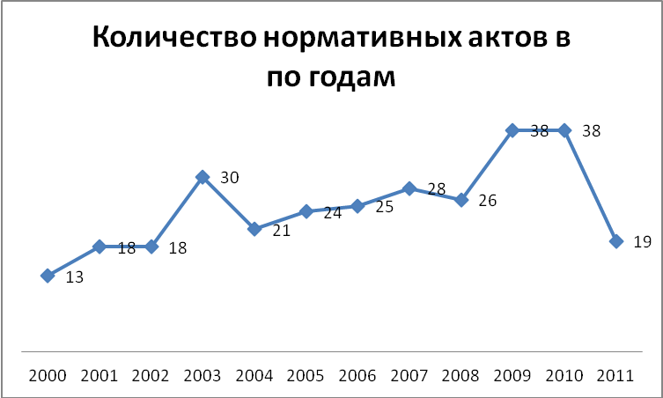
Number of legal acts and regulations adopted in the selected regions
* 7 months of 2011 counted

Slide 10
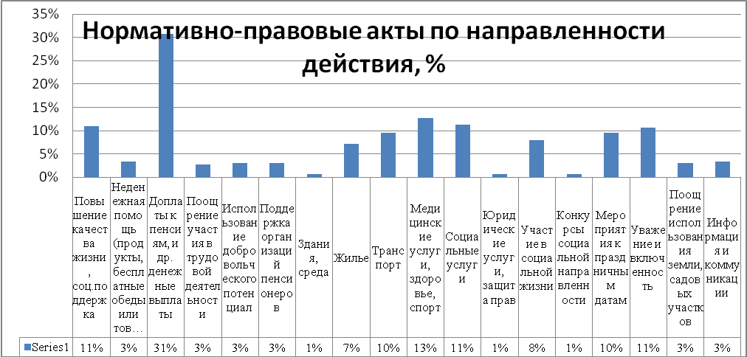
Focus of enactments and regulations
Monetary compensations
Inclusion and participation
Monetary
Reimbursements for services

Slide 12
`
Discrimination on the basis of age alone is forbidden in the hiring, retention, promotion and training of employees
Workplaces are adapted to meet the needs of disabled people
Training in post-retirement options is provided for older workers.

Slide 14
Volunteer opportunities for older people

Slide 15
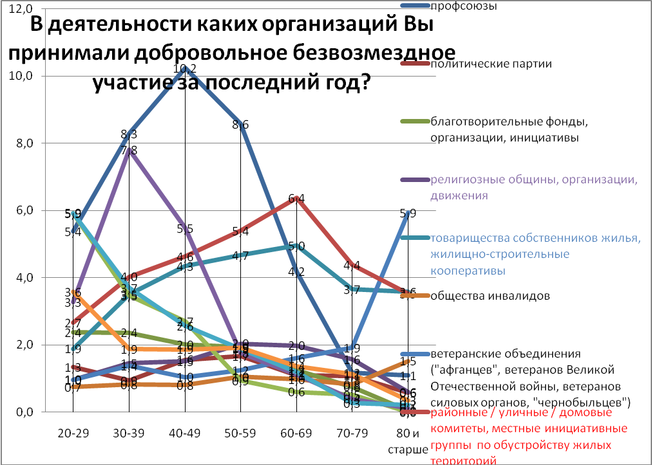
What kind of organizations did you volunteer for last year?
Religious organizations
Comdominium owners
Veterans’councils
Local community committees
Data from the all Russian Monitoring

Slide 16
Government programs?
Yes, few
Government social service centers
Some regional programs

Slide 17
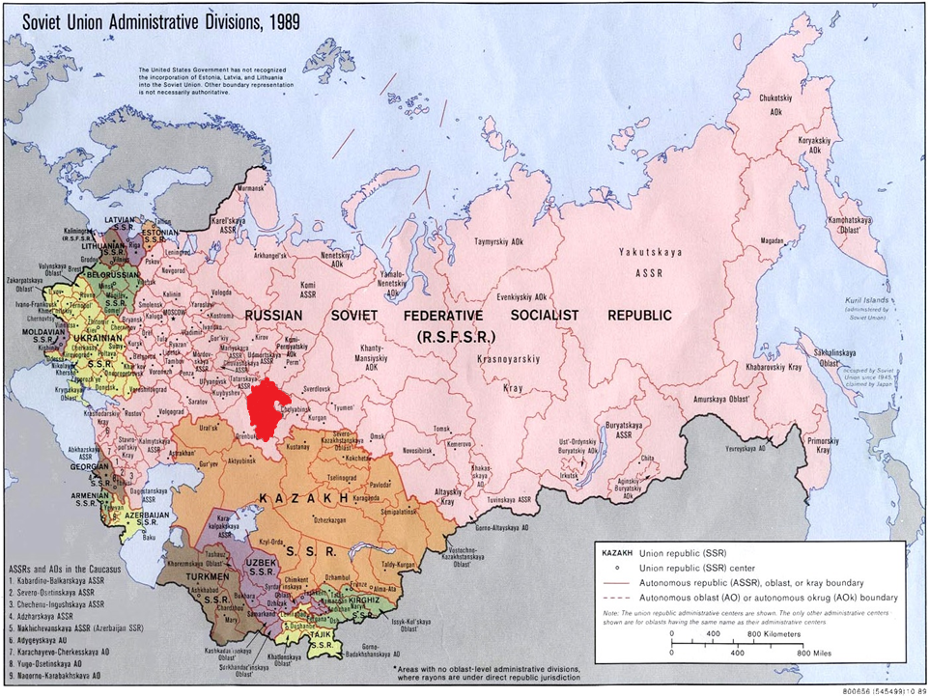

Slide 18
Republic of Bashkortostan
Third Age Universities
(4 courses)
Social tourism

Slide 19
Third Age Universities in Bashkortostan
In 2011 - 2 200 000 rubles (55 000 EURO)
- all cities in Bashkortostan
- 16 220 older learners
- at no cost

Slide 20
Third Age Universities in Bashkortostan
Problems:
Funding available for licenced educational institutions only
School teachers are not prepared to teach older learners
Limited courses (4): health, English, computer basics, psychology

Slide 21
NGO programs?
YES !!!
Network of NGO «Knowledge» (16 branches all over the country)
Individual NGOs

Slide 22
Advantages and disadvantages
Diversity of programs
Involve older learners in other activities
Better teachers
Difficult to sustain
Not always good cooperation with the government
Little resources available

Slide 23
Obstacles
Lack of political will
Not all have realized the importance of the issue
Stereotypes

Slide 24
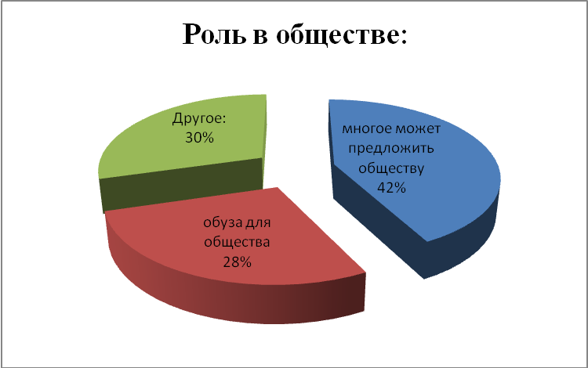
Role in the society as seen by other generations
Has a lot to offer
A burden

Slide 25
Conclusion
We are moving!
Slowly
But in the right direction

Slide 26
Thank you! And see you in Bashkortostan!
Conference «Advantageous ageing»
23-25 October 2012
Ufa, capital of Bashkortostan, Russian Federation
m.gulnara@gmail.com
+79166296264

