Slide 1
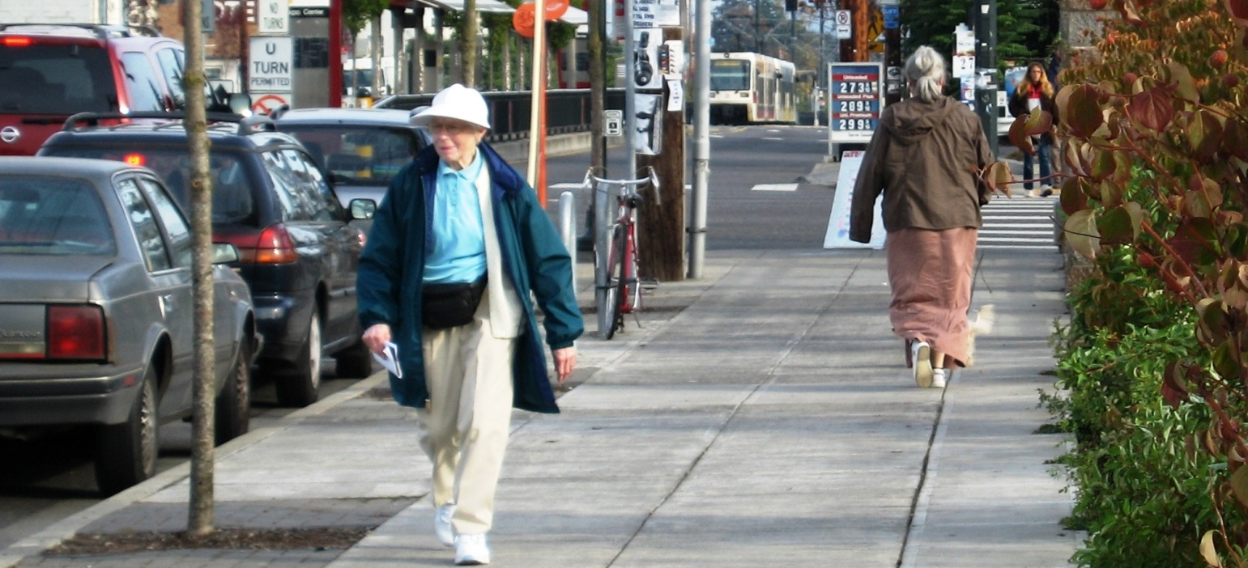
Developing a Plan for an Age-Friendly Portland
International Federation on Ageing
May 30, 2012
Margaret B. Neal, Ph.D.
Institute on Aging |

Slide 2
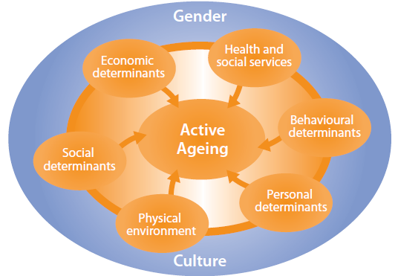
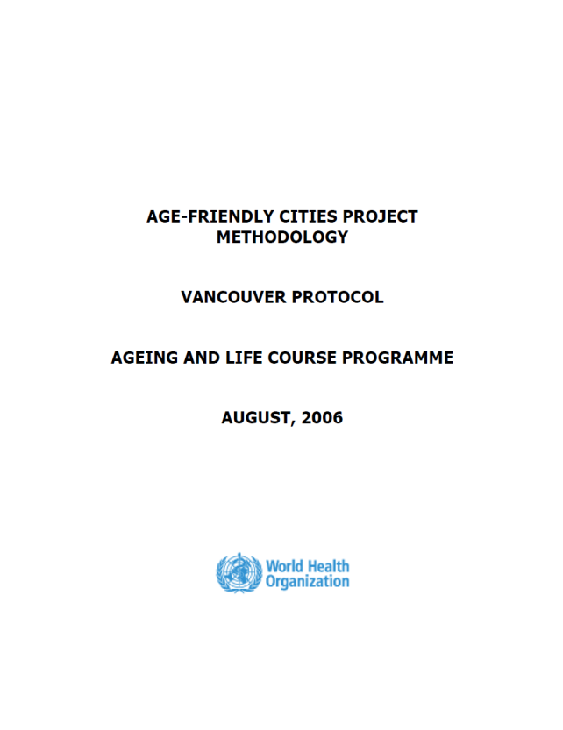
Original Age-Friendly Cities Project
Active aging framework:
Involves optimizing opportunities for health, participation, & security
Is determined by various factors that are cumulative over the life course
“Vancouver protocol” used:
As a standardized tool for assessing community’s age-friendliness
Identify areas for action
Contribute to WHO’s global guide

Slide 3
Study Objectives
For WHO: to identify concrete indicators of an age-friendly city and produce a practical guide to stimulate and guide advocacy, community development and policy change to make urban communities age-friendly
For participating cities: to increase awareness of local needs, gaps and good ideas for improvement in order to stimulate development of more age-friendly urban settings
Notes:
3

Slide 4
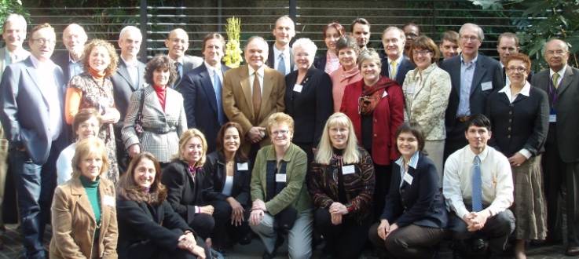
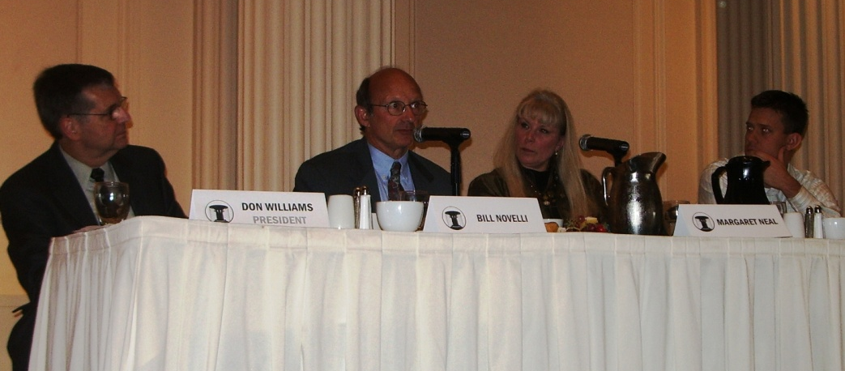
Overview of Portland’s Efforts Connected to the WHO’s Age-Friendly Cities Project
Fall 2006: Portland (via IOA) invited to participate in WHO’s global Age-Friendly Cities project
Spring 2007: Project completed, participated in meeting re: findings in London, England
Fall 2007: Launched findings on Oct. 1st, International Day of Older Persons
2008-present: Continued dissemination of findings and building of partnerships
→
Initial Convening of WHO’s Age-Friendly Cities Participants in London – March, 2007
→
Presentation to the City Club of Portland with Bill Novelli, AARP CEO – October, 2007

Slide 5
Select Findings
Housing
More affordable & accessible housing was suggested (e.g., infill development such as below seen as inadequate)
Outdoor Spaces & Buildings
Even more natural features & green spaces were desired, with attention toward accessibility
“A reporter [called] me and [told] me he was writing an article about new homes in the Portland area, brand new construction built to be accessible, and I laughed and said it would be a very short article.” – Design Expert

Slide 6
Select Findings (cont.)
Transportation
Regional transportation options were considered age-friendly, but improvements were suggested
Social Participation
Many educational and social opportunities were noted, but additional options were desired
www.pdx.edu

Slide 7
Select Findings (cont.)
Respect & Social Inclusion
Language and inclusion matter! Terms such as “honored citizen” and “long-term living” were preferred, and organizations were encouraged to consult and listen to the advice of older adults
Civic Participation & Employment
Employment and volunteer opportunities for older adults, especially those with lower incomes and less education, were advocated
www.trimet.org

Slide 8
Select Findings (cont.)
Communication & Information
Opportunities to learn how to use technology were seen as important, but services should not assume access and proficiency by all
Community Support & Health Services
Connecting necessary services to people was seen as critical to making Portland age friendly

Slide 9
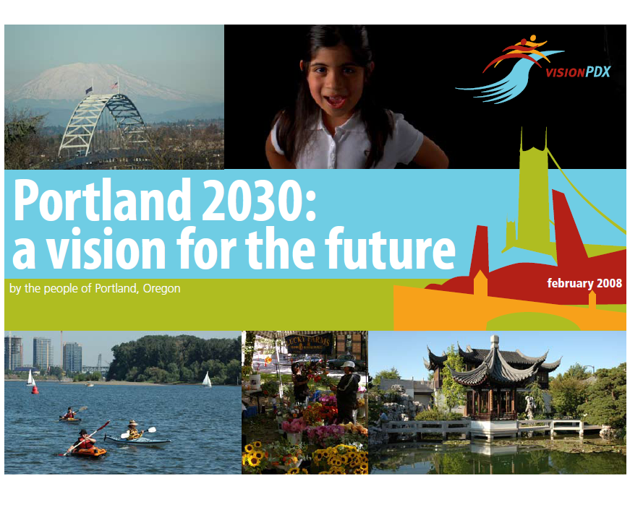
Initial Implementation Efforts
2007: Written suggestions, based on our research findings, given to VisionPDX, the former City of Portland mayor’s community-led initiative to create a vision for Portland for 2030
2007: Joined Healthy Aging Planning Workgroup formed by service providers and advocates to advise the City on health-related planning issues connected to VisionPDX
2008: New mayor Sam Adams elected; assumed office in 2009
2009: Mayor Adams initiated the Portland Plan planning effort, overseen by the City’s Bureau of Planning and Sustainability (BPS)

Slide 10
From Research to Policy
The goal of the Portland Plan: To make Portland a more thriving and sustainable city for all residents
Intended to inform a “once-in-a-generation” opportunity to revision Portland’s 25-year strategic, comprehensive plan
Mayor created the Portland Plan Advisory Group (PPAG) to advise the project
Invited IOA researchers to serve on PPAG
IOA role: ensure attention given to needs, strengths of older adults and persons with disabilities

Slide 11
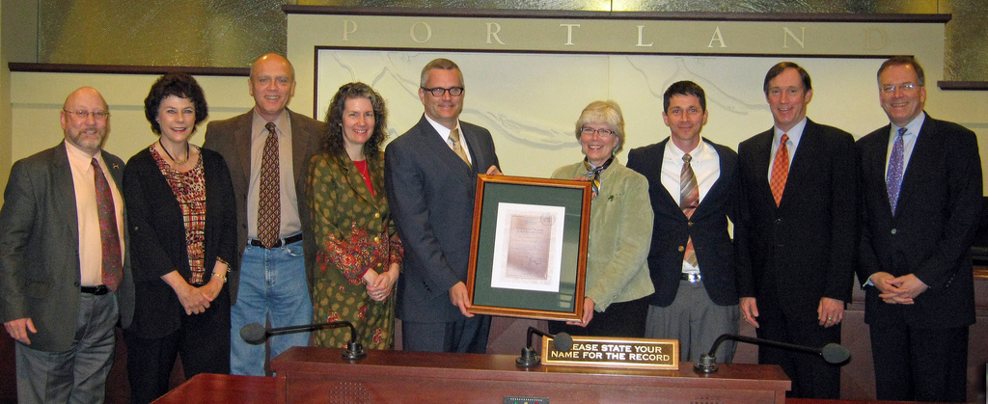
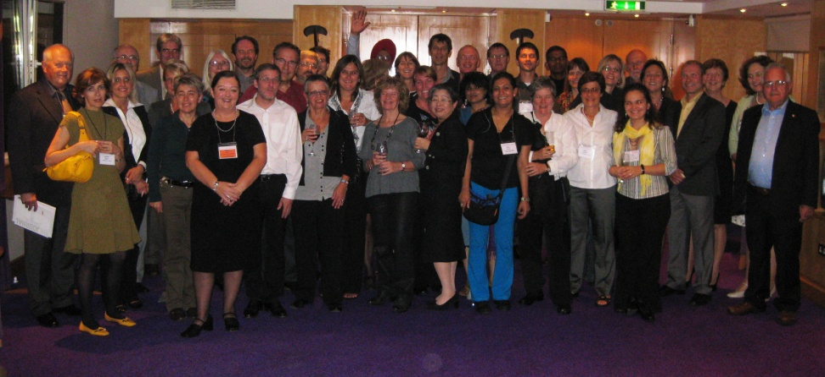
A New Opportunity: The WHO Global Network
of Age-Friendly Cities
Spring 2010: IOA/City applied for membership in the Network
Summer 2010: IOA/City among first 9 cities accepted
2010-12: IOA contributed to development of the Portland Plan
Spring 2011: IOA/City received official acceptance into the WHO Global Network
Summer 2011: IOA + key community partners presented certificate of membership to Portland City Council
Fall 2011: Attended 1st Intl. Conference on Age-Friendly Cities in Dublin, Ireland
Fall 2011: Formally formed Age-Friendly Portland Advisory Council
Presentation of Certificate of Membership to Portland’s City Council, June, 2011
→
→
Members of the WHO Global Network of Age-Friendly Cities, October, 2011

Slide 12
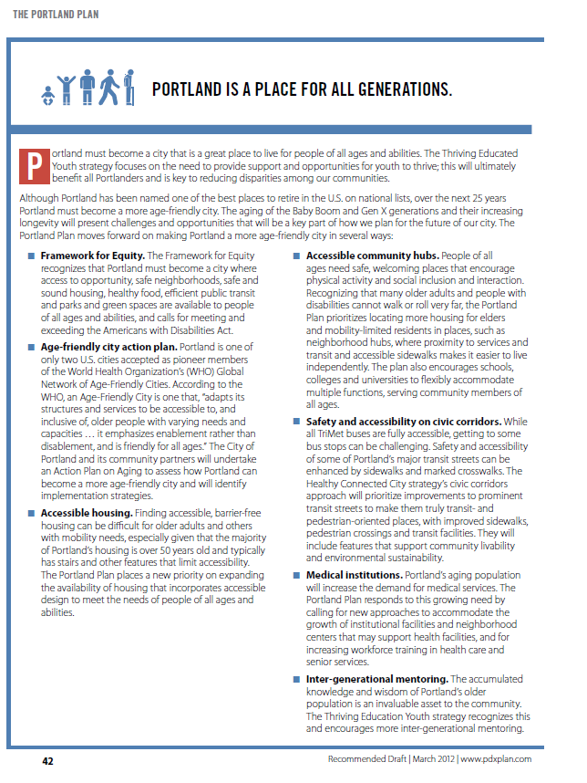
“Portland [will be] a Place for All Generations”
Draft Portland Plan released March 2012
Written comments were submitted that specifically addressed needed improvements to the Plan
BPS requested a meeting with IOA, other aging and disability representatives to discuss written comments
March 2012 – IOA asked to present to Portland’s Planning Commission
Final result: Portland Plan now specifically addresses how Portland can become a more age-friendly city

Slide 13
Portland Plan Action Items
Develop an age-friendly city action plan
Prioritize expansion and availability of accessible housing
Concentrate on age-friendly, accessible community hubs
Foster safe and accessible civic corridors (e.g., infrastructure and transit)
Increase access to and services within medical institutions
Increase inter-generational mentoring opportunities
Bolster framework for equity, including integration with newly forming City of Portland Office of Equity

Slide 14
Current Efforts
Developing Action Plan and indicators for an age-friendly Portland (in partnership with PSU’s Institute of Metropolitan Studies, building on its Greater Portland Pulse regional indicators project)
Seeking funding to augment baseline data concerning Portland’s age friendliness at the neighborhood level
Getting ready for next mayor: Community partners AARP Oregon and Elders in Action hosted, on April 7, 2012, a mayoral candidate forum on “Creating an Age-Friendly Portland;” after the forum, IOA held a community discussion concerning participants’ visions for a more age-friendly Portland
Continuing to partner with the City
Testified at City Council re: approval of Portland Plan (4/18/12)
With BPS, advising a PSU Masters of Urban and Regional Planning student workshop project focused on outreach to underrepresented groups and making recommendations for enhancing Portland’s age-friendliness

Slide 15
Next Steps
Invited to join Policy Expert Groups being formed by BPS for Comprehensive Plan policy updates, such as:
Public participation
Neighborhood centers and corridors
Network and public infrastructure (e.g., transit)
Residential development and compatibility
Economic development
Fostering further connections with City departments beyond Bureau of Planning and Sustainability
Metro (Portland’s regional government)
TriMet (regional transportation provider)
Bureaus of Housing and Transportation
Other governmental and community-based organizations

Slide 16
Barriers to Creating an Age-Friendly Portland
Citizen Participation
Push back: What happened to the recommendations from the first visioning (VisionPDX) effort?
When will action be taken?
Multiple jurisdictions providing different services:
City: infrastructure, parking
County: social services, aging services, including “Helpline”
Region: transportation, long-term planning
Lack of government resources
For maintenance, development and redevelopment

Slide 17
Barriers (cont.)
Competing agendas of stakeholders (e.g., elected officials, researchers, private sector)
Planning for older adults varies as a priority (e.g., compared to education, economic development, homelessness, bike friendliness)
This university-government-community partnership model is imperfect and evolving
“Where’s the champion, where’s the torch?” - The university can do the research and provide advice; the community must advocate; the government must implement the plans
Ongoing, translational research is needed and funding required
Transitions in government leadership

Slide 18
The University’s Role in Getting to Scale
Conduct the baseline research (and augment), disseminate findings, and advocate for the program
Engage the mayor’s office and write Network application
Engage Bureau of Planning and Sustainability staff
Serve as a resource to BPS staff and liaison to Network
Enlist and collaborate with community partners
Read draft Portland Plan, respond with written comments, and testify
Remain calm, committed, and be persistent
Write Action Plan, contribute to Comprehensive Plan
Develop and measure indicators of progress
Collaborate, collaborate, collaborate

Slide 19
Madrid International Plan of Action on Ageing
“In some ways, drafting a policy or plan of action and getting it approved is actually the easy part…once a policy or plan is agreed, it is time to start thinking about its implementation… Implementation and monitoring raises a whole new set of challenges… (p. 59)

Slide 20
For more information, please contact us:
Margaret B. Neal, Ph.D.
Director
Institute on Aging
Portland State University
503.725.5145
nealm@pdx.edu
Thank you! Questions?

