Slide 1
Integrated Service Areas (ISA) for Ageing in Place in Germany, Switzerland, the Netherlands and Denmark International Platform
Holger Stolarz
housing and care concepts in residential areas
Bonn, Germany
IFA 11th Global Conference on Ageing 2012, Prague

Slide 2
ISA Website: International Platform for Integrated Service Areas Integration of Housing, Care and Social Support in Residential Areas
Initiative of
Germany (DE):
KDA, German Foundation for the Care of Older People,
Netherlands (NL):
SEV, Steering Group on Experiments in Housing
Switzerland (CH):
Age Foundation, as well as
Denmark (DK):
Danish Knowledge Center on Ageing
www.isa-platform.eu

Slide 3
ISA Website: International Platform for Integrated Service Areas
Content of the platform: for each country
national context and project examples (town + country)
New member of the network: Sweden
Overseas cooperation: Japan, United States
Perspective: more examples, more countries, systematic comparison between countries, networking between projects, international congress

Slide 4
Comparison of Housing and Care Provisions in Relation to the 80+ Population
X 1000 | Proportion Population 80+ | Number of People 80+ | Places in Nursing homes | Places in Assisted housing | professional home care (people)
Germany | 5.0% | 4.000 | 650 16% | 230 5.7% | 470 11.8%
Nether- lands | 4.0% | 660 | 164 25% | 129 20% | 190 28.7%
Denmark | 3.7% | 204 | -- | 84 41% | 202 58%
Switzer- land | 4.7% | 363 | 123 19.1% | ? | 154 21.0%
Notes:
Deutschland: viel Hilfe von Angehörigen wegen ‘’Sippenhaft’’
NL: Starker Abbau von Heimen und Ersetzen durch Betreute Wohnanlagen
DK: 2001 Ende des Heimgezetzes; umfassendes Angebot von ambulanter Hilfe
CH: stärke Entwicklung von Spitex - ambulante Hilfe, jedoch viele Heime

Slide 5
Specific National Features
Germany: much help through families, also because of financial obligations
Netherlands: drastic reduction (of the big number) of nursing homes in favour of Assisted Housing
Denmark: no nursing homes after new legislation in 2001, comprehensive provision of domiciliary care as well as independent forms of housing
Switzerland: development of both domiciliary care (central organisation SPITEX) as well as nursing homes including care groups (also people with low care needs)

Slide 6
Basic Ideas of Integrated Service Areas
Structural changes in the care of older people
Change from a provision oriented to a participation oriented care
Small scale and interlinked structure of care within residential areas
Economically necessary
Serves the needs and wishes of older people

Slide 7
Structural Features of Integrated Service Areas
Small-Scale Residential Area
Building Blocks of Supply: Housing, Social Support, Nursing Care
Means of Implementation: Cooperation, Participation, Somebody “who minds”

Slide 8
The Building Blocks of Integrated Service Areas
Fields of Supply
Housing
Social Support
Nursing Care
Housing Adaptation
Barrier-Free Housing and Surroundings and infrastructure
Forms of Housing for Self-reliant Living
(e.g. communal housing)
Domestic Care linked to the Area
Forms of Housing with Care Provision (e.g. group living)
Integration of Nursing Homes, Short-term -and Day-Care
Counselling, Coordination, Home Help
Social Integration and Mutual Help
(e.g. meeting places)

Slide 9
Implementation: Cooperation of Players
Municipality: sometimes director as well as provider of finance, mostly supporting partner (differing in countries)
Welfare Organisations: important partner but also competitors
Housing Enterprises: Both housing (investment, organisation) and (increasingly) social service provision
Citizen’s Associations: partner but (as in Germany) also sometimes director or initiator
COOP Models: “Social democratic” (DK), “Polder” (NL), “Valley” (CH)

Slide 10
Implementation: Participation of Citizens
Delivering care within families
Counselling, support services, neighbourhood help (payed/unpayed)
Citizen’s associations, organising activities,
financing/sponsoring
Taking the role of initiator or director (as for example in Eching (DE) or Elsendorp (NL)

Slide 11
Specific features of Integrated Service Areas
DE: Citizen’s participation, special 24 hour home care arrangements (Bielefeld)
NL: barrier free new buildings through social housing associations, town planning model (STAGG) versus cooperation network
DK: integrated teams (social and care provisions) for the area, activity centres, decentralised nursing care
CH: decentralised solutions in smaller municipalities, small care providers

Slide 12
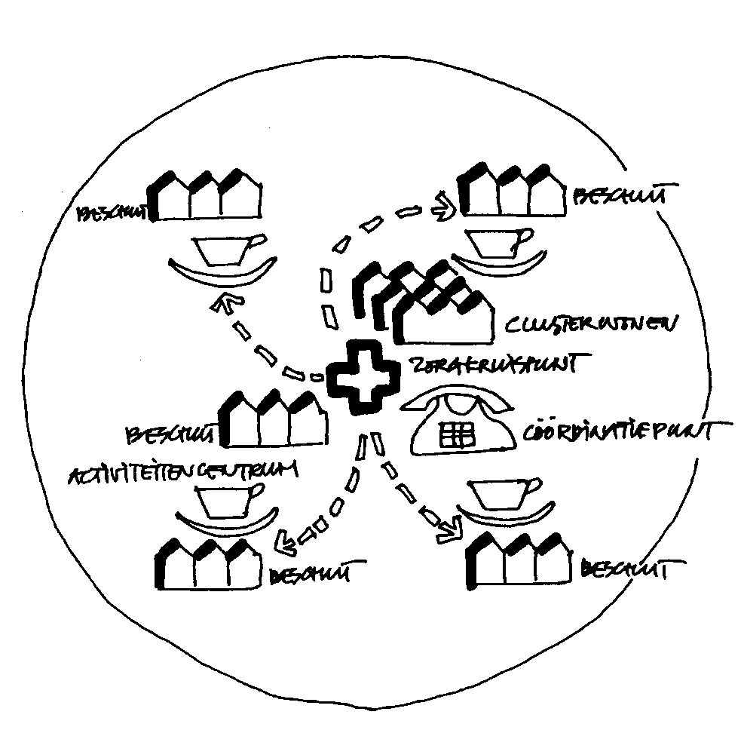
Netherlands: „STAGG“ Mode (town planning model )
Normal housing
Assisted housing
* Communal housing
Neighbourhood meeting point
Coordination office
Servicecentre

Slide 13
Project example: De Bilt (NL)
42.000 people, 10 residential areas
2 pilot areas since 2007
Integration and crosslinking of welfare services (24-hour care, care team for the area)
Staff for advice and case management
Inclusion of socially isolated senior citizens
“Empty nest” concept

Slide 14
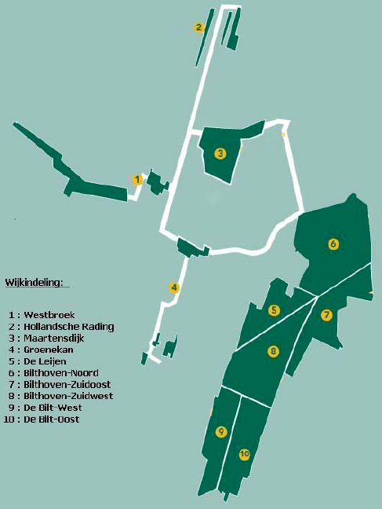
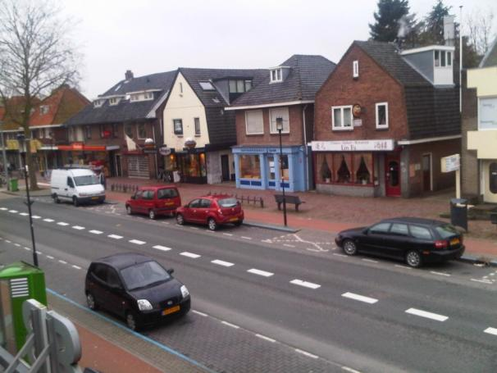
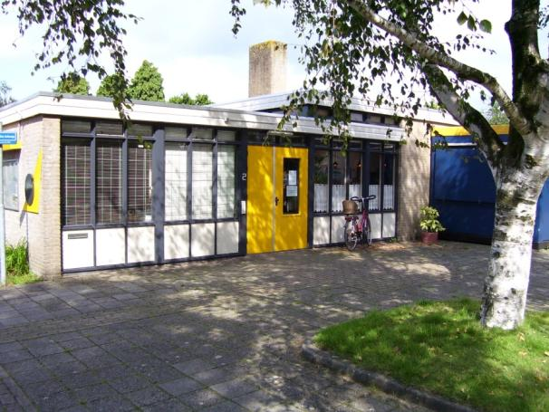

Slide 15
Project example: Syddjurs (DK)
42.000 people, 4 residential areas
Residential area community centre “Rosengaarden”
Dementia care team; no nursing home
Free choice between individual or collective (group) arrangements
Municipal service provision: private providers disappeared after a while

Slide 16
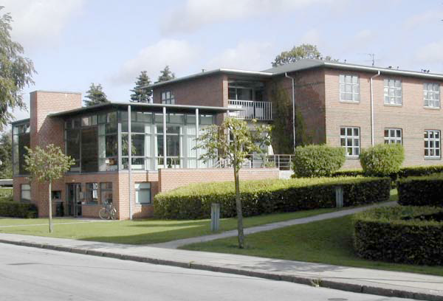
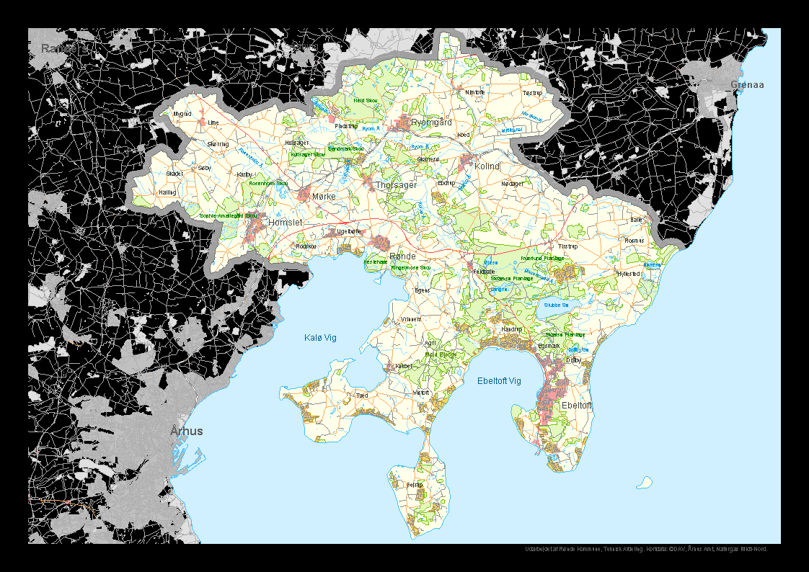
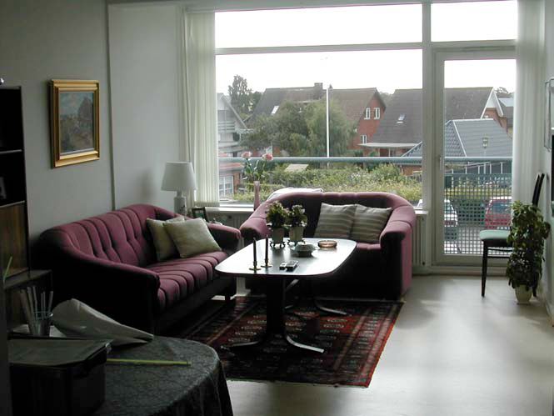

Slide 17
Project example: Eching (DE) Local Centre with the Building of Eching Service Centre for Older People

Slide 18
Eching Service Centre for Older People (DE)
13,600 people (1 integrated service area)
Start of service centre: 1995 (planning mid 1980)
Old peoples and community centre with assisted housing (60 units) and services
Local care chain without nursing home (only one care group)
Provider: citizen’s association
Cooperation with municipality (financing) and all local players

Slide 19
Eching Service Centre for Older People (DE) Building of the Service Centre

Slide 20
Perspectives
Needs and wishes of senior citizens are similar in different European countries
They want to remain self-reliant as long as possible
The service provision, however, is quite different from country to country
Financing und legal regulations are important
Centralised or decentralised operation of service providers is also influential
EU convergence: The best of each system

