Slide 1
Volunteering and mutual support in the united states:
THE “Village” MOdel
Andrew Scharlach, PhD
Kleiner Professor of Aging
Center for the Advanced Studies of Aging Services
School of Social Welfare
University of California, Berkeley
May 30, 2012

Slide 3

Center for the Advanced Study of Aging Services
Mission:
  Improving services for the elderly through research, collaboration and education
Examples of projects:
  California Villages Project
  Creating Aging-Friendly Communities
  Strategic Plan for an Aging CA
  Family Caregiver Support Project
  Consortium for Social Work Training in Aging
Notes:
If you go to our website listed on the previous slide you can find our reports on these projects as well as our newsletter.

Slide 4
US Sociocultural Context
Individualism
Independence
Privacy
Individual problems > communal concerns
Marketplace solutions
Limited community role

Slide 5
Aging in Place
Aging in Community
Underlying motivation:
Reactive
Proactive
Goals:
Avoid institutionalization
Foster
interdependence
Responsibility:
Individual
Communal
View of Aging:
Avoidance
Opportunity
Service delivery:
Unidirectional
Reciprocal
Elder Role:
Care recipient
Participant
(Based on work by Janice Blanchard, Janet Stambolian and William Thomas, MD)

Slide 6
 | Community Aging Initiatives in the US
 | Type
 | Community-wide planning |  |  | 23%
 | Community-wide cross-sector system change |  |  | 15%
 | Consumer-driven support networks |  |  | 20%
 | Residence-based support services |  |  | 23%
 | Individual-oriented programs and services |  |  | 19%
Notes:
Community-wide planning efforts
(e.g., WHO Age-Friendly Communities, N4A/PLC “Jump Start the Conversation”, AdvantAge Initiative)
Community-wide cross-sector system change
(e.g., RWJ CPFOA)
Consumer-driven support networks
(e.g., Beacon Hill Village and replications)
Residence-based support services
(e.g., NORC-SSPs)
Individual programs and services
(e.g., care coordination programs)

Slide 7
 | Roles of Older Persons
 | Role of Older Persons (Highly Involved) | Community Planning (n=27) | System Change (n=18) | Consumer Networks (n=24) | Residence Based Services (n=27) | Individual Programs (n=23) | All initiatives (n=119)
 |  | Percentage (%) |  |  |  |  | (%)
 | Providing input | 85% | 89% | 88% | 63% | 52% | 75%
 | Developing the initiative | 4% | 83% | 88% | 41% | 17% | 44%
 | Oversight or governance | 33% | 50% | 88% | 33% | 17% | 44%
 | Providers of services or support | 19% | 33% | 63% | 22% | 30% | 33%
 | Recipients of services or supports | 56% | 50% | 75% | 78% | 4% | 54%

Slide 8
Social Capital
Bonding Capital
Bridging Capital
Linking Capital
Notes:
8

Slide 9
The “Village” Model
“Villages are self-governing, grassroots, community-based organizations, developed with the sole purpose of enabling people to remain in their own homes and communities as they age.”
[from Village-to-Village Network website]

Slide 10
Characteristics of “Villages”
Created by members, for members
Membership dues
Service coordinator (“concierge”)
Basic member services (e.g., transportation, shopping)
Social and educational activities
Referrals to preferred providers

Slide 11
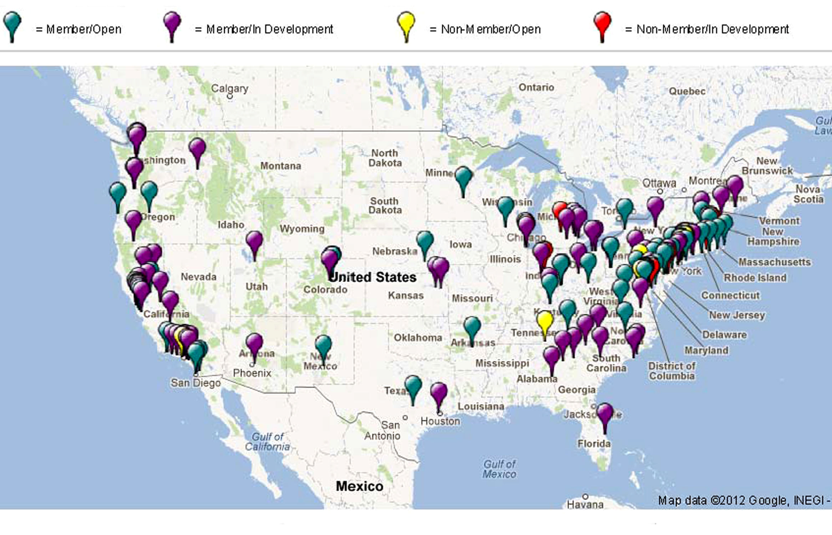
Villages in the United States

Slide 12
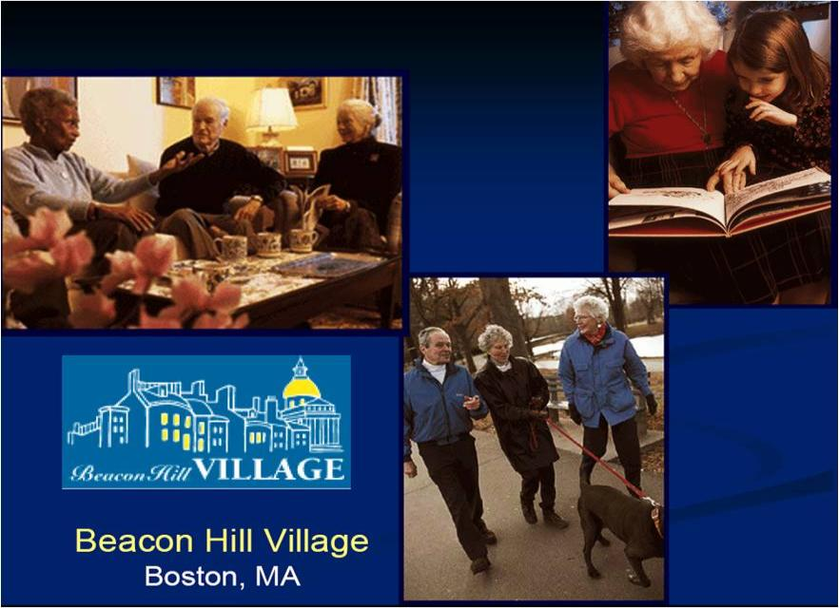
Notes:
Villages
Israel’s Supportive Community Program, initiated by ESHEL (the Association for the the Planning and Development of Service for the Aged in Israel)
Medical services: physician house calls
Emergency call service
Home repairs
Friendly visiting
Social activities
Facilitated by neighborhood “father”
Volunteers
Evaluation showed high satisfaction, with 70% of members surveyed reporting increased sense of security, 1/3 report decreased burden on members’ children, and ¼ report an increased ability to age-in-place.
Greatest satisfaction was with emergency call service and neighborhood facilitator role.
12

Slide 13
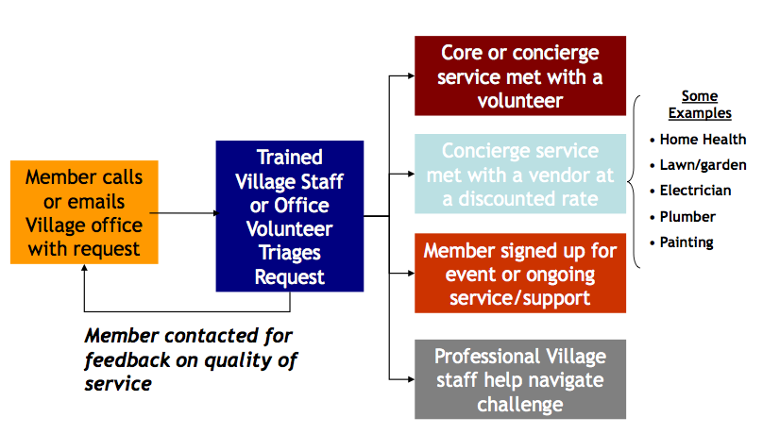

Slide 14
Primary Focus of Village
Service provision/access 39%
Building peer support 21%
Education/information 15%
Notes:
14

Slide 15
Variations of the Village Model
Service access
  Front Desk Florence
Service brokerage
  Beacon Hill Village
“Volunteer first”
  Capitol Hill Village
Peer support
  Fierce Independent Elders
Case-managed volunteer model
  ElderHelp of San Diego

Slide 16
Member Roles
Development of the Village 75%
Governance 72%
Service provision 45%
Notes:
16

Slide 17
Potential impacts of Village membership
Individual Capacity
Physical and psychosocial wellbeing
Facilitate Service Access
Build Community
Promote Elder Empowerment
Aging in Community
Community Capacity
Social Capital
Improved service delivery system

Slide 18
Concierge Club:
Providing comprehensive membership-based home care solutions

Slide 19
ElderHelp Concierge Club Volunteer Model
ElderHelp of San Diego
  Membership-based care management
  Serving isolated older adults since 1970
  Lower income & ethnically diverse population
Services Provided by Volunteers
  Tidy Keeper (Homemaker)
  Friendly Visitor
  Home repair/maintenance
  Gardening
  Grocery delivery
  Bill minder (financial help)
  RUOK? (telephone reassurance)
  Pet Pals
  Seniors-a-Go-Go (transportation)
Notes:
Characterisitcs of Elderhelp that make it important to evaluate.
Many villages are trying to expand their services to more low income, ethnically diverse seniors and an evaluation of this program.

Slide 20
ElderHelp Concierge Club Evaluation
Impact - Preliminary results
Impact of program: Since becoming a member of ElderHelp….
  45% know more people than they used to
  34% leave their home more than they used to
  68% say their quality of life is better than before they were a member
  30% are less worried about money now
  61% know more about available community services
  71% know who to ask for assistance
  70% say they are more likely to stay in their own home as they age because of ElderHelp.

Slide 21
ElderHelp Concierge Club Evaluation
ROI - Preliminary results
Annual Cost of Volunteer Program = $103,347
Annual Value of Volunteer Services = $159,453
ROI = $56,106 (54%)
Notes:
Annual Cost includes the salaries of Volunteer Coordinator, Member Liaison, other staff, as well as this total cost is advertising and recruitment, training, administration, support and recognition, supplies and equipment, food and accommodation, volunteer insurance, and volunteer-related building costs

Slide 22
Other Voluntary Sector Innovations

Slide 24
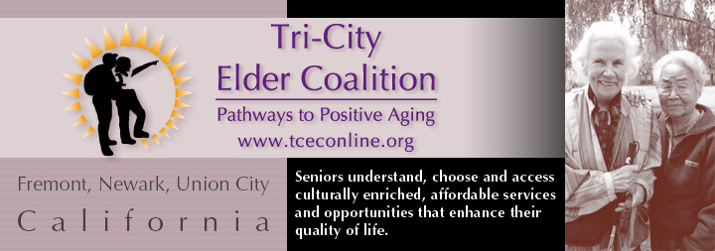
Community Ambassadors Program
Notes:
Senior volunteers
Serve as a bridge between the formal network of social services and faith based and cultural communities:
Indian
Muslim
Sikh
Chinese
Taiwanese
Afghani
Catholics
Presbyterians
Community elders help community members access needed services, provide counseling, support.
Funded by RWJ Foundation grant, + city $.

Slide 25

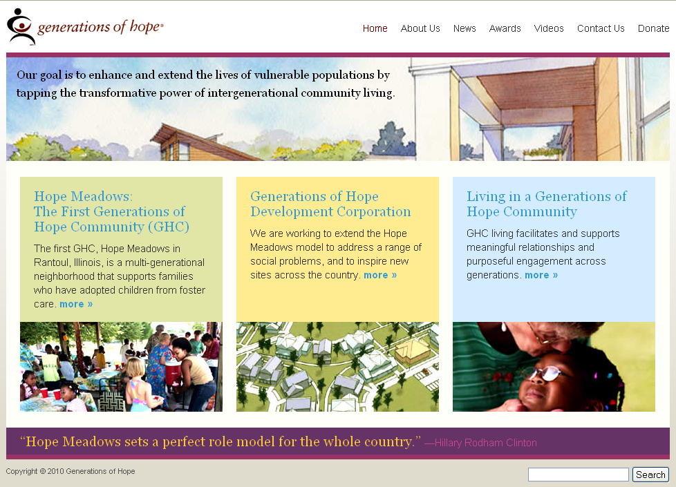
Hope Meadows
Notes:
HOPE MEADOWS
Created in 1994
Rantoul, IL (small town)
Land on a former air force base initially purchased with state $.
Innovative intentional community
5-block neighborhood
Adopted children living in foster homes
(11 families, 33 adopted ch, 13 biological ch)
Kids have behavioral and emotional problems
Retirees volunteer >6 hours/week,
get apartments at reduced rent.
“family” connections help seniors as they age

Slide 26
Challenges for the Future
Sustainability
Inclusiveness
Community integration
Comprehensiveness
Effectiveness

Slide 27
UC Berkeley Villages Project
Evaluation of individual Villages
    Service use
    Member satisfaction
    Member outcomes
    Growth
    Cost-effectiveness
Cross-site survey of Village organizations
    Factors associated with sustainability and effectiveness
Longitudinal study of Village members
    Impact of the Village model

Slide 28
Thank You!
Andrew Scharlach, PhD
Center for the Advanced Study of Aging Services
scharlach@berkeley.edu

