Slide 1
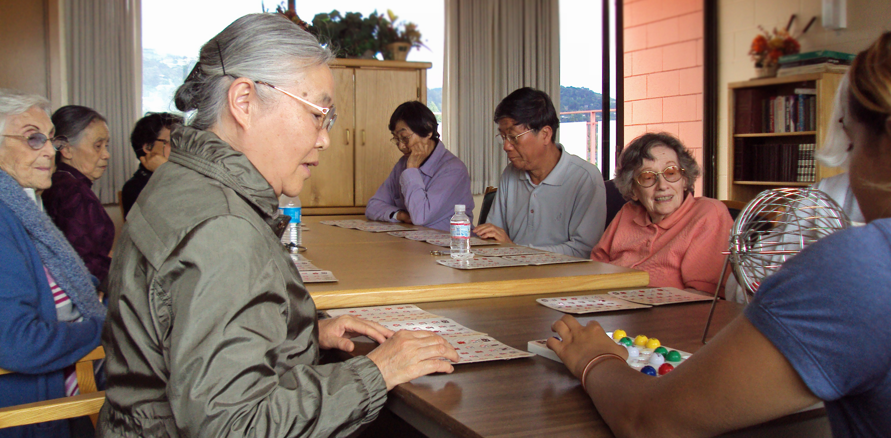
Volunteering as a way to Prevent and Alleviate Social Isolation
Mary McCall
International Federation on
Ageing Conference
30 May, 2012 – Prague, CZ
Notes:
Introduce Satellite Housing, especially resident services

Slide 2
SOCIAL ISOLATION
the scope of the problem in the U.S.
Living Longer
Boomers!
Cultural value of: “Strike out on your own”

Slide 3
“Social Isolation and exclusion are associated with increased rates of premature death and poorer chances of survival after a heart attack...”
-The World Health Organization
Notes:
Read the rest of the quote:
“People who get less social and emotional support from others are also more likely to experience lowered feelings of well-being, more depression and higher levels of disability from chronic diseases.”

Slide 4
Seniors make up over 17% of our country, but Less than 1.5% of all community-based mental health care goes to the elderly.
-American Geriatrics Society

Slide 5
CONSEQUENCES OF ISOLATION
DEPRESSION
ANXIETY
SUBSTANCE USE
PHYSICAL DECLINE
COGNITIVE DECLINE
SELF-ESTEEM
MOTIVATION FOR LIVING

Slide 6
SATELLITE HOUSING, INC.
AmeriCorps Vista volunteer for 2 years who conducted a research project
Interviewed Service Coordinators and Activities Coordinators
Conducted survey and focus group of residents (including Chinese and Spanish-speaking residents, with a translator; and survey was also translated) -- n=378

Slide 7
Survey Findings

Slide 8
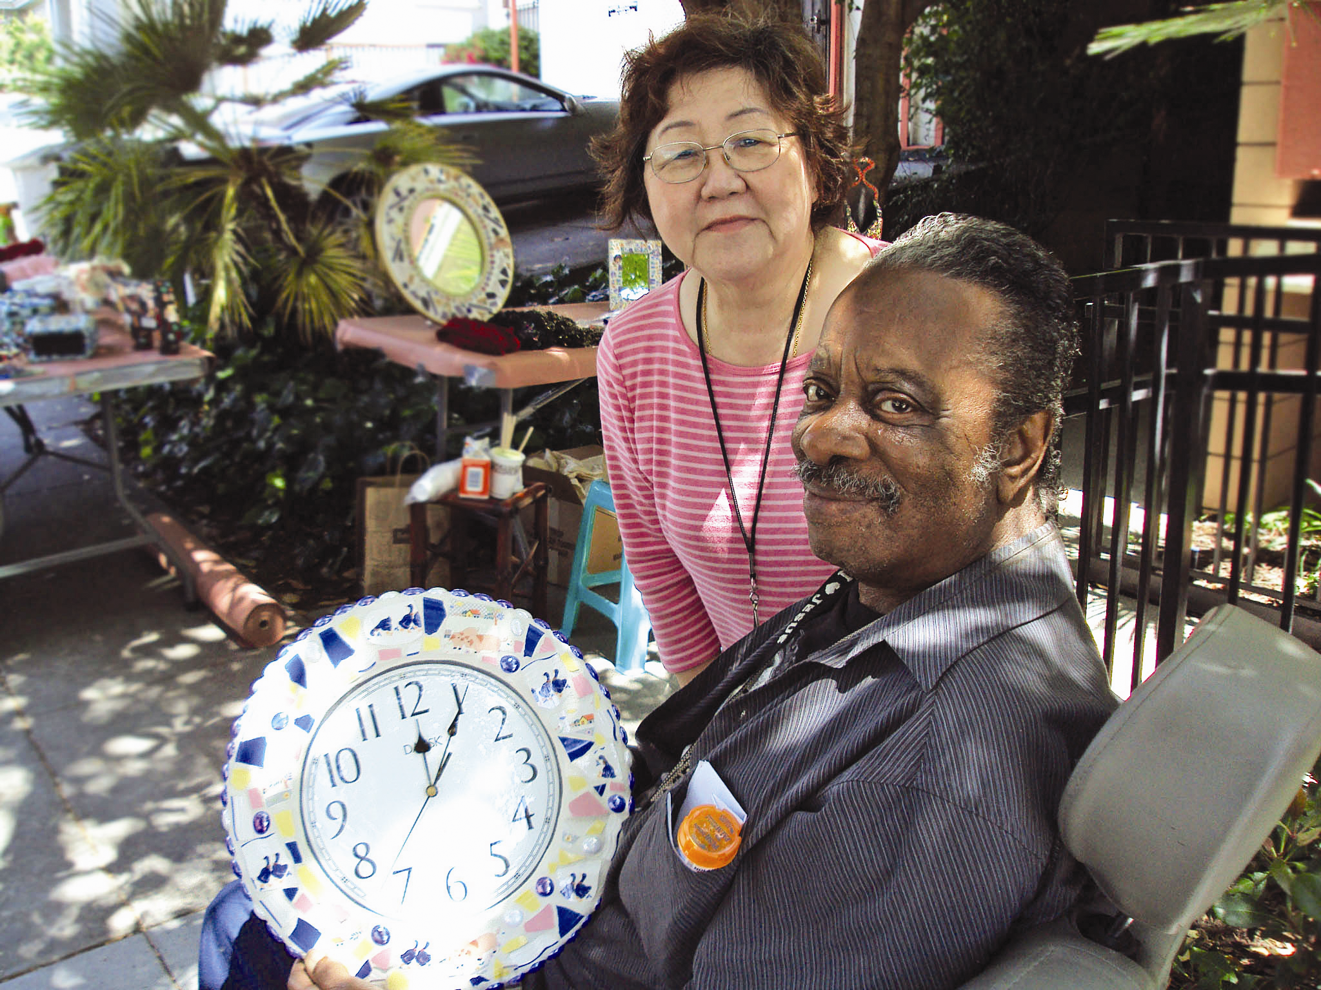
RISK FACTORS
10 risk factors
and
interventions

Slide 9
10 RISK FACTORS FOR ISOLATION
Income
Physical health and disabilities
Cognitive health and functioning
Behavioral health issues
Gender
Intimate Relationships
Friendships
Transportation
New to the area
Language and culture

Slide 10
Health and Disabilities
Keep track of ADL limitations
In-home support services
Doctor visit reminders
Public health nurse
Home visits
Notes:
Health and disabilities:
-Our survey showed isolated seniors reported health problems at a rate 12% higher than the overall group.
-Those numbers might not represent the full scope of the problem because many seniors with very mild health problems reported that they had health problems.
-Worsch et all found that physical health problems can cause depression from isolation as a result of a disability or even neurochemical changes that the illness causes in the brain. “Worsch, Shulz, and HeckHausen, “Health Stresses and depressive symptomatology in the elderly: A control process-approach.”
-Additional note that sometimes infections, diabetes, thyroid issues or unremembered knock on the head can cause confusion, etc.
-mention quotes from the focus groups that were too downbeat to put in the book?

Slide 11
Cognitive Health
Stimulating activities
Social Interaction
Exercise
Nutrition
Notes:
Just talk about it.

Slide 12
Behavioral Health
Use non-clinical language
Recommend behavioral health services
Encourage peer-support groups
Distribute medications lists
Notes:
Seniors make up over 17% of U.S., but less than 1.5% of community mental health center patients are elderly.
-“Mental Health and the Elderly Position Statement.” American Geriatrics Society, 2009. www.americangeriatrics.org
The two issues we focused in on were:
Substance abuse and med misuse
Hoarding behaviors
Handout about signs that indicate substance or med-related problem?
Include warning signs of suicidality?
Put resources in handouts:
Check out the www.mha-sf.org
Suicide hotlines: 1-800-273-TALK

Slide 13
Intimate Partnership
Peer support
Community grief and loss groups
Ask open ended questions
Hold a memorial

Slide 14
Gender
Satellite Seniors
71 % women
29% men
Of those who are isolated
62% women
38% men

Slide 15
Gender
Men’s group
Men’s interests
Make Transgender supports known
Include Transgender on forms
Notes:
Women are disproportionately widowed- outliving men on average of 5.4 years. ( Johnson C.L. Barer B. M. Life beyond 85 Years: The Auro of Survivorship. (New York: Psringer, 1996; 169.
It used to be understood that women were at more risk than men (Kivett 1979). But a reporting bias due to gender socialization is a likely explanation for the mix up.
Overall, men represent 29% of the Satellite Housing population, with women accounting for 71% of the population. Of those identified by their service coordinator as socially isolated, men represent 38%, while women represent 62%. This indicates that men are potentially at greater risk for becoming socially isolated.
The SC focus groups confirmed that men are at higher risk for isolation.

Slide 16
Friendships
Friendly Visitor
Senior Center Without Walls
Pets
Pet visitation programs
Notes:
We focussed on relationships with friends rather than family:
The information gathered from Satellite Housing residents indicates that of those with no contact with family, 88.1% report feeling content most of the time. This compares markedly with those residents who stated they had no contact with friends, in which 61.5% report feeling content most of the time. The same is true for hopefulness levels. Of those without family contact, 90.5% report feeling hopeful most of the time, compared with 73% who have no contact with friends.
This data suggest the importance of friendships in maintaining high levels of contentment and hopefulness, and should be considered when assisting a resident in overcoming social isolation.
Tell the “time of my life” story?
Pets and animal therapy-
“animal socials.”
Pet therapy guinea pig.
Example of Tony La Russa’s Animal Foundation’s People Programs: Pet Hug Pack and Added Touch program
See handout with resources.

Slide 17
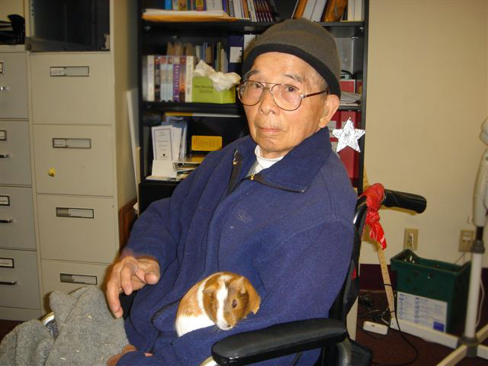

Slide 18
Transportation
Paratransit, Dial-A-Ride
Survey Transportation use at your site
Volunteer driver programs
“Travel Training” workshops
Share with Assisted Living or Retirement Communities
Notes:
Add Beverly foundation www.beverglyfoudnation.org to resources list
WHO says that transportation is a determinant of health- it plays a role in independence and shapes individuals access to resources.
According to the Surface Transportation Project’s analysis of the National Household Transportation Survey of
2001--
Compared with older drivers, older non-drivers in the United States make:
• 15% fewer trips to the doctor;
• 59% fewer shopping trips and visits to restaurants;
• 65% fewer trips for social, family and religious activities.
(whether these numbers are averages or what is not available).

Slide 19
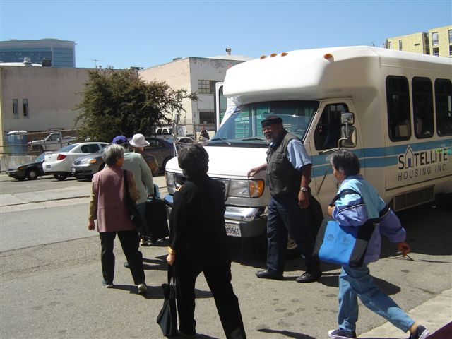

Slide 20
New to the Area
Keeping track
Create a booklet
Establish a “welcome committee”
Invite new residents to activities
Organize neighborhood safety meetings
Voter Registration
Notes:
As a SC, the first few days of the move-in are crucial time to connect- esp if the building has a “personality” of isolation– before they get in the rhythm of the rest of the building (Asha has good stories about this).
In focus groups- SC said that fear of crime in the neighborhood was a big factor. Residents mentioned they went out more now that there are security cameras.
All residents:
From Nearby Bay Area 80.50%
From Outside Bay Area 19.50%
Isolated Residents:
From Nearby Bay Area 70.80%
From Outside Bay Area 29.20%
Figure out how to deal with this data– get “active” figures, not “overall.”
Mention tenant organization, “buddy-system,” town-hall meetings or any self-governance sort of intra building civic engagement.

Slide 21
Language and Culture
Offer ESL
Recognize and honor differences
Find translation
Make picture cards
Intercultural activities
Cultural Ambassador Programs
Faith-based groups and services
Notes:
Not speaking English is not actually the problem- it depends on the prominent language of that building.
In CA, 1 out of every 3 seniors of foreign born. Brown, Patricia Leigh“Invisible Immigrants, Old and left with ‘No One to Talk To.’” NY Times August 31 2009.
Culture- for example, in traditional Chinese culture “individuals are not encouraged to disclose their feelings to family members and friends, or seek professional services when mental problems exist.” Smith, Ashton (Thriving not Surviving: Meeting the Needs of Seniors in Poverty (Service Utilization and Quality of Life in Three Types of Senior Housing). St. Mary’s College of CA, 2006.
-Our focus groups reaffirmed this.
Deaf seniors are at risk of isolation due to lack of sign language competency in conventional senior housing. Talk about FOG.
Add language line stuff

Slide 22
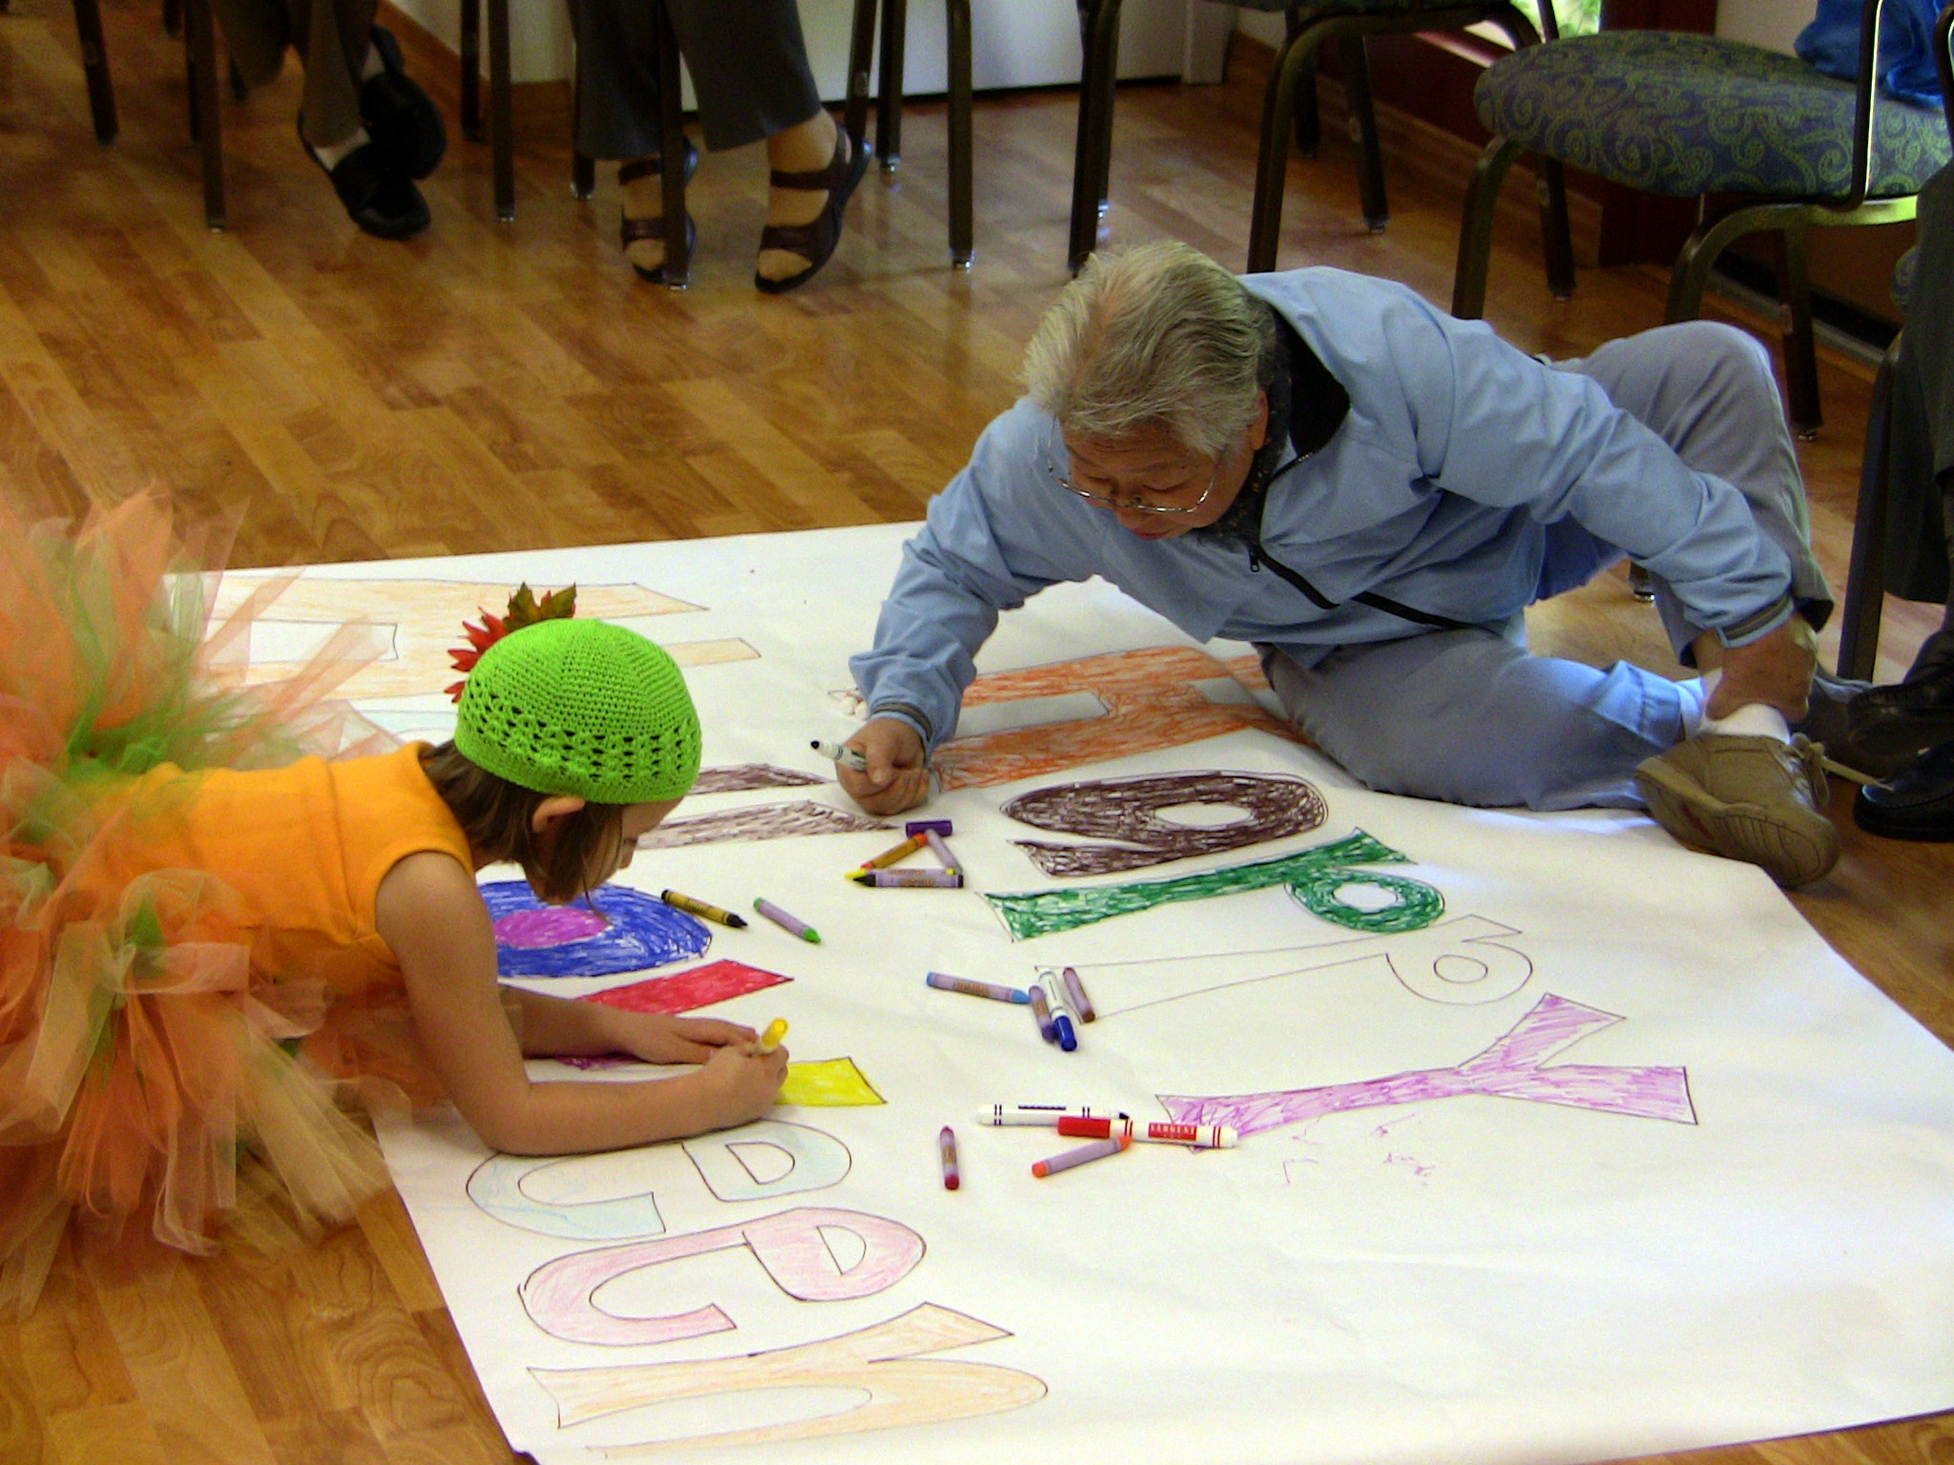
Intergenerational
Activities
and Civic Engagement

Slide 23
Reading to children in at-risk schools
Gardening
Hosting Halloween parties
Rhythm circles for preschoolers
Collecting disaster relief funds
Making quilts for the local children’s hospital
Advocating for affordable housing
Performing at board and care homes
Organizing crime watch groups

Slide 24
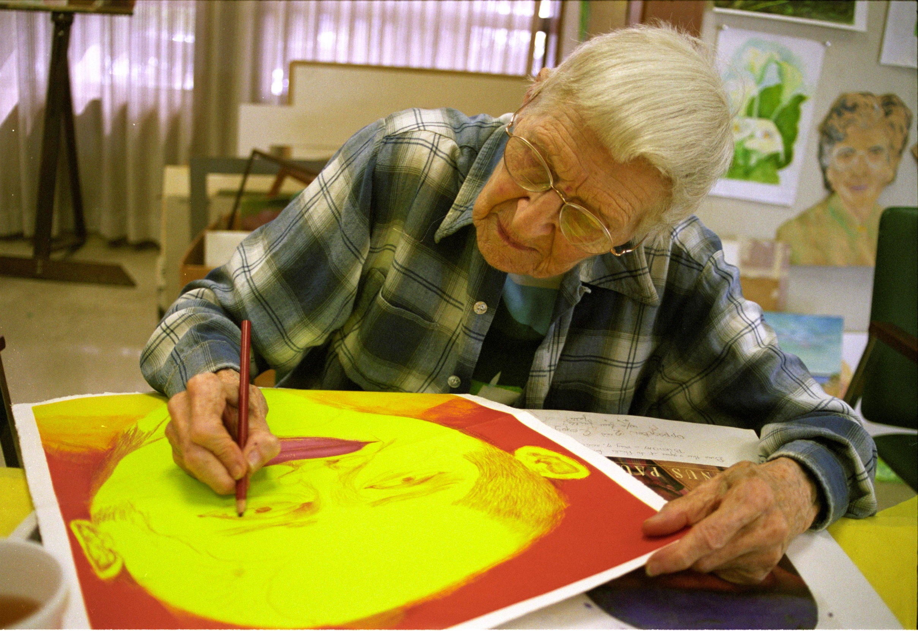
Persistence

Slide 25
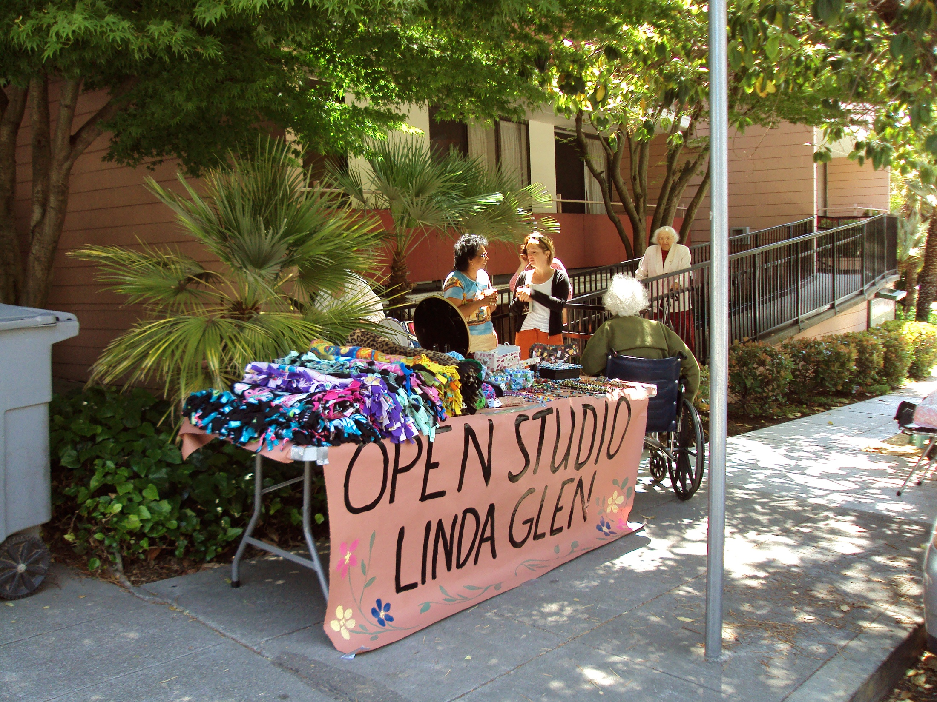
Marketing
your activities

Slide 26
Make flyers visible
-don’t post too far in advance
Personally invite residents
Reminders
Door-knocking and walking to activities
Something to take home
Find resident leaders
Peer-to-peer promotion
“buddy system.”
Interest survey
Notes:
Flyers in Large Font, high contrast and translated
Make sure to mention these were tips that the senior focus groups also mentioned.

Slide 27
