Slide 1
Ageing, the Built Environment and Livability in an Extreme Climate
Bruce Judd, Margaret Kay, Catherine Bridge & Toni Adams
City Futures Research Centre, Faculty of Built Environment,
University of New South Wales, and
Local Government and Shires Association of NSW

Slide 2
Presentations
1. Compounding Vulnerability: Population Ageing, Climate Change Adaptation and the Built Environment
Bruce Judd, City Futures Research Centre, UNSW
2. Local Government Ageing in Different Environments
Margaret Kay, Local Government and Shires Associations of NSW
3. Ensuring Enabling and Supportive Regional Town Centres: An In-depth Look at Three from and Older Persons’ Perspective
Catherine Bridge, City Futures Research Centre, UNSW
4. Policy Factors Which Impact on Older People’s Desire to Downsize
Catherine Bridge (for Toni Adams) City Futures Research Centre UNSW

Slide 3
The Research Projects
Ageing, the Built Environment and Adaptation to Climate Change
Bruce Judd, Tracie Harvison & Rachelle Newman, University of NSW (Funded by Australian Climate Change Adaptation Network for Settlements and Infrastructure, 2011)
The Local Government and Ageing Project
Elizabeth O’Brien & Peter Phibbs, University of Western Sydney (Funded by NSW Ageing, Disability and Home Care, 2009-10)
A User Appraisal of the Contribution of Built Environment Factors to the Independence and Wellbeing of Older People in Two NSW Regional Town Centres
Catherine Bridge, Vijay Sivaraman, Margaret Kay, Lisa Langley, Bruce Judd, Aolly Li & Jason Thorne, University of NSW (Funded by Ageing, Disability and Home Care, NSW Department of Family and Community Services, (2011)
Downsizing Amongst Older Australians
Bruce Judd, Catherine Bridge, Hazel Easthope, Laura Davey, Toni Adams, Edgar Liu, University of NSW (Funded by the Australian Housing and Urban Research Institute) (2011-12)

Slide 4

Compounding Vulnerability: Population Ageing, Climate Change Adaptation and the Built Environment
Bruce Judd, Tracie Harvison & Rachelle Newman
City Futures Research Centre,
Faculty of Built Environment
University of New South Wales

Slide 5
The Research Project
Funding: Australian Climate Change Adaptation Network for Settlements and Infrastructure (ACCARNSI) of the National Climate Change Adaptation Resource Facility (NCCARF)
Research Team: Bruce Judd, Tracie Harvison & Rachelle Newman City Futures Research Centre, UNSW
Aim: to understand the relationship between the impacts of climate change and population ageing, and the role of the built environment in reducing the vulnerability of older people to climate change.
Method: International Literature review to identify:
  The vulnerabilities of older people to climate change
  Adaptation strategies to reduce vulnerability
  Current policy responses to support adaptation
  Synergies and conflicts between policies for climate change adaptation and population ageing

Slide 6
The Issue
Strong scientific evidence that climate change is occurring due to global warming and that this is attributed to human activity (IPCC, 2007; The Global Humanitarian Forum, 2009; CSIRO, 2011)
At the same time there is a global trend toward population ageing
Climate change and population ageing are now two of the major concerns of Government policy worldwide, each with wide social, economic and environmental implications
Older people and young children are the most vulnerable groups to the impacts of climate change
However, only rarely have the combined effects of these two trends been considered together
When they are, a compounding problem is evident
The built environment has and important role to play in the adaptation of an ageing population to climate change

Slide 7
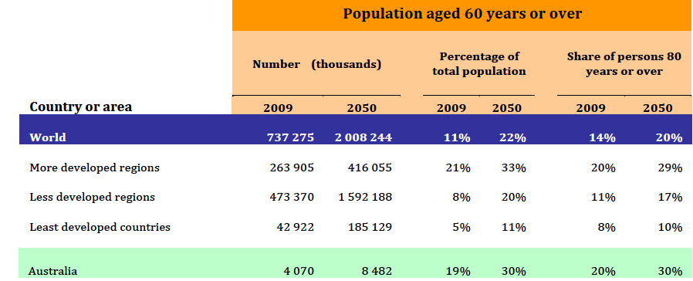
Global Ageing
Source: United Nations, 2009 (Extract from UN Table on Population Ageing and Development)

Slide 8
Ageing in Australia
Australian Bureau of Statistics Estimates 2004-2051
Percentage of 65 yrs and over will double
Percentage of 85 yrs and over will quadruple
40 year forecast of huge budget blowout (Australian Treasury, 2002) due to reduced tax base and increased costs of pensions, health and aged care
A major social and economic policy challenge
Ageing in place a key policy strategy
Increased level of home-based aged care
Housing design?
Urban/neighbourhood design?
Public transport infrastructure?

Slide 9
Climate Change
Definition: “…a statistically significant variation in either the mean state of the climate or in its variability, persisting for an extended period (typically decades or longer)” (IPCC, 2007)
Causes: Population growth and human activity resulting in increases in carbon dioxide emissions leading to increased warming of global temperatures
Consequences:
  Melting of polar ice caps resulting in sea level rise
  Disruption to food supply and water resources
  Damage to physical infrastructure
  Increased public health risks
  Modified global biogeochemical cycles, as well as oceanic and atmospheric circulation patterns (IPCC, 2007)

Slide 10
The Built Environment
Why urban environments are important
60-80% of the world’s energy use emanates from cities and urbanised areas (IEA, 2008)
50% of the world’s population now lives in urbanised areas (OECD, 2010)
By 2050, 70% in developing countries and 80% in developed countries will be living in cities (OECD, 2010)
Cities contribute to climate change in three main ways:
  Direct emissions of greenhouse gases
  Greenhouse emissions from outside embodied in urban infrastructure
  City-induced changes to atmospheric chemistry and surface reflectivity (urban heat island effect) (OECD, 2010)

Slide 11
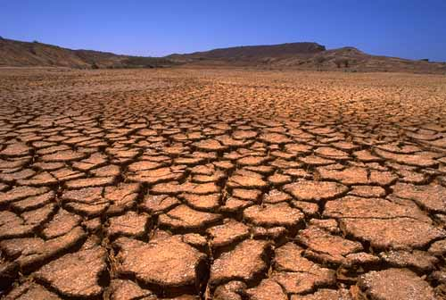
Australia’s Climate
Highly variable and diverse climate due to size and location of the continent
Ranging from tropical (hot/humid) north, arid (hot/dry) interior, temperate (cool) south east
Parts of Australia are prone to tropical cyclones, coastal erosion, floods, droughts and bushfires
Dorothea Mackellar’s poem:
I love a sun burnt country
  A land of sweeping plains
  Of rugged mountain ranges
  Of droughts and flooding rains
  I love her far horizons
  I love her jewel sea
  Her beauty and her terror
  The wide brown land for me

Slide 12
Global Emissions
Source: Data from Energy Information Agency (Department of Energy), cited by Union of Concerned Scientists 2010

Slide 13
Per Capita Emissions
Source: Data from Energy Information Agency (Department of Energy), cited by Union of Concerned Scientists 2010

Slide 14
Addressing Climate Change
Mitigation
Refers to efforts to reduce or stabilise greenhouse gas emissions through investment and development of more sustainable infrastructure and/or prohibition of less sustainable practices. (UNDP, 2010)
Longer term focus – future generations
Adaptation
Refers to coping strategies in response to the consequences of climate change allowing (UNDP, 2010)
Shorter term focus – current population
Relationship
In reality, these often overlap and can be complimentary or contradictory
Notes:
Overlap example: passive thermal design of housing can reduce energy consumption and reduce greenhouse emissions, as well as enabling residents to cope with or adapt to extreme heat events.
Contradict example: increasing urban densities may increase public transport usage and reduce greenhouse emissions, but could also increase urban heat island effect

Slide 15
Climate Change Impacts in Australia
Temperature increases
    extreme heat days
    droughts
    bushfires
    urban heat island effect
Sea level rise
    storm surges,
    coastal flooding,
    coastal erosion
Extreme weather events
    increased severity of cyclones
    intensive rainfall and flooding
    Storms/hail storms
Impacts on physical infrastructure
    materials (expansion, cracks, damage)
    structures (flood and cyclone damage)
    transport (damage, flooding)
    flood damage (housing, public domain)
    coastal infrastructure
    Many of these will impact on older people disproportionately

Slide 16
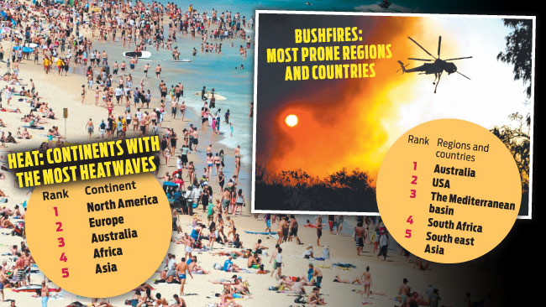
Australia’s Climate Extremes
Source: Neil Keene The Daily Telegraph May 18, 2012

Slide 17
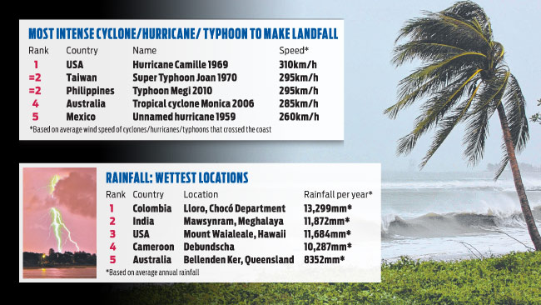
Australia’s Climate
Source: Neil Keene The Daily Telegraph May 18, 2012

Slide 18
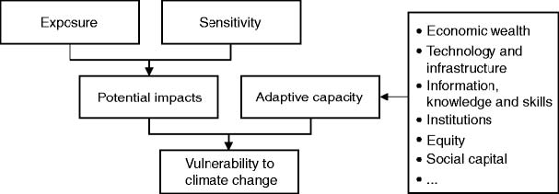
Vulnerability to
Climate Change
Source: Intergovernmental Panel on Climate Change (IPCC), 2001 Third Assessment Report. p. 32

Slide 19
Health Exposures
Attributed to Climate Change
Temperature related morbidity and mortality
  Heatwaves
  Bushfires
  Disruption to local food supply
Extreme weather events
  Tropical cyclones/storm surge
  Severe thunder storms
  Flooding
Impacts on air quality
  Air borne pollutants
Water and food borne diseases
  Contaminated by pathogens (eg Cholera)
Vector and rodent borne diseases
  Malaria, yellow fever, dengue fever
Heatwaves:
Responsible for the death of more Australians than any other natural disaster. (Coats 1996)
  2009 Victorian 9 day Heatwave:
  80% of the 374 fatalities were people 65+ (84% of these 75+) (Cooper, 2009)

Slide 20
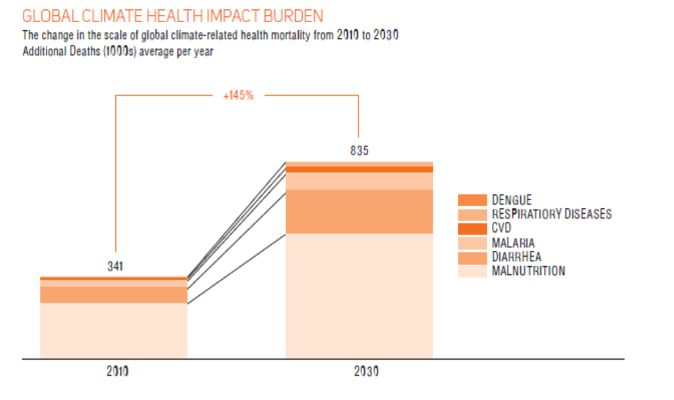
Global Health Impact of
Climate Change 2010-2030
145% increase predicted over 20 years
Source: DARA, 2010
The most vulnerable are those with pre-existing health conditions or weakened immune and metabolic resistance – i.e. the very young and the old. (McMichael et al, 2006)

Slide 21
Sensitivities of Older People
Physiological: Increased probability of pre-existing chronic disease and/or physical impairment resulting in:
  Reduced mobility, physical strength and stamina;
  Difficulties thermo regulating body temperature placing older persons at a higher risk of hypothermia and/or heat stress;
  Difficulties perceiving risks or dangers due to impairment of senses including sight, sound but also temperature;
  Skin being more fragile with age;
  an impaired immune system increasing the risk of infection and/or reaction to toxins and pathogens in the environment.

Slide 22
Sensitivities of Older People
Psychological: Higher risk of becoming isolated and/or disengaged from society as a result of:
  retirement from full-time employment
    reasons for engagement as well as
    loss of income supporting or allowing engagement in activities;
  loss of friends or a spouse;
  reduced mobility due to physical or cognitive impairment.
Economic: Increasing risk of financial stress and/or loss of economic independence with age due to retirement from full time employment.

Slide 23
Adaptation and the
Built Environment
Housing:
  Energy conservation to reduce increasing costs
  Thermal control (passive and active systems)
  Robust design to withstand extreme weather events
Neighbourhood/Urban Public Spaces:
  Urban greening to reduce Urban Heat Island (UHI) effect
  Material choices that reduce reflectivity and UHI
  Shade (trees, shelter devices)
Urban Planning:
  Land use & evacuation planning in areas of risk from extreme weather, bushfires, cyclones, floods
Transport Infrastructure
  Safe, accessible, convenient, comfortable, reliable, affordable public transport

Slide 24
Conclusion
Population ageing and climate change are two of the most critical areas of policy in the 21st century
To date they have largely been seen as separate areas of policy
Older people, particularly the older old (75+) are amongst the most vulnerable groups to the impacts of climate change
The growth, particularly of the older old cohort, will see vulnerability to climate change increase dramatically in the first half of the 21st century
This compounding vulnerability effect needs to be taken into consideration in both climate change and ageing policy
The built environment (housing, urban/neighbourhood design, land use planning, and transport infrastructure) will have an important role to play in climate change adaptation for an ageing population

Slide 25
References
Australian Bureau of Statistics (2006) Census of Population and Housing, Canberra
Australian Treasury (2002) Intergenerational Report 2002-03. Canberra: Commonwealth of Australia.
Coates, L. (1996). An Overview of Fatalities from Some Natual Hazards in Australia’. NDR96 Conference on Natural Disaster Reduction. Gold Coast, Australia: 49-54.
Cooper, M. (2009). "Death Toll Soared During Victoria's Heatwave". The Age. Melbourne.
Department of Health and Ageing [DoHA] (2006) A Community for All Ages: Building the Future: The Findings and Recommendations of the National Speakers Series June 2006. Commonwealth of Australia, Canberra.
Harvison, T., Newman, R. & Judd, B. (2011) Ageing, the Built Environment and Adaptation to Climate Change. NCCARF/ACCARNSI, Sydney.
International Energy Agency (IEA), 2008 World Energy Outlook 2008, Paris.
iPCC (2001). Climate Change 2001: Impacts, Adaptions and Vulnerabilitity. Contribution of Working Group II to the Third Assessment Report of the Intergovernmental Panel on Climate Change (IPCC). Edited by J. McCarthy, O. Canziani, N. Leary, D. Dokken and K. White. Cambridge UK: Cambridge University Press.
IPCC (2007). Climate Change 2007 – The Physical Science Basis (Working Group I Contribution to the Fourth Assessment Report of the IPCC), Cambridge UK: Cambridge University Press.
McMichael, A., Woodruff, R. & Hales, S. (2006). "Climate Change and Human Health: Present & Future Risks." Lancet, 367:9513: 859-869.
The Global Humanitarian Forum, 2009, The Anatomy of a Silent Crisis (Human Impact Report, Climate Change), Geneva
OECD & China Development Research Foundation, 2010 Trends in Urban Policies in OECD Countries: What Lessons for China?
CSIRO (2007). "Climate change in Australia: Technical report, Commonwealth Scientific and Industrial Research Organisation, Australia Government, Canberra.
UNDP (2010) "Local governance and climate change: Discussion notes", United Nations Development Program; United Nations Capital Development Fund (UNCDF) and United Nations Environment Programme (UNEP), Bangkok.
Union of Concerned Scientists (2010). "Each country's share of CO2 emissions", accessed 20.6.2011 from <http://www.ucsusa.org/global_warming/science_and_impacts/science/each-countrys-share-of-co2.html>.
United Nations (2009). "Population Ageing & Development 2009", Department of Economic and Social Affairs, Population DivisionTables. S. E. S. A/290. United Nations, New York, USA
Notes:
Overlap example: passive thermal design of housing can reduce energy consumption and reduce greenhouse emissions, as well as enabling residents to cope with or adapt to extreme heat events.
Contradict example: increasing urban densities may increase public transport usage and reduce greenhouse emissions, but could also increase urban heat island effect

Slide 26
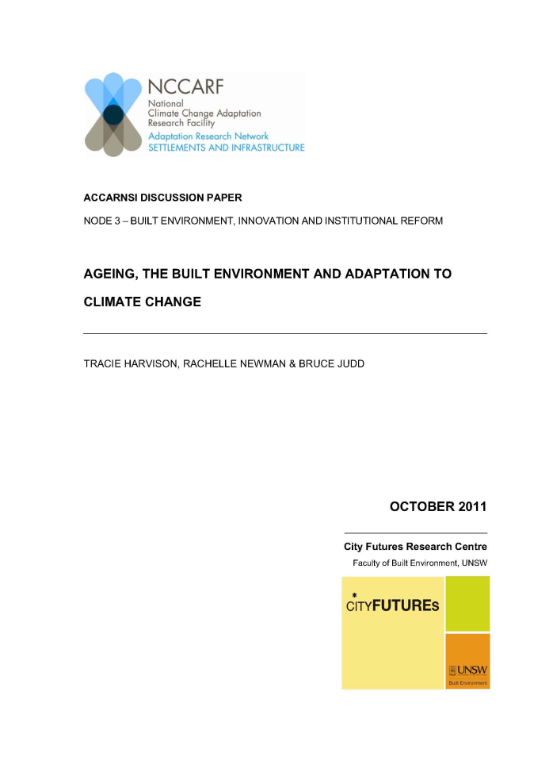
Report Available Online
http://www.nccarf.edu.au/wwwold/settlements-infrastructure/
re
Notes:
Overlap example: passive thermal design of housing can reduce energy consumption and reduce greenhouse emissions, as well as enabling residents to cope with or adapt to extreme heat events.
Contradict example: increasing urban densities may increase public transport usage and reduce greenhouse emissions, but could also increase urban heat island effect

