Slide 1

Workforce planning for the future
PRESENTED BY
STANIKA RJAZANCEW- DJURDJEVIC
IFA 11TH GLOBAL CONFERENCE ON AGEING

Slide 2
The Dilemma and The Challenge
THE DILEMMA: We cannot continue business as usual
THE CHALLENGE : To create a sustainable workforce, society and its economy

Slide 3
KEY AREAS
1) Information system – relevance/ importance in retention
2) Education – to retain or to re-deploy
3) Migration – ethical and moral dilemma
4) Branding and Social media
5) Technology- Artificial Intelligence

Slide 4


Slide 5
Historical Data Analysis
2003
Information System -70
2006 Information System - 75
2009 Information System-72
Non Compliance with Standard 1.8 Information System (The Standard Special Edition 2009)

Slide 6
Information systems
68% Out-dated information
12% Job description, Policies/procedures
8% Lifestyle, work life balance
6% IT - complicated software
4% Orientation and induction program

Slide 7
What have we learn
Information has cycle of life
Nurses/ potential staff will choose employer based on information provided
Workload vs Job description
Education, skills and best practice
Use diversity to advance
Retention starts on the day of orientation

Slide 8






What other Industries do?

Slide 9
Focus on Human Sustainability
Recruitment and retention strategies form part of Strategic Planning and workforce planning
Employees are the most important customer- Organisation is a community of human beings
Investment in people enhances present and future performance that result in human sustainability
Post staff survey action- value their feedback and acts
Increase employee role in decision making
Plan staff retention with staff whilst they are still employed
Develop capacity and capability for corporate reshaping and renewal
Ethical leadership

Slide 10
BRANDING
Planning for the workforce for the future :
- What is our business?
- Where are we now?
- Where are we heading?
- What don’t we have?
- What don’t we have?
- What can we learn from other industries?

Slide 11
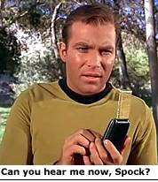
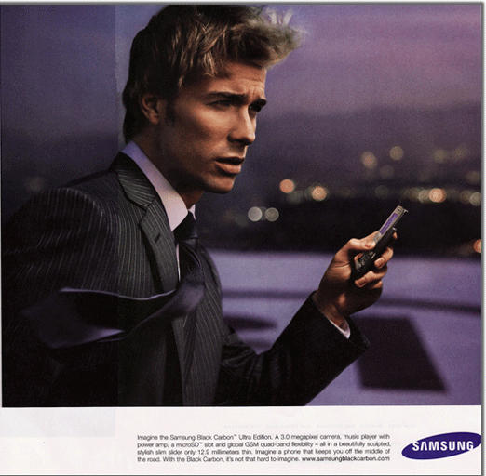
TECHNOLOGY 1960’s and 2000’s

Slide 12
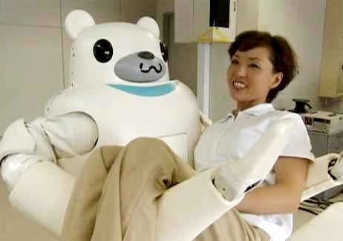
August 28, 2009 3:57 PM PDT
Japanese create teddy bear robot nurse

Slide 13
HOLOGRAPHIC STAFF AT UK
In an attempt to quicken the pace at security checks at the London Luton and Manchester , a staff of holograms have been introduced.
Replicas of "John" and "Julie" -- actual Manchester employees -- were designed by Musion, and are now always on hand to "explain the liquid restrictions and remind passengers to have their boarding cards ready," according to The Telegraph

Slide 14
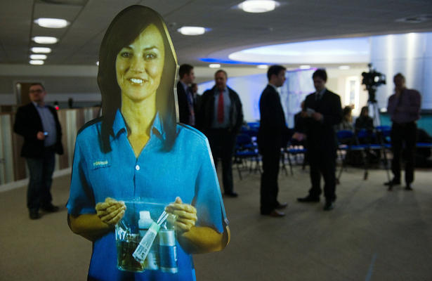
Hologram staff

Slide 15
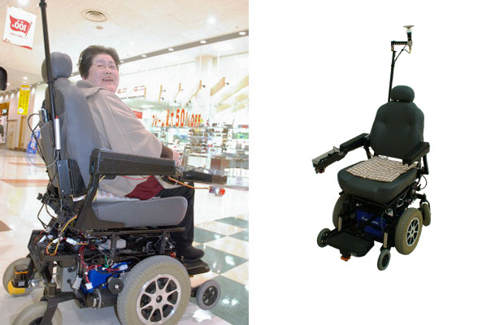
ROBOTIC WHEELCHAIR

Slide 16

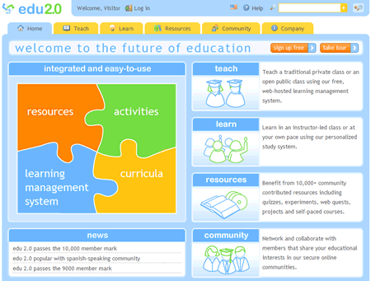
E-LEARNING AND VIRTUAL CLASSES

Slide 17
IN CONCLUSION
Commitment to people
Systematic building of human capacities
Employees feel part of the organisation
Respect for innovation
Technology is part of social change
World best practice
The new business may be totally irrelevant to today’s business model

Slide 18
References
A case study in Strategic sustainability, Fuji Xerox eco Manufacturing Centre; Innovation: management, policy & practice (2004) Volume 6, Issue 2: 258–268.
Bunning's and Sustainability , http://www.bunnings.com.au/contact-us_bunnings-sustainability.aspx, viewed 11/11/2011
Dunphy, D Griffiths, A and Benn, S (2003) Organisational Change for Corporate Responsibility. Routledge, New York
Fuji Xerox sustainability Report 2010, http://www.fujixerox.com.au/sustainabilityreport/, viewed 24/11/2011
Google pictures , viewed 13/11/2011
Herold, MH& .Fedor DB 2008 Change the way you lead change, Leadership strategies that really work, Stanford, California
Peterson, J.L, 2008, Wild Cards: Thinking About Big Future Surprises, Knowledge Base of Future studies, Foresight International, Vol1, CD-ROM
Scantic Hotels, http://www.scandichotels.com/settings/Side-foot/About-us-Container/Responsible-living/Society/, viewed 24/11/2011
Shell Royal Dutch Company, Sustainability Report 2011, http://reports.shell.com/sustainability-report/2011/servicepages/welcome.html, viewed 12/12/2011 and 3/3/2012
Stora Company, (dated since 1360’s) http://www.storaenso.com/about-us/Pages/welcome-to-stora-enso.aspx, viewed 11/11/2011 and 5/3/2012
The Aged Care Standards and Accreditation Agency, The Special Edition Report, 2009, http://www.accreditation.org.au/about-us/the-standard/, viewed 12/12/2012

Slide 19
QUESTIONS AND THANK YOU

