Slide 1


Baby Boomers: Planning for a Healthy Old Age or Just Letting it all Hang out?
11th Global Conference of the International Federation of Aging
28May to 1st June, 2012
Dr Jennifer Buckley
University of Adelaide
Australian Population and Migration Research Centre

Slide 2
Overview
Baby Boomers - 1946-1965
Reason for taking a cohort perspective
Theory
Methods
Health Status
Health Beliefs, Attitudes and Behaviours
Constraints to a healthy lifestyle
Conclusion

Slide 3

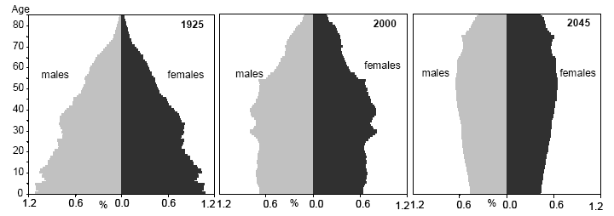
Why Baby Boomers are Important
Disordered Cohort Flow
Impact on Future Health and Wellbeing
Population Ageing
Cutting edge of change

Slide 4
Demographic and socio-cultural theories of social change
Reflexive/late modernity; individualization; risk (Giddens; Beck)
Cohort flow and social change, (Riley, Ryder, Mannheim, Dannefer & Uhlenberg)
Period Effects
Cohort Effects
Reflexivity;
devolution of responsibility to individual
Baby Boomers 1946-65
Preparation for Later Life Under Conditions of Reflexive Modernity (Denton et al, 2001; 2004)
Successful Ageing
(Rowe & Kahn)
Analysis
Reflexive planning for health in later life. Intra-cohort analysis – agency & structure (Dannefer & Uhlenberg)

Slide 5
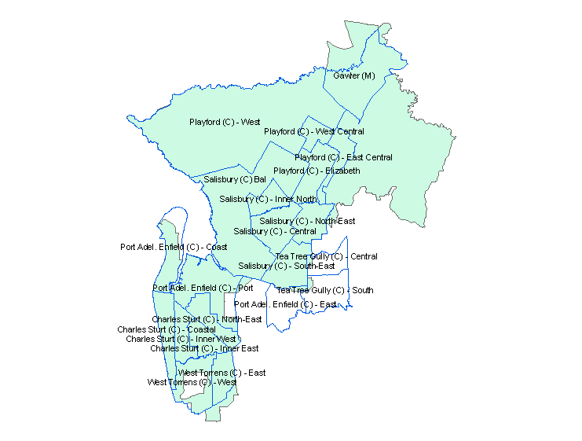

North West Adelaide Health (Cohort) Study
LGAs
NWAHS n=4060
Study Population: Baby Boomers 1946-1965
Notes:
CLICK The analysis of later life preparation drew on a sample of baby boomers from the North West Adelaide Health Study which is a longitudinal population based biomedical study CLICK incorporating a representative cross section of urban-based adults drawn from the north western region of Adelaide. This Study has developed a comprehensive database with extensive bio-medical and self report health data and a wide range of social and demographic variables. CLICK The data used in the study were collected at several time points as shown here.
Perhaps leave this section out - Additional data specific to the thesis was collected through a postal and a telephone survey. This survey collected information on attitudes to ageing, health behaviours, planning behaviour, living arrangements, housing preferences, social participation and support, income expectations for later life, employment, and caring responsibilities.

Slide 6
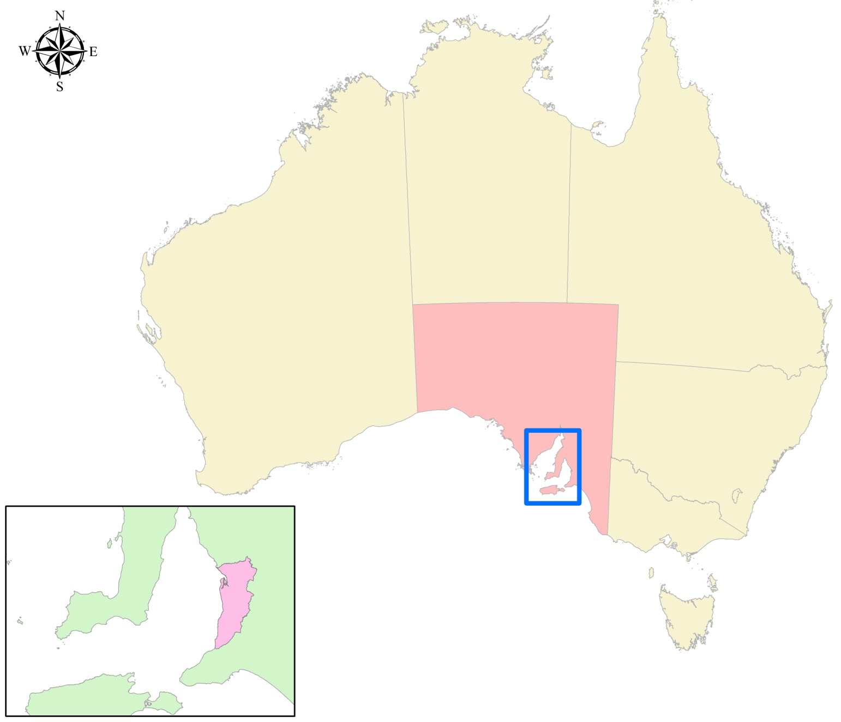
Geographical Context
Notes:
Which is situated about here in Australia.

Slide 7
North West Adelaide Health (Cohort) Study
LGAs
NWAHS n=4060
Study Population: Baby Boomers 1946-1965:
  Stage 2, 2004-06 n=1195
  CATI Survey 2007 n=1058
  Postal Survey 2007 n=797
Notes:
CLICK The analysis of later life preparation drew on a sample of baby boomers from the North West Adelaide Health Study which is a longitudinal population based biomedical study CLICK incorporating a representative cross section of urban-based adults drawn from the north western region of Adelaide. This Study has developed a comprehensive database with extensive bio-medical and self report health data and a wide range of social and demographic variables. CLICK The data used in the study were collected at several time points as shown here.
Perhaps leave this section out - Additional data specific to the thesis was collected through a postal and a telephone survey. This survey collected information on attitudes to ageing, health behaviours, planning behaviour, living arrangements, housing preferences, social participation and support, income expectations for later life, employment, and caring responsibilities.

Slide 8
Methods
Sub-Groups within the cohort
Males
Females
Older Boomers (1946-55)
Younger Boomers (1956-65)
Singles n=216
Depressed n=133
Low Income (<$40,000) n=293
Retired n=113
Non Planners n=360
Casual/Unemployed n=102
Notes:
Most quantitative studies on baby boomers and later life have focused on averages for the whole cohort so one of my major aims was to look at CLICK sub-groups within the cohort that are likely to differ from the mainstream or to be more at risk in later life. Sub-groups that fitted this description included: CLICK singles, CLICK those who are suffer from moderate to severe depression, CLICK low income earners, CLICK the retired, CLICK those who are not planning for or thinking about retirement, CLICK and casual or unemployed workers.

Slide 9
Chronic Conditions
Baby Boomers 1946-65
Condition %
Obesity 32.5
Arthritis 19.1
Doctor Diagnosed Mental Health Conditions 18.1
Asthma 15.2
COPD (Chronic obstructive pulmonary disorder) 6.3
Diabetes 6.0
Chronic kidney disease (St 3-5) 5.2
Cardiovascular Disease 3.9
Doctor diagnosed Osteoporosis 1.6
Source: NWAHS TFU Follow-up (Postal) 2007
Notes:
We examined the above conditions all of which have been assigned national priority status except for COPD, kidney disease and osteoporosis
Older baby boomers sig more likely to have all conditions except for Pysc disturbance and asthma.
Females sig more likely to have Stage 3-5 Kidney disease; arthritis; osteoporosis; doctor diagnosed mental health condition and COPD and males more likely to have cardiovascular conditions.

Slide 10
Chronic Conditions by Gender
Baby Boomers 1946-65
*
*
*
*
*
p value*<.05;
Source: NWAHS, Stage 2, 2004-06
Notes:
We examined the above conditions all of which have been assigned national priority status except for COPD, kidney disease and osteoporosis
Older baby boomers sig more likely to have all conditions except for Pysc disturbance and asthma.
Females sig more likely to have Stage 3-5 Kidney disease; arthritis; osteoporosis; doctor diagnosed mental health condition and COPD and males more likely to have cardiovascular conditions.

Slide 11
Multiple Morbidity
0 conditions
1 condition
2 conditions
Source: NWAHS, Stage 2, 2004-06; *p value=*<.05; **=<.001
Multiple conditions=diabetes, asthma, cardio, COPD, psyc distress, kid dis, arthritis, osteoporosis
3 or more conditions

Slide 12
Source: NWAHS, Stage 2, 2004-06
Notes:
Results indicate the magnitude of the gap in health outcomes between at-risk and mainstream groups with this being particularly large for low income, depressed and retired groups. All at-risk groups except for non-planners were more likely to report arthritis or a mental health problem. Again, this was also the case for those with an employment status of casual or unemployed. Those in low income, singles and retired groups were more likely to have diabetes while all at-risk groups except for singles were more likely to have COPD. COPD was particularly prevalent in the depressed group at 17.1 per cent compared to 4.8 per cent for the not depressed. By contrast, the prevalence of cardiovascular disease was similar for both at-risk and mainstream groups. p180

Slide 13
The Association between Health Status and Attitudes to Exercise and Diet - Baby Boomers 1946-1965
Lifestyle Factor Rating | Poor-fair SRH | Good-Excellent SRH | 3 > CCs | < 3 CCs
Exercise unimportant | 16.1** | 5.7 | 22.2** | 6.4
Exercise important | 83.9 | 94.3 | 77.8 | 93.6
Diet unimportant | 7.0* | 3.3 | 12.9** | 3.2
Diet important | 93.0 | 96.7 | 87.1 | 96.8
Note: Other = not important, slightly important or neutral; Impt = important or very important
P Value **=<.001; *=<.05
Source: NWAHS TFU Follow-up (Postal) 2007
Notes:
Although poor health may in itself lead to fatalistic views that inhibit the adoption of more positive lifestyles, a UK study, which took this factor into account, showed that the likelihood of adopting a positive lifestyle is influenced by chance locus of control, future salience and having a conscious awareness of the impact of lifestyle on health, and that these in turn are influenced by socio-economic status and class (Wardle and Steptoe 2003). Although the cross sectional nature of the analysis undertaken in this thesis means that causality cannot be determined, it is clear that, regardless of whether disempowering views are due to social location or ill-health, there would be benefits in targeting those who hold beliefs that discourage the adoption of positive lifestyles.
Chance locus of control refers to a belief that health is more influenced by chance or external factors than by an individual’s own actions (Wardle and Steptoe 2003:440-441).
Future salience refers to the extent to which thinking about the future influences motivations to maintain a healthy lifestyle with those who think little about the future being likely to be less motivated (Wardle and Steptoe 2003:440-441)

Slide 14
Attitudes to Ageing - Rating of Protective Factors
Baby Boomers 1946-65
Source: NWAHS TFU Follow-up (Postal) 2007
Notes:
high proportions of all groups considered healthy weight, regular exercise and good diet to play an important role in contributing to health and happiness in later life but those on a low income were less likely to consider these factors important than their mainstream counterparts.

Slide 15
Beliefs versus Lifestyle
Baby Boomers 1946-65
Protective Factors - Beliefs
Actual Lifestyle
Exercise 92.3
Good diet 96.0
Healthy weight 94.8
Meaning in life 88.3
Friends/social engagement 86.9
Sufficient Activity 35.4
Vegetables per day (median) 2.0
Normal Wt (BMI 18.50-24.99) 25.3
Hobbies/interests 74.4
Satisfied with socialising 42.8
Source: NWAHS TFU Follow-up (Postal and CATI) 2007; NWAHS Stage 2, 2004-06
Notes:
This gap suggests two possible issues. Firstly, there is a lack of knowledge about what constitutes a lifestyle that will lead to positive ageing and secondly, those who know what constitutes such a lifestyle find it difficult to put into practice.

Slide 16
Constraints to Making
Positive Lifestyle Changes
**
**
**
**
**
*
*
**
*
*
**
*
*
**p<.001; *p<.05;
Source: NWAHS TFU Survey 2, (Postal) 2007

Slide 17
Perceptions of Benefits of Regular Exercise
Source: NWAHS TFU Survey 2, (Postal) 2007

Slide 18
Constraints to Exercise
Baby Boomers 1946-1965
Source: NWAHS TFU Follow-up (Postal) 2007
Notes:
Not surprisingly, the most common barrier to exercise was lack of time. This was closely followed by lack of self-discipline (33.3), lack of energy (27.2), lack of interest (20.1), and lack of enjoyment (18.5), suggesting motivational factors are a key barrier to exercise. When looking at the whole cohort, external resources such as lack of money, or lack of access to facilities, exert less influence over the extent to which baby boomers exercised. Although there were few cohort differences, younger boomers were more likely to nominate being self conscious about their looks while older boomers were more likely to say lack of interest.

Slide 19
Constraints to Exercise by Subgroup
Structural Factors
*
*
*
*
*
**
*
*
**
*
*
**
*
*
**p<.001; *p<.05;
Source: NWAHS TFU Follow-up (Postal) 2007
Notes:
The differences between men and women are paticularly striking

Slide 20
Constraints to Exercise by Subgroup Motivational Factors
**
**
*
*
*
*
*
**
*
Source: NWAHS TFU Follow-up (Postal) 2007
Notes:
The differences between men and women are paticularly striking

Slide 21
Constraints to Exercise by Gender
Source: NWAHS TFU Follow-up (Postal) 2007

Slide 22
How Do baby Boomers Socialise?
All Baby Boomers and At-Risk Groups
*
*
*
*
*
**
*
**
*
*
*
*
*
**
*
*
**
*
*
*
*
*
*
*
*
*
**p<.001; *p<.05;
Source: NWAHS TFU Survey 2 (Postal) 2007.

Slide 23
Constraints to Socialising
**
**
**
*
**
**
**
**
**
*
**
*
**
**
**
*
*
**
**p<.001; *p<.05;
Source: NWAHS TFU Survey 2, (Postal) 2007

Slide 24
Conclusion
Principles of successful ageing embraced but gap between beliefs and action
Capacity to build health resources varies by social location, gender and life stage:
  Financial and social constraints – at-risk groups
  Poor work-life balance – mainstream and younger boomers
  Gender differences in physical activity
Impact of social change on social connections and participation?
Health policies need to take diversity into account
Notes:
Lack of time was a major constraint for both at-risk and mainstream groups and followed a similar pattern to that observed for exercise and making positive changes to lifestyle.

Slide 25
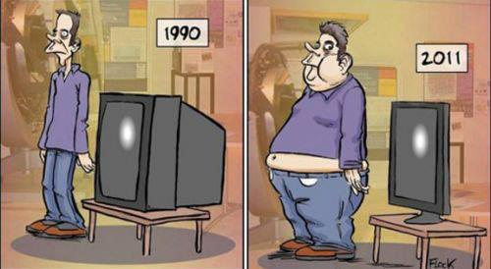
Planning for a Healthy Old Age or Just Letting it All Hang Out?

Slide 26
Contact Details
Jennifer Buckley
Email: jennifer.buckley@adelaide.edu.au

