Slide 1



Linking Evidence to Health Policy
for the Ageing:
A Social Health Atlas of Older Adults in a Major Japanese City
Megumi Kano,¹ Jimpei Misawa,² Kayo Suzuki,³
Masataka Nakagawa,³ Katsunori Kondo³
¹WHO Centre for Health Development, Kobe, Japan; ²Rikkyo University, Tokyo, Japan;
³ Center for Well-being and Society, Nihon Fukushi University, Nagoya, Japan

Slide 2
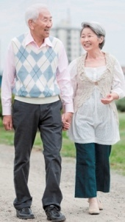

Japan’s achievements in longevity
Life expectancy at birth
  86 yrs for women, 80 yrs for men
Healthy life expectancy at age 60
  21.7 yrs for women, 17.5 yrs for men
Key contributing factors:
  Health system and health services
  Social and physical environment
  Health behaviour
  Genetics
Notes:
Life expectancy data is from 2009; Healthy life expectancy data is from 2002.

Slide 3
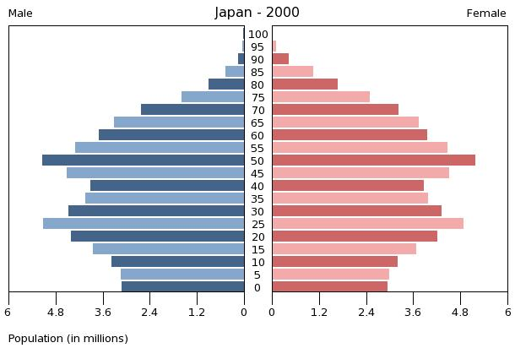
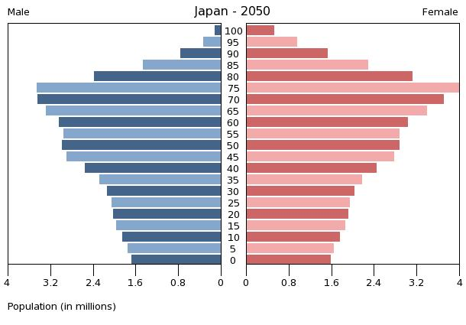
The demographics of ageing in Japan

Slide 4
RAPID ageing

Slide 5
Key Challenges
Ageing of the urban population
Dwindling resource base
Growing income inequalities → health inequalities?
“Ageing in Place”
Lack of data to enable evidence-based policy and practice, especially at the local government level

Slide 6
Project Objectives
To establish a mechanism for integrating research into policy and programme development to promote elderly health and wellbeing in a major metropolitan area of Japan
To build the epidemiological evidence base on the broader determinants of health and wellbeing among elderly residents in rapidly ageing urban areas
To empower local stakeholders to create healthy conditions in which people live, work, and age

Slide 7
Main Project Partners
City of Kobe: Public Health and Welfare Bureau, Health Division, Long Term Care Insurance Unit (Kobe, Japan)
Centre for Well-being and Society, Nihon Fukushi University (Nagoya, Japan) and the JAGES Research Group
WHO Centre for Health Development (Kobe, Japan)
  Common interests in urban health, health equity assessment, social determinants of health, and evidence-based policy/programme development

Slide 8

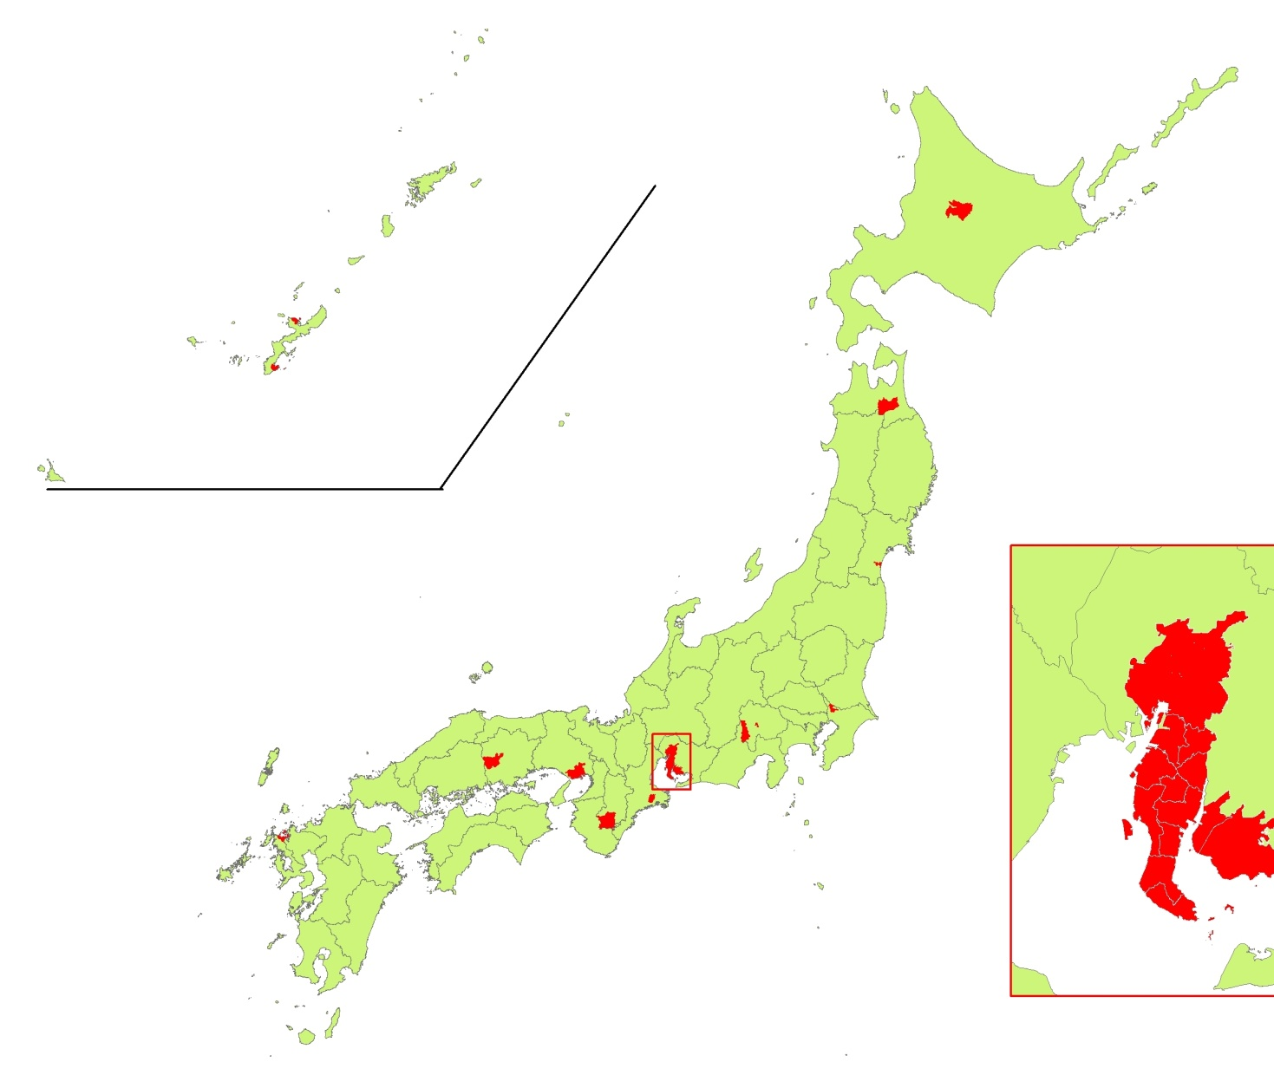
Japan Gerontological
Evaluation Study (JAGES)
One of the few population-based social epidemiological gerontological surveys in Japan
Conducted in 1999, 2003/4, 2006/7, 2010/11
2010/11 included 112,123 individuals across 31 municipalities in 12 prefectures
Kobe City was among the first few major metropolitan areas to join this study in 2010/11
Notes:
Kobe (total=1.5 m, 65+=305 k) and Nagoya (total=2.2 m, 65+=409 k) are only two cities in JAGES with a population over one million. Four other cities with total population over 100k; others have less than 100k.

Slide 9
Survey Items
Health status indicators: self-rated health, chronic conditions, health behavior, oral health, nutrition/diet, tobacco, alcohol, ADL/IADL, etc
Psychological indicators: depression, subjective well-being, etc
Social indicators: social support, social capital, social participation
Socioeconomic status indicators: income, education, relative deprivation, pension, etc
Environmental indicators: road safety, parks and recreation, accessibility, etc

Slide 10
JAGES Survey: Kobe
Kobe City has the sixth largest population in Japan and a significant proportion of elderly residents (20% in 2005)
It is a “government-decreed city”
Representative sample of 15,000 independent, community-dwelling elderly residents aged 65 years or older
  9,873 responses (66% response rate)
  9,328 valid responses
Self-administered mail survey conducted between December 2011 and February 2012

Slide 11
Kobe sample characteristics
Age (years) 65-74 75-84 85-94 95-99 | 56.3% 37.7% 5.8% 0.2%
Sex Male Female | 45.2% 54.8%
Equivalent household income group Low (<2 million JPY) Middle (2-4 million JPY) High (>4 million JPY) | 43.6% 33.9% 8.4%
Household composition Lone elderly Elderly couple Other | 23.3% 44.8% 31.9%
Notes:
2 million yen ~ 25,000 USD
4 million yen ~ 50,000 USD
Equivalent household income is considered a more adequate measure of standard of living (per capita) than raw household income.

Slide 12
Self-rated health:
“Very/Somewhat good”
Nagoya
Kobe
Mean
Notes:
Percent reporting “somewhat good” or “very good” health.

Slide 13
Income inequality
Kobe
Gini coefficient for total population = 0.329
Notes:
Gini coefficient for the whole population of Japan, late 2000s = 0.329 (OECD, 2011)

Slide 14

Physical environment:
Parks and pedestrian paths
Kobe
Notes:
Other good indicators: Access to shops selling fresh fruits and vegetables

Slide 15
Social-physical environment:
Places to visit for a casual drop in
Notes:
Other negative indicators: graffiti and trash; places that are unsafe to walk alone at night

Slide 16
Social capital:
Trust in the community
Notes:
Other social capital indicators: trust in people in general, likelihood that a wallet would be returned, people in the community are wanting to help others

Slide 17
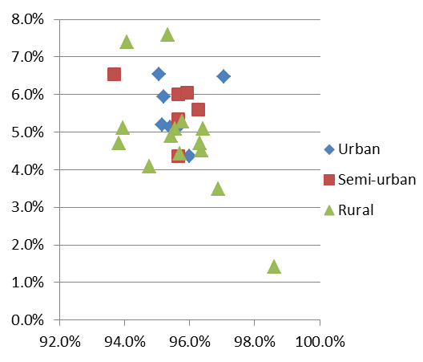
Determinants of health
*Ages 65-74 only
Ecological analysis at the municipality level
Multilevel analysis at the sub-municipality level
Prevalence of low BMI <18.5
Prevalence of social isolation
Sense of decline in community activities and relationships in past 3 years
Coefficient of correlation=.568
Trust in the community
Coefficient of correlation=-.539
Notes:
Other bivariate correlations at the municipality level: membership in hobby groups and remaining teeth/home- bound/depression/falling; membership in sports clubs and BMI/home-bound
The multilevel analysis controlled for individual-level factors and still found significant effects for small-area level factors like poverty (% of household equivalent income<median), and perceptions that community festivals have become infrequent, and interactions and activities among community members have declined over the past 3 years.

Slide 18
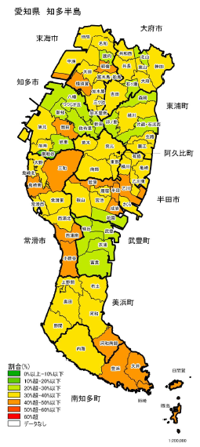
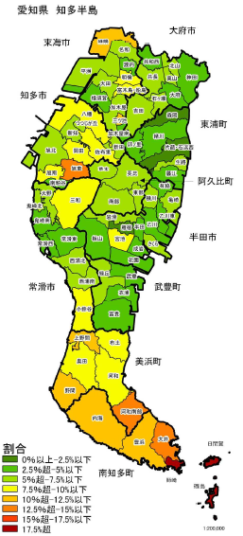
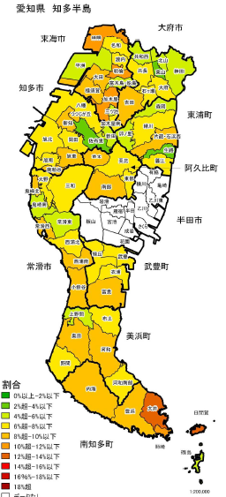
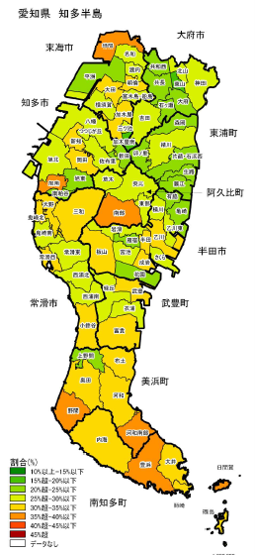
Small-area data mapping
Has not received health check-up in the past year (%)
Goes out less than once a week (%)
Geriatric Depression Scale score
(*Only among >=75)
Had a fall in the past year (%)

Slide 19
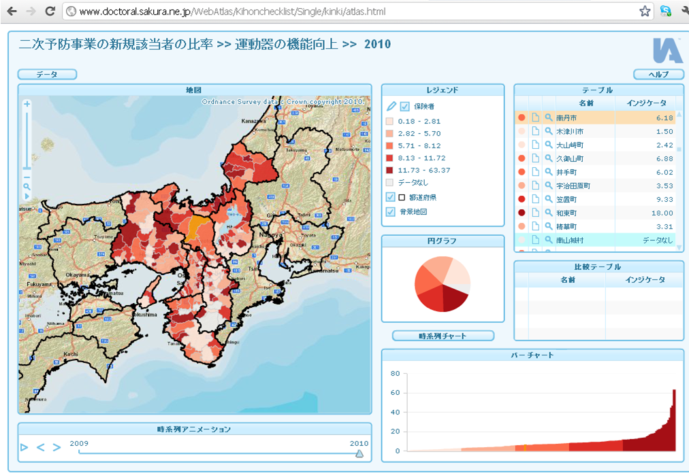
Interactive data mapping http://www.doctoral.sakura.ne.jp/WebAtlas/Kihonchecklist/Single/kinki/atlas.html
Notes:
http://www.doctoral.sakura.ne.jp/WebAtlas/Kihonchecklist/Single/kinki/atlas.html
InstantAtlas, Tableau
User-friendly mapping interface

Slide 20
Conclusions
Older adults in large urban areas may feel healthier and benefit from better infrastructure and economy, but may experience poorer social well-being compared to smaller, more rural municipalities
Multilevel analysis confirmed some of the correlations between neighbourhood-level social factors and health indicators
Systematic collection, mapping, and analysis of social and health data by small geographic units are crucial to develop policies and programmes that are responsive to the geographically non-uniform needs of the local elderly population
Technological innovations have made interactive data mapping a feasible and effective tool for both researchers and policy-makers

