Slide 1



HELPS PROJECT
Housing and Home-care for the Elderly and vulnerable people and Local Partnership Strategies in Central European cities
IFA 11th Global Conference on Ageing
28 May – 1 June 2012, Prague, Czech Republic
Štěpánka Pfeiferová
Socioeconomics of Housing
Institute of Sociology CAS, Prague, CR
stepanka.pfeiferova@vupsv.cz

Slide 2

Project HELPS
The project is implemented through the CENTRAL EUROPE Programme co-financed by the ERDF
Programme:
  Active ageing in the CENTRAL EUROPE
Priority 4
  Enhancing competitiveness and attractiveness of cities and regions
Area of Intervention 2
  Addressing the territorial effects of demographic and social change on urban and regional development
Concept 6
  Innovative housing and care solutions for the elderly and vulnerable persons in Central European cities
Duration: October 2011 – September 2014

Slide 3
Background
Socio-demographic changes → dramatic increase of the number of elderly and vulnerable people
Improvement of health conditions → decrease of the need for intensive care
The primary aim nowadays is to give vulnerable people as much control over their lives as possible
More elderly and vulnerable people continue to live in their own flats/houses and need support for active re-integration
Central Europe is still characterized by centralistic approaches that have often difficulties in matching with the needs of such population groups
    Offer of standardized solutions for supposedly homogenous needs
    Favour the institutionalisation and the separation of such population groups from other residential areas and/or population groups
    Focus on intensive care-provision while other needs are neglected
Neighbourhood-based care and housing solutions needed to increase the autonomy of these groups and contribute to maintain their abilities

Slide 4
Project’s objectives
To improve the quality of life of vulnerable groups, especially elderly and people with disabilities residing in urban areas in Central Europe
To develop the most appropriate living environment and care for them
To foster innovative housing and care solutions for elderly and other vulnerable people with a view to increase their autonomy
To support elderly and other vulnerable people in living in their own homes
To find management solutions in integrative housing and enable participation of the elderly and vulnerable groups in the coordination of relevant stakeholders
To develop innovative housing and homecare solutions by supporting models of integrated local governance orienting policies, products and services
To decrease functional and spatial separation of different age groups in urban areas

Slide 5
Areas for innovative practices
community building
housing accessibility (including technical devices, ICT)
housing affordability
social and health care
access to information and/or education

Slide 6
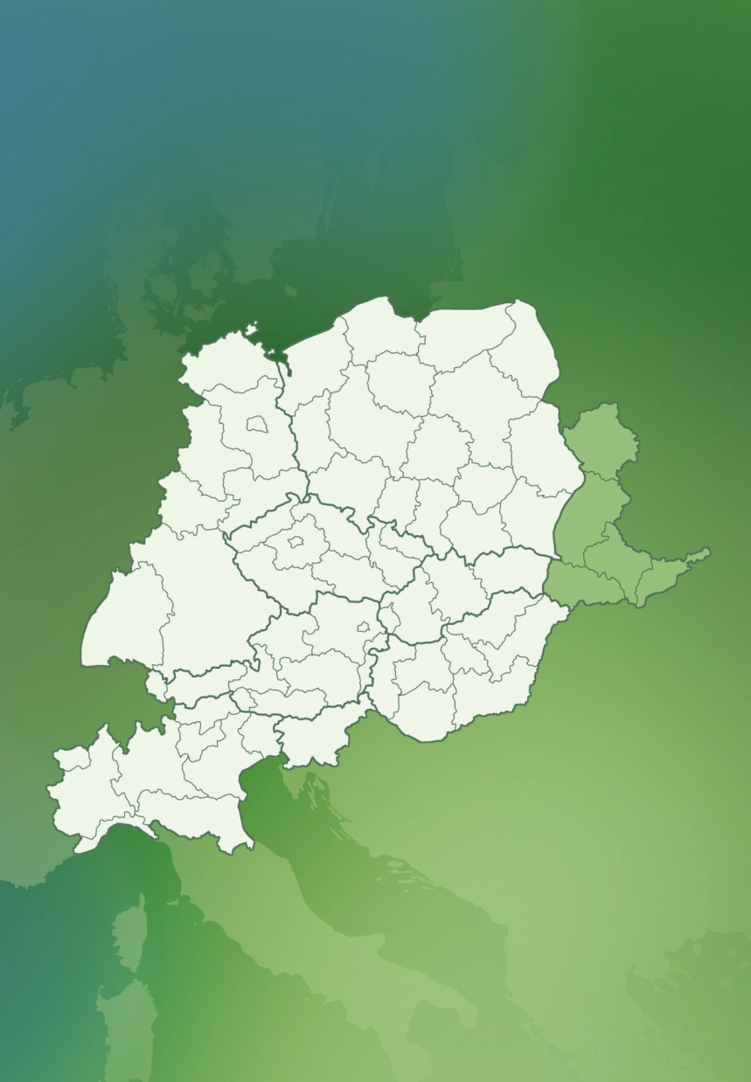
Partnership
FVG Region – ITA
City of Leipzig, Economic Development Office – D
Municipality of the City of Debrecen – HU
Veneto Region – ITA
Association of Towns and Communities of Slovakia - SK
Institute of Sociology of the Academy of Sciences of the Czech Republic – CZ
Institute for Sociology Slovak Academy of Sciences – SK
German Association for Housing, Urban and Spatial Development – D
Poznan Supercomputing and Networking Center – PL
Samariterbund Burgenland – A
Hungarian Maltese Charity Service – HU
Slovenian Federation of Pensioners’ Organizations – SLO
City of Brno - CZ
Institute of Social Research - ITA
Ministry of Labour - SLO

Slide 7
Work plan
WP1: Project management & coordination
WP2: Communication, knowledge management and dissemination
WP3: Transnational review of innovative practices in housing and care for elderly and other vulnerable people in Central European cities – Institute of sociology CAS (CZ)
      Transnational overview of innovative policies
        Comparative analysis of best practices
          Definition of needs and formulation of recommendations
WP4: Pilot actions - Municipality of the City of Debrecen (HU)
      Focus on community-based development
        Creating local governance platforms
WP5: Transnational design of strategies and actions for mainstreaming pilot cases - Veneto Region, Department of Social Services (IT)
      Local Action Plans
        Transnational recommendations and toolkit

Slide 8
Expected outcomes
Sound review of innovative practices and the context of their application
Publications based on gathered information
Small number of piloted newly developed or reviewed services and housing solutions for the targeted population groups (introduction of innovative practices)
Needs-driven and efficient provision of services/solutions for the targeted population group
Definition of needs, recommendations for national policies and transnational programs

Slide 9

Thank you for your attention!
http://seb.soc.cas.cz/projekty/helps.htm
stepanka.pfeiferova@vupsv.cz

