Slide 1
Future Care Needs of Older Canadians Needing Assistance: Who Will Do How Much and « What If »…
Yann Décarie, Institut National de la Recherche Scientifique (INRS)
Jacques Légaré, Université de Montréal
Janice Keefe, Mount Saint Vincent University
Samuel Vézina, Mount Saint Vincent University
International Federation on Aging
Prague, May 28 to June 1 2012

Slide 2
Research Questions
How many future older Canadians will need and receive assistance with every day activities, due to a long term health condition, and help received will come from which support networks ?
What if we project important changes in the patterns of support networks usage of older persons ? How would such a scenario affect the support networks in the future ?

Slide 3
Methodology
Methodology is in three parts
1- LifePaths
2- Regressions
3- « What if … » scenario

Slide 4
Sources of assistance
Our analysis of the assistance provided is based on the older person’s responses to questions about the help received from either a formal or informal source.
Formal support refers to the assistance provided by a paid employee (government or non-government) or volunteer from a private or public agency.
Informal support refers to the assistance provided by family, friends, and/or neighbours.
Cases where assistance is received from both the formal and informal support networks are referred to as “mixed support”.

Slide 5
Types of activities
The 2002 GSS focuses on help received by older persons who need assistance in performing four specific types of activities:
Inside home duties (IH), such as meal preparation, meal clean-up, house cleaning, and laundry or sewing;
Outside home duties (OH), such as house maintenance and outdoor work;
Transportation (TR), such as transportation, shopping for groceries or other necessities, and banking or bill paying;
Personal care (PC), such as assistance with bathing, toileting, brushing teeth, shampooing and hair care, and dressing.

Slide 6
Micro-simulation
(LifePaths)
Cross-sectional: GSS & CCHS
Regression 1
Disability
A
S
MS
SL
R
PB
Regression 2
Need for assistance
D
A
S
R
Age
Sex
Schooling level
Region
Marital status
Age of spouse
Place of birth
Surviving children
A
Regression 3 (by sex)
S
NA
A
SL
R
MS
PB
SC
Living arrangement
SL
Regression 4 (for those who NEED ASSISTANCE)
Received assistance
R
LA
D
A
S
SL
R
PB
SC
Regression 5 (by sex) (for those who RECEIVE ASSISTANCE)
MS
LA
D
Source of assistance
A
SL
R
PB
SC
AS
PB
SC
2006 2011 2016 2021 2026 2031

Slide 7
« What if … » Scenario (1/2)
This scenario aims at assessing how changing patterns of networks usage would impact on the distribution of the older Canadian population by source of assistance of help received
It was designed because descriptive analysis of the population receiving assistance in the 2002 and the 2007 GSS revealed significant differences.

Slide 8
« What if … » Scenario (2/2)
To do so, the parameters of the first four regressions are kept constant throughout the projection period.
We applied the regression parameters measures of the fifth regression at time 1 (2006), and changed them in the subsequent projection years so that the applied parameters in 2031 will be equal to the parameters obtained for regression #5 using the 2007 GSS.
Between 2006 and 2031, probabilities were simply interpolated linearly.

Slide 9
Projections 2006 – 2031 :base results
Canadian population of 65 years and over, living in private households, excluding people living in the three territories:
  Needing assistance
  Receiving assistance by source of assistance

Slide 10
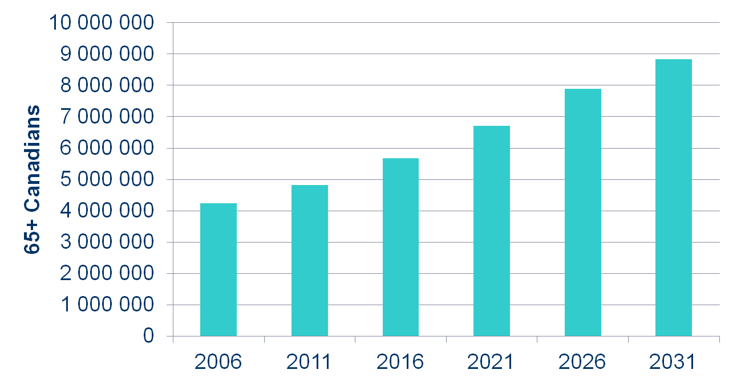
We project 8.8 million older Canadians living in private households, in 2031
100% increase between 2006 and 2031

Slide 11
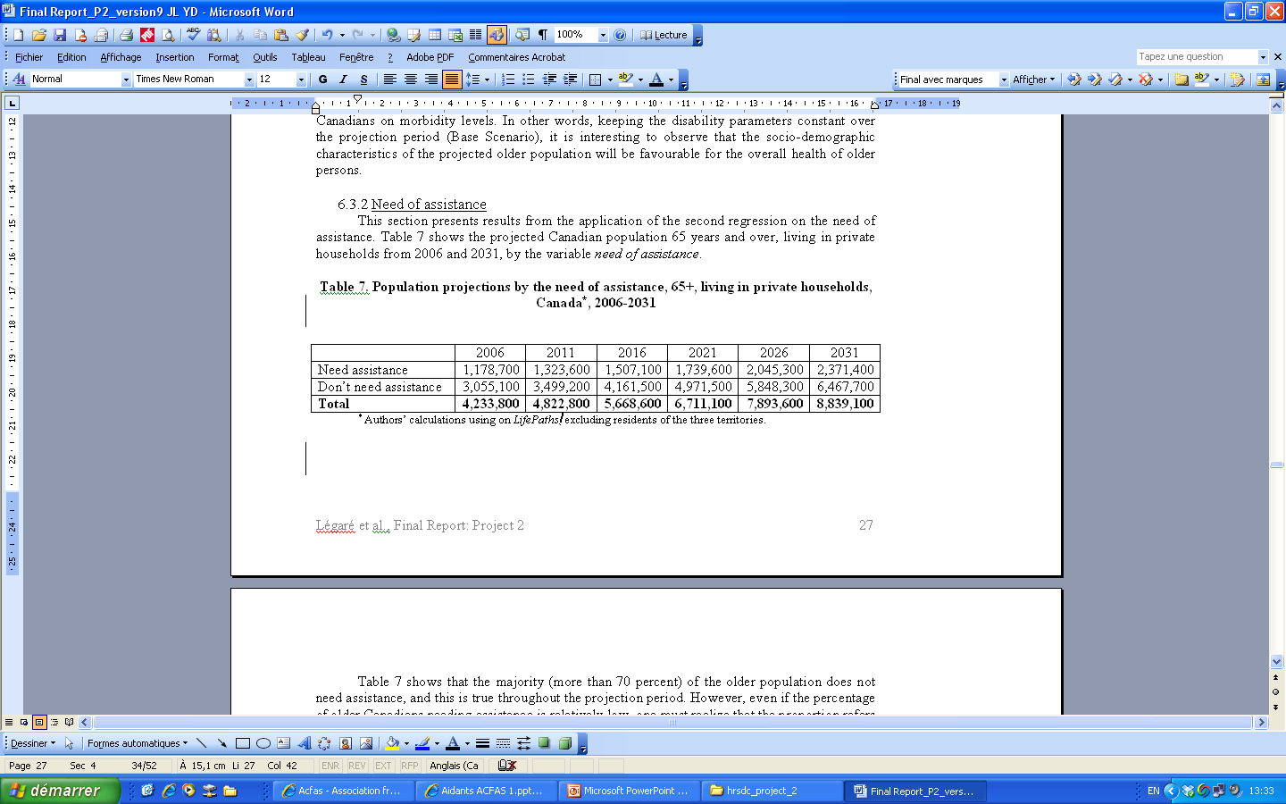
Population projections by the need of assistance, 65+, living in private households, Canada*, 2006-2031
We project a slightly smaller proportion of people aged 65 and older needing assistance, in 2031 than in 2006, despite the fact that the numbers are doubling.

Slide 12
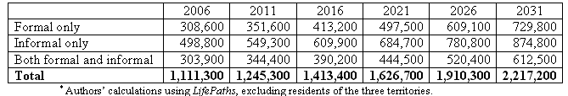
Population projections by source of assistance, 65+, living in private households, Canada*, 2006-2031
Despite the narrowing of the gap between the proportions of older Canadians receiving informal help and formal help, the informal network is projected in 2031 to remain the most prevalent network of assistance for older people.
Moreover, if patterns of network usage stay similar in the next few decades, future older persons are likely to receive more formal assistance, since they will have fewer children on which to rely.

Slide 13
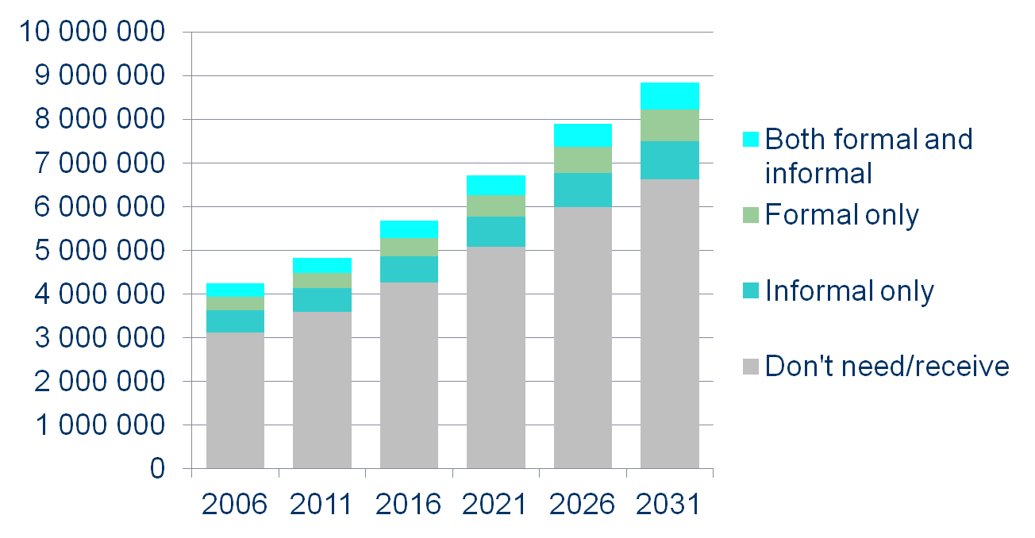
More than 70 percent of the older population do not need assistance, and this is true throughout the projection period
Population projections by source of assistance, 65+, living in private households, Canada, 2006-2031

Slide 14
Projections 2006 – 2031 :scenario results
Canadian population of 65 years and over, living in private households, excluding people living in the three territories by source of assistance

Slide 15
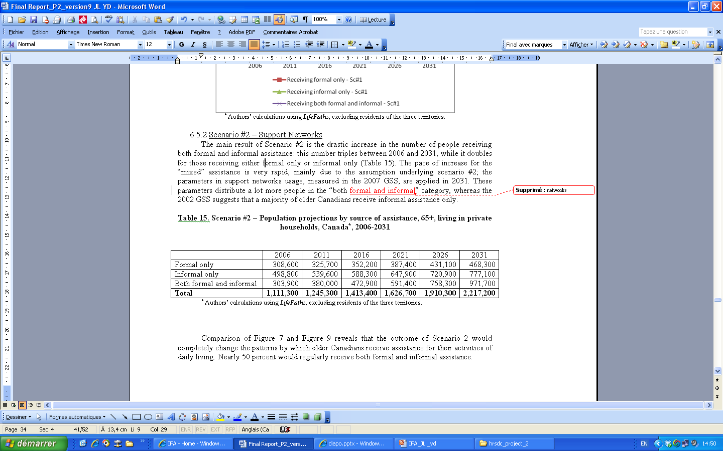
Scenario – Population projections by source of assistance, 2006-2031
The main result of the scenario is the drastic increase in the number of people receiving both formal and informal assistance: this number triples between 2006 and 2031, while it doubles for those receiving either formal only or informal only.
The pace of increase for the both formal and informal assistance is very rapid, mainly due to the assumption underlying this scenario; the parameters in support networks usage, measured in the 2007 GSS, are applied in 2031. These parameters distribute a lot more people in the “both networks” category, whereas the 2002 GSS suggests that a majority of older Canadians receive informal assistance only.

Slide 16
Scenario – Proportions projections by source of assistance, 2006-2031
45%
16

Slide 17
Comparison – Population projections by source of assistance, 2006-2031

Slide 18
Conclusions (1/2)
The demand for assistance will clearly be a challenge given evidence already of a shortage in personal care workers in many provinces in Canada.
Research suggests that provincial home care programs are seeking innovative solutions to recruit and retain enough of workers to serve their client’s needs.
But that demand will double at a time with the general Canadian labour force is shrinking.

Slide 19
Conclusions (2/2)
The “What if…” scenario should it be realized means an even greater demand for home care workers. Results point to an unprecedented increase in the proportion of situations where both informal and formal networks are involved in the care of older people in the community. This change in organization of care may have repercussion for care delivery as well.
Among the other challenges of finding human resources described above, there may be increased need for care coordination of tasks provide; and a greater need for mediation between family and friend involvement and that of formal providers. Policies to support family and friends in their roles will continue to be important levers to maintain continuity of their involvement.

Slide 20
Thank you
For more information, please contact me at:
yann.decarie@ucs.inrs.ca

Slide 21
LifePaths
The population is simulated with LifePaths: a Canadian dynamic longitudinal microsimulation model.
This model has been developed for several years by Statistics Canada in a programming language named Modgen.
LifePaths is an overlapping cohort model that produces for each run a representative sample of the Canadian population.
The simulated cases are a series of events that occur in continuous time using behavioural equations estimated from a large number of data sources.

Slide 22
Regressions (1/2)
Some of the key variables needed in our project are either not available in LifePaths or have a different definition than what we use in our research program. This is the case for :
-Disability: (D),
Needing assistance (NA),
Living arrangement (LA),
Receiving assistance (RA),
Source of assistance (SA).
In order to project the older Canadian population by these five dimensions, we apply regression parameters from cross-sectional surveys to the LifePaths outputs.

Slide 23
Regressions (2/2)
The objective is to break down the projected population by these five variables.
The results of regression analyses using data from the 2000/01 Canadian Community Health Survey (CCHS) and the 2002 General Social Survey (GSS) were used to achieve this objective.
Regression parameters were transformed into probabilities that were applied to the population projections.

Slide 24
Information from the GSS in 2002
Canadian population of 65 years and over, living in private households, excluding people living in the three territories by:
  Amount of assistance by group of activities
  Sources of assistance by group of activities

Slide 25
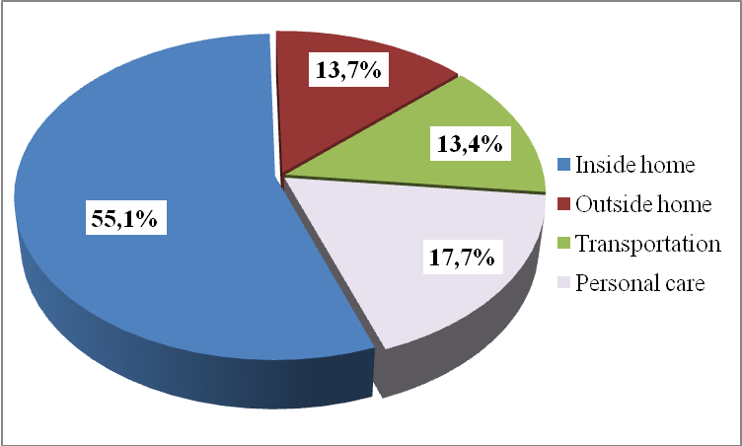
Amount of assistance received, 2002

Slide 26
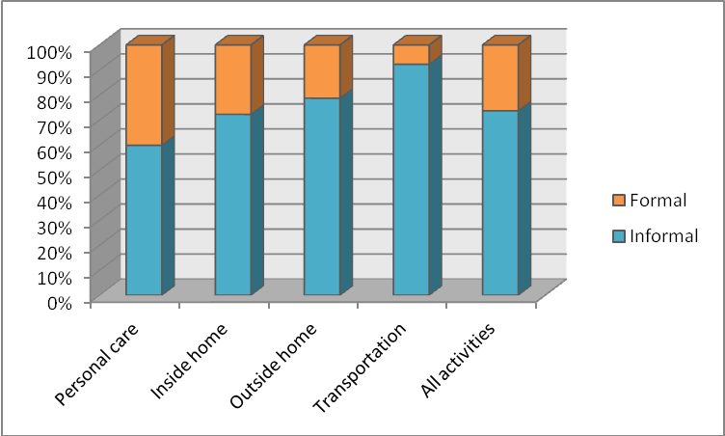
Contribution of social networks to the total amount of assistance provided by group of activities, 2002

Slide 27
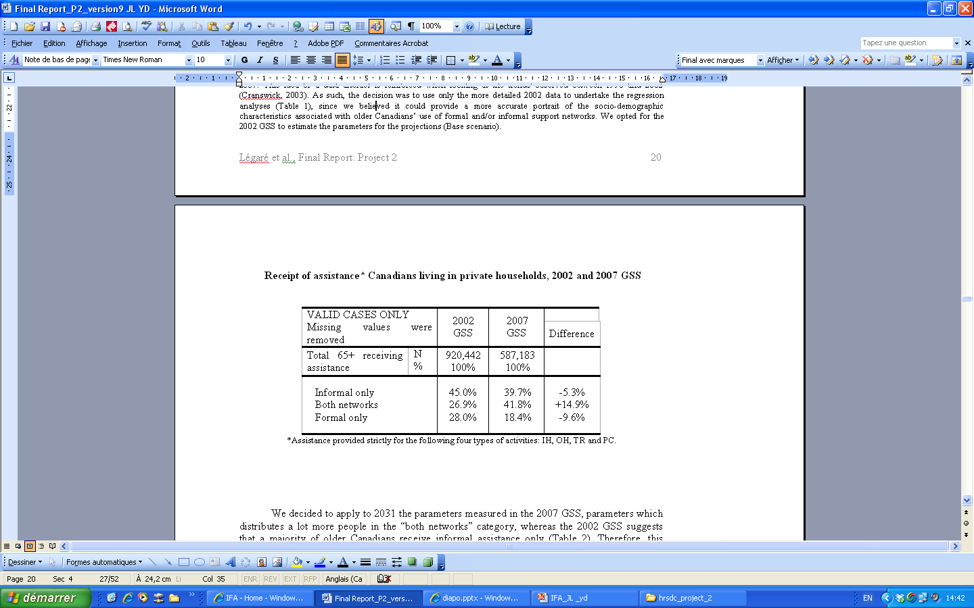
Receipt of assistance* Canadians living in private households, 2002 and 2007 GSS

