Slide 1
Intergenerational Solidarity and Depression of Older People in Contemporary South Korea
Seung-Min Park
(DPhil Candidate)
IFA Conference (30th May 2012, Prague)

Slide 2
Demographic Transitions and Changing Intergenerational Solidarity in Contemporary South Korea

Slide 3
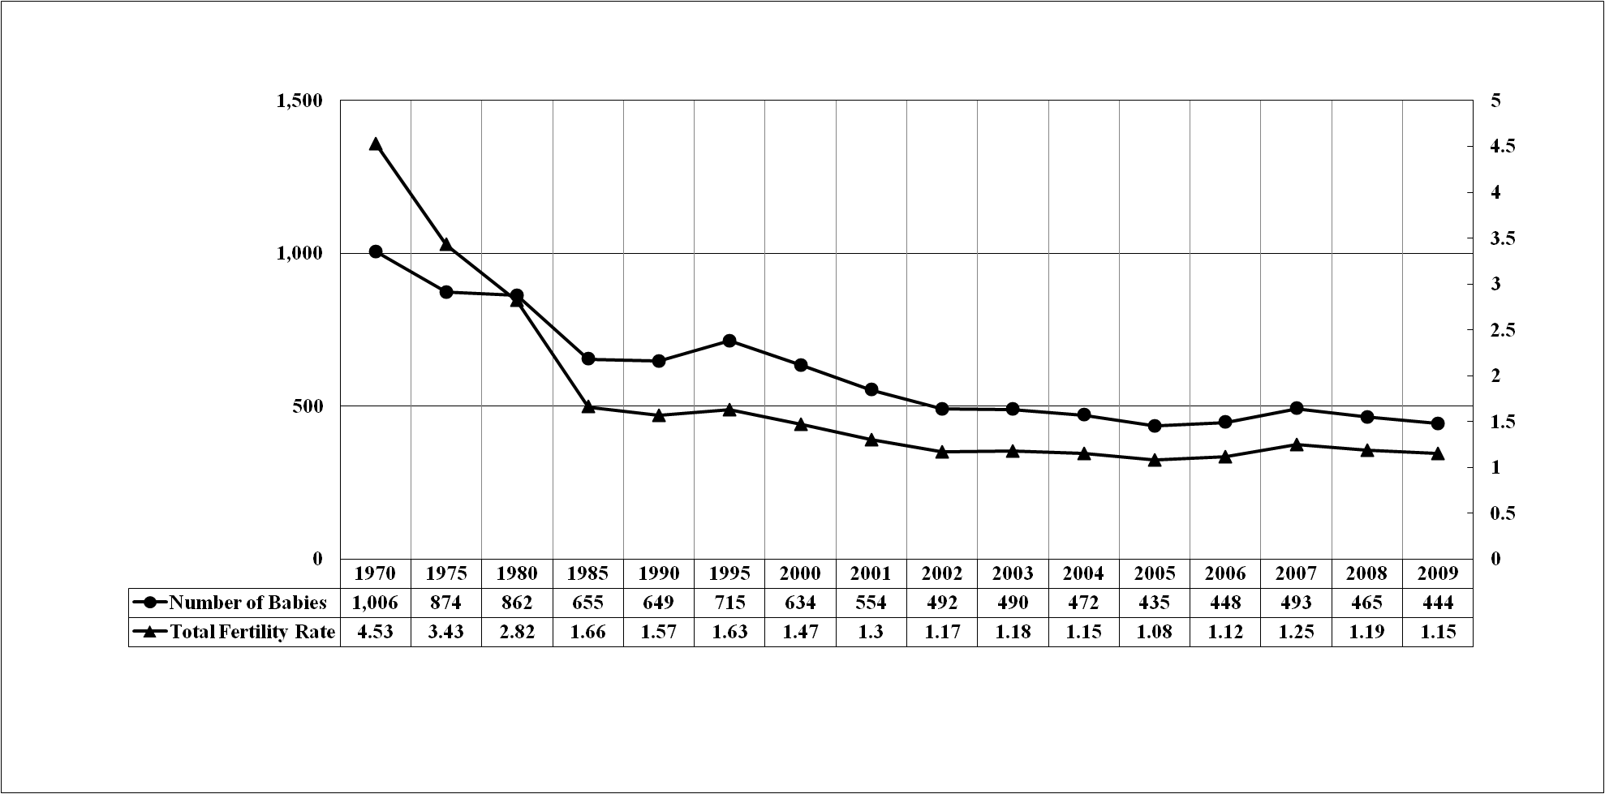
Total Fertility Rate and Number of Babies since 1970 in South Korea

Slide 4
Life Expectancy at Birth since 1970 in South Korea
 | 1970 | 1980 | 1988 | 1998 | 2008
Male | 58.7 | 61.8 | 66.3 | 71.7 | 76.4
Female | 65.6 | 70 | 74.6 | 78.5 | 83.3
Family Composition since 1970 in South Korea (%)
 | 1970 | 1980 | 1990 | 2000 | 2005
Extended Family | 18.8 | 11 | 10.2 | 7.9 | 6.9
Nuclear Family | 71.5 | 72.9 | 76 | 82 | 82.8

Slide 5
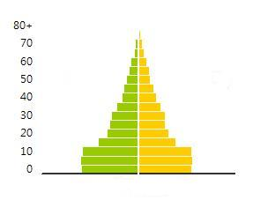
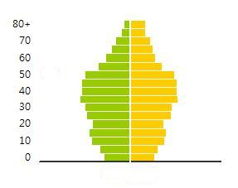
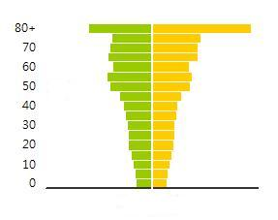
Population Pyramid since 1970 in South Korea
1970
2010
2050

Slide 6
Research Context
Demographic transitions undermine the Korean traditional intergenerational solidarity for older people.
Intergenerational solidarity is the critical element determining the depression of older people. Therefore, it is unequivocal that the depression of older people should be affected by the collapsing intergenerational solidarity.
Research Question: How does the intergenerational solidarity significantly determine the depression of older people in contemporary South Korea?

Slide 7
Intergenerational Solidarity
Dimension | Definition | Summary | Measurement
Associational Solidarity | The frequency and patterns of interaction in various types of activities in which family members engage. | Integration vs Isolation | the frequency of contact between intergenerational family members such as face-to-face, telephone, mail or email
Affectual Solidarity | The type and degree of positive emotional closeness, sentiments and evaluations about family members and the degree of reciprocity of these sentiments. | Intimacy vs Distance | rating of affection, warmth, closeness, trust, respect and perceived reciprocity for family members
Consensual Solidarity | The degree of agreement on values, attitudes and beliefs among family members | Agreement vs Dissent | ratings of perceived subjective accordance, orientation or similarity in values, attitudes and beliefs

Slide 8
Intergenerational Solidarity
Dimension | Definition | Summary | Measurement
Functional Solidarity | The degree of helping or resources which is given, received and exchanged across generations including financial, instrumental, and emotional support. | Dependency vs. Autonomy | the frequency of exchanging assistance and ratings of reciprocity in exchanging resources between generations
Normative Solidarity | The strength of commitment to performance of familial roles or attitudes about the importance of the familism or of meeting familial obligation. | Familism vs. Individualism | The amount or strength of meeting familial obligation
Structural Solidarity | The opportunity structure for intergenerational relationships reflected in number, type and geographic proximity of family member. | Opportunity vs. Barriers | residential closeness, number of family members, health status of family members and so on

Slide 9
Hypotheses
Hypothesis 1: The stronger the associational solidarity, the lower the degree of depression of older people.
Hypothesis 1-1: The more frequent the face-to-face contact with adult children, the lower the degree of depression of older people.
Hypothesis 1-2: The more frequent the contact with adult children via telephone or (e)mail, the lower the degree of depression of older people.
Hypothesis 2: The stronger the affectual solidarity, the lower the degree of depression of older people.
Hypothesis 3: The stronger the functional solidarity, the lower the degree of depression of older people.
Hypothesis 3-1: The more financial support they receive from adult children, the lower the degree of depression of older people.
Hypothesis 3-2: Receiving non-financial support from adult children will decrease the level of depression of older people.

Slide 10
Data and Variables
4,040 older people aged 65 and over selected from the 2nd wave (2008) of the Korean Longitudinal Study of Ageing
Socio-Demographic and Economic Status
age, gender, marital status, religion, education, income, asset, and ownerships of a vehicle and a house.
Intergenerational Solidarity
Associational solidarity (frequency of face-to-face meeting and contact via telephone, letter or email)
Affectual solidarity (degree of satisfaction with the relationship with adult children)
Functional solidarity (financial and non-financial support from adult children to older parents).
Depression
Measured by 10 dimensions (losing interests, difficulty in concentration, feeling depressed, losing energy and feeling tired, feeling doing well, feeling afraid, difficulty in sleeping, non-grievance, feeling lonely, feeling worthless). Cronbach’s A = .882

Slide 11
Association between Intergenerational Solidarity and Depression of Older People
Independent Variables |  |  | Model 1 B (SE) / β | Model 2 B (SE) / β | Model 3 B (SE) / β
Socio-Demographic Status |  | Age | .014 (.002) / .150***
 |  | Gender (female=1) | .185 (.030) / .150***
 |  | Marriage (married=1) | -.074 (.033) / -.058*
 |  | Religion (religious=1) | -.095 (.027) / -.078***
Socio-Economic Status |  | Education |  | -.057 (.016) / -.086***
 |  | Income |  | -.012 (.013) / -.023
 |  | Assets |  | -.009 (.013) / -.016
 |  | Vehicle (having=1) |  | -.070 (.050) / -.033**
 |  | House (house=1) |  | -.176 (.036) / -.111***
Intergenerational Solidarity | Associational Solidarity | Meeting (1st) |  |  | .010 (.008) / .033**
 |  | Meeting (2nd) |  |  | .003 (.008) / .009*
 |  | Meeting (3rd) |  |  | .005 (.009) / .016*
 |  | Contact (1st) |  |  | .024 (.009) / .078
 |  | Contact (2nd) |  |  | .008 (.009) / .027
 |  | Contact (3rd) |  |  | .011 (.009) / .035
 | Affectual Solidarity |  |  |  | -.008 (.001) / -.218***
 | Functional Solidarity | Amount of Money Received From Adult Children |  |  | -.029 (.012) / -.053*
 |  | Non-financial Support From Adult Children (received=1) |  |  | -.049 (.073) / -.014
Constant (SE) |  |  | .863 (.172) | 1.344 (.201) | 1.845 (.208)
R² (R² Change) |  |  | .068 | .092 (.024)*** | .165 (.073)***
F |  |  | 35.826*** | 22.024*** | 21.453***

Slide 12
Discussion (This part is still ongoing)
Why less likely to be depressed?
Younger, male, married, religious, higher education, having a car and a house
Why not
Associational solidarity in terms of contact and non-financial functional solidarity?

Slide 13
Thank you
Please do not hesitate to contact to me should you have any queries.
( seung-min.park@kellogg.ox.ac.uk )

