Slide 1
Long Term Outcomes of Restorative Home Care
Gill Lewin, Janine Alan, Helman Alfonso

Slide 2
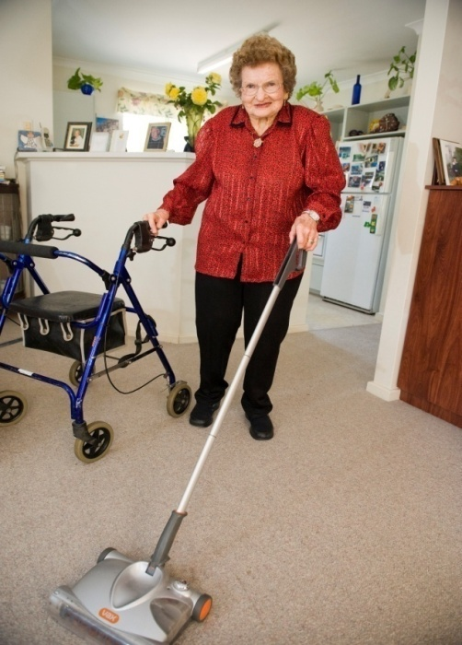
Restorative Home Care Programs
Aim to maximise independence, self esteem and quality of life and reduce care required
Key elements:
  Comprehensive assessment
  Goal setting
  Individualised care plans
  Targeted evidence-based interventions
Often time limited
May be directed to specific target groups

Slide 3

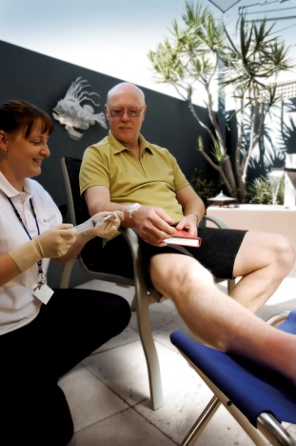
Silver Chain
WA
West Australian
Community Health and Aged Care Provider
40,000 + clients annually
Many health and home support services
~ 45% of Govt. funded home care in WA
In 1999 had waitlists for home care services
Developed Restorative Home Care programs, HIP + PEP
HIP + PEP available across Perth since 2002

Slide 4
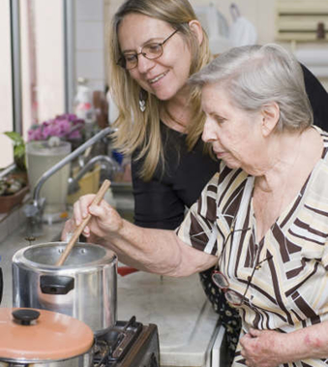
Silver Chain’s Restorative Programs
Home Independence Program (HIP)
  Older individuals needing homecare
  Community based referral
  12 weeks maximum
Personal Enablement Program (PEP)
  Leaving hospital, potential to improve
  Hospital referral (may include post acute nursing)
  8 weeks maximum

Slide 5
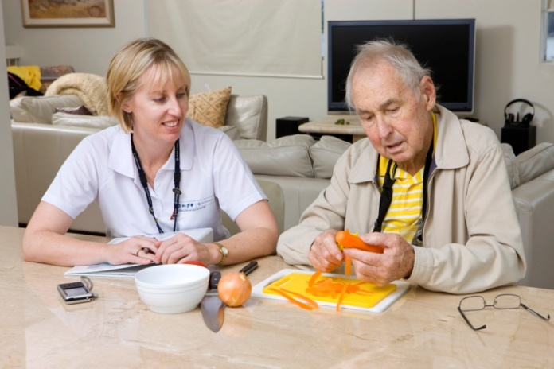
Study Objectives
Primary objective:
  Compare aged care service use over 5 yrs of individuals who participated in HIP / PEP with that of individuals who received HACC.
Secondary objectives:
  Examine the impact of participating in an independence program, as compared to receiving usual home care services, on delaying the need for recommendation into residential care, improving survival and reducing care costs over time.

Slide 6
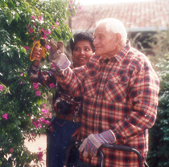
Study Design and Method
Retrospective Cohort Study
65+ yr old HIP, PEP and HACC clients
Referred for service 1 Jan 2004 – 31 Dec 2008
No diagnosis of dementia
2004-2009 client data from Silver Chain Comcare, HACC MDS, ACAP database and mortality register linked
Service use examined at 12, 24,36, 48 and 60 months
Poisson regression to identify predictors of service use
Cox regression to compare ACAT assessment or death
Quantile regression to compare costs between groups

Slide 7
Results - Demographics

Slide 8
Results – HACC All Service Use
*Adjusted for age, sex, living arrangement, having carer, dependence level and requiring PC service previous start study

Slide 9
Results – HACC Personal Care Use
*Adjusted for age, sex, living arrangement, having carer, dependence level and requiring PC service previous start study

Slide 10
Results – ACAT assessment over time
Year acap | Control N=2,332 | PEP N=5,450 | HIP N=2,586
2004 | 14 (0.60) | 10 (0.18) | 7 (0.27)
2005 | 24 (1.03) | 27 (0.50) | 12 (0.46)
2006 | 30 (1.29) | 54 (0.99) | 22 (0.85)
2007 | 35 (1.50) | 78 (1.43) | 42 (1.62)
2008 | 31 (1.33) | 68 (1.25) | 24 (0.93)
2009 | 13 (0.56) | 19 (0.35) | 18 (0.70)
Total | 147 (6.30) | 256 (4.70) | 125 (4.83)
outcome | level | Control N=2,332 | PEP N=5,450 | HIP N=2,586
appcomm | 1 | 91 (3.90) | 176 (3.23) | 87 (3.36)
appeach | 1 | 27 (1.16) | 22 (0.40) | 13 (0.50)
appother | 1 | 99 (4.25) | 204 (3.74) | 94 (3.63)
appresi | 1 | 86 (3.69) | 160 (2.94) | 75 (2.90)
appresi | 2 | 29 (1.24) | 20 (0.37) | 13 (0.50)
group | Crude OR (95% CI) | Adjusted* OR (95% CI)
PEP | 0.64 (0.52-0.79) | 0.96 (0.75-1.22)
HIP | 0.65 (0.51-0.82) | 0.91 (0.69-1.19)
*Adjusted for age, sex, living arrangement, having carer, dependence level and requiring PC service previous start study , using Cox regression

Slide 11
Results – Risk of death
group | Crude OR (95% CI) | Adjusted* OR (95% CI)
PEP | 0.39 (0.36-0.42) | 0.52 (0.47-0.57)
HIP | 0.45 (0.41-0.50) | 0.58 (0.52-0.65)
*Adjusted for age, sex, living arrangement, having carer, dependence level and requiring PC service previous start study , using Cox regression

Slide 12
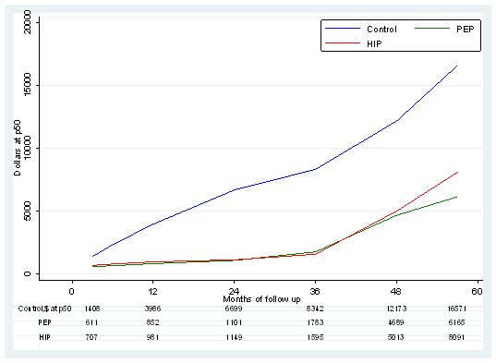
Results – Adjusted Median Cumulative Costs
*Adjusted for age, sex, living arrangement, having carer, dependence level and requiring PC service previous start study

Slide 13
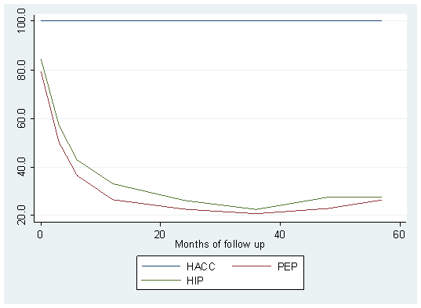
Returns on Investment
*Adjusted for age, sex, living arrangement, having carer, dependence level and requiring PC service previous start study

Slide 14
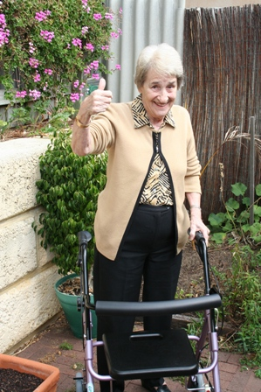
Conclusions
Individuals who receive a restorative home care service rather than usual HACC home care:
have a reduced likelihood of subsequently using:
- any home care service for three years
- a personal care service for five years
are somewhat less likely to be ACAT assessed
within the next 5 years and much less likely to be
approved for nursing home high level care
are less likely to die over the next 5 years
represent a much better return on investment

Slide 15
Contact for more information:
g.lewin@curtin.edu.au

