Slide 1
Intel-GE Care Innovations™ Guide
Guide – verb:
to assist (a person) to travel through, or reach a destination in, an unfamiliar area, as by accompanying or giving directions to the person
-- dictionary.com

Slide 2
The Business Decision
2009 : Intel & GE Alliance
2011 : Intel & GE JV
GE Healthcare's Home Health division and Intel's Digital Health Group
The market segments for telehealth and home health monitoring predicted
to grow to an estimated $7.7 billion by 2012,
the jointly-owned company’s focus will be to help address some of the largest issues facing society today, the aging population, the growing number of people with chronic conditions and increasing healthcare costs.

Slide 3
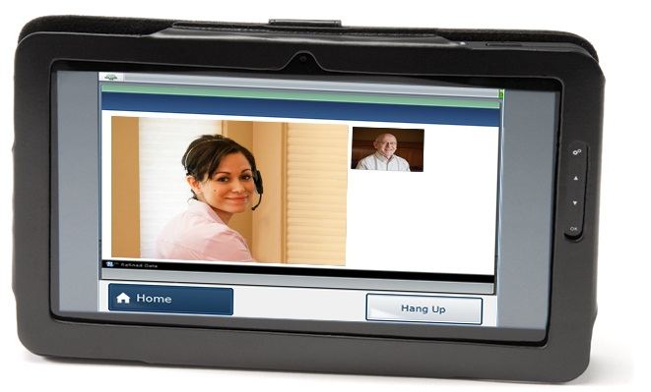
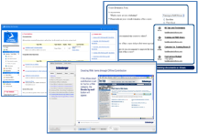
Care Innovations™ Guide System Overview
Home
Phone line
Internet
3G wireless
Nurse Care Manager
Patient Education
and Protocols

Slide 4
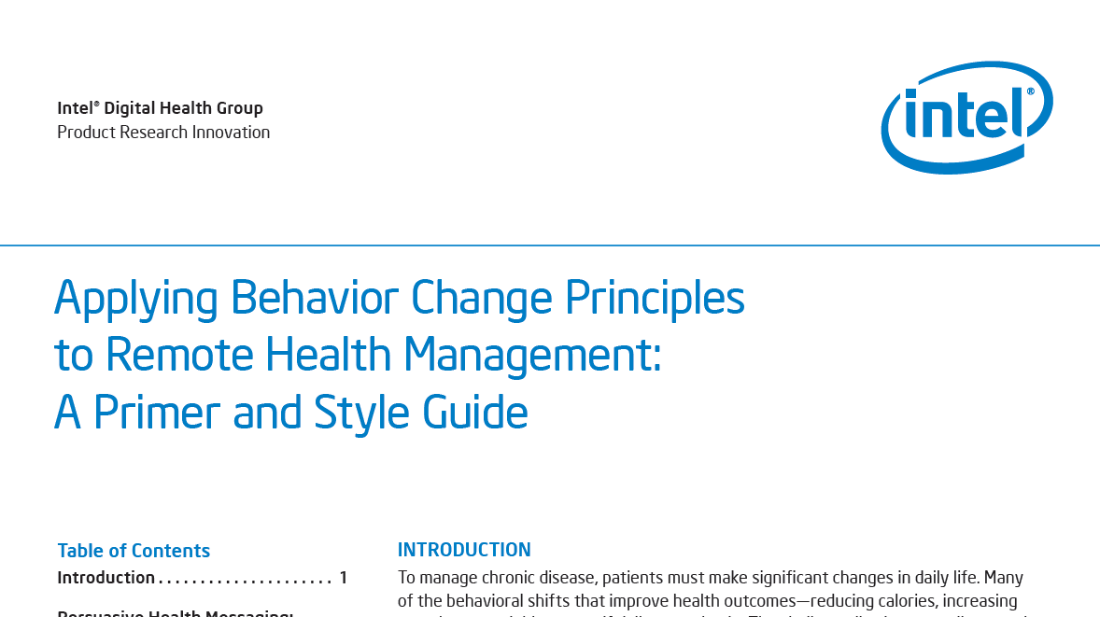
Ethnographers in: 1000 homes • 100 clinics • 20 countries •
10 years •
Reducing dietary salt by 3g per day is projected to reduce the annual number of new cases of CHD by 60,000 to 120,000 [33%], stroke by 32,000 to 66,000 [32%], and myocardial infarction by 54,000 to 99,000 [35%]
Kirsten Bibbins-Domingo, Ph.D., M.D. (2010). Projected Effect of Dietary Salt Reductions on Future Cardiovascular Disease. N Engl J Med 2010; 362:590-599

Slide 5
Guide-facilitated model of care…
A model of care delivered by a clinician and facilitated by the Care Innovations Guide has been shown to:
impact behavior change in patients,
improve medication adherence,
improve quality of life,
increase awareness leading to improved self-management behaviors,
and drive appropriate utilization of healthcare resources.

Slide 6
… and about Lifestyle
Engage
Educate
Evaluate
Empower

Slide 7
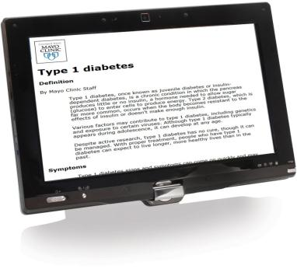
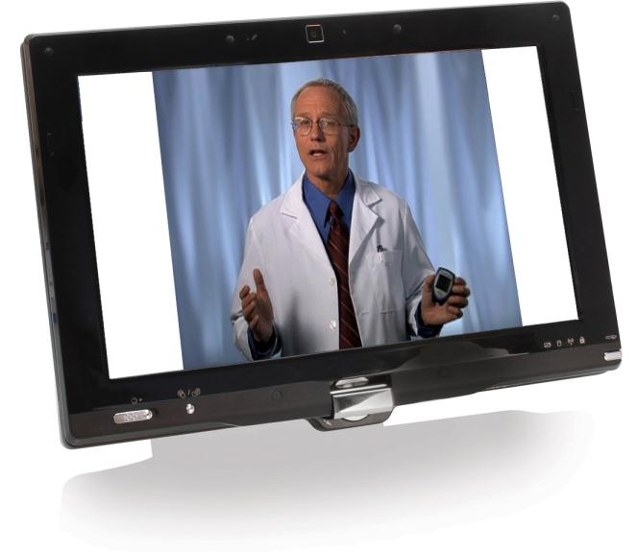
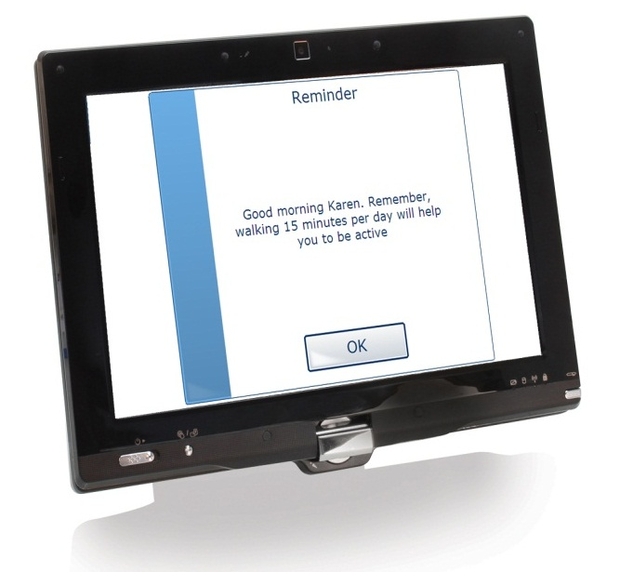
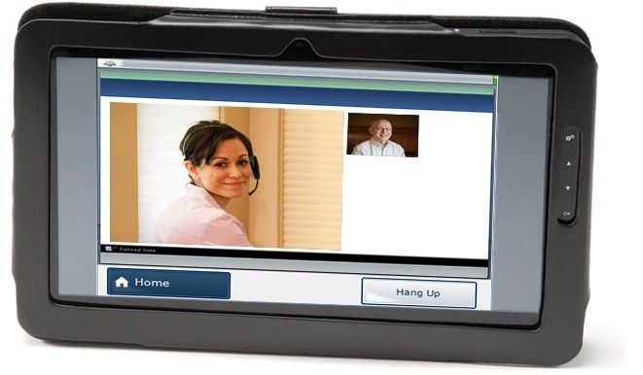
Educate
Long-Form Education
“Type 1 diabetes, once known as juvenile diabetes or insulin-dependent diabetes, is a chronic condition in which the pancreas produces little or no insulin, a hormone needed to allow sugar (glucose) to enter cells to produce energy. Type 2 diabetes, which is far more common, occurs when the body becomes resistant to the effects of insulin or doesn't make enough insulin.
Various factors may contribute to type 1 diabetes, including genetics and exposure to certain viruses. Although type 1 diabetes typically appears during adolescence, it can develop at any age.
Despite active research, type 1 diabetes has no cure, though it can be managed. With proper treatment, people who have type 1 diabetes can expect to live longer, more healthy lives than in the past.” …
Video Education
Video Education Long-Form Education
Short Reminders
Live Video Conferencing
Short Notes To Reinforce Daily Habits
“remember, walking 15 minutes per day will help you to be active”

Slide 8
Intel-GE Care Innovations™ Guide Solution
Content Library (example)
Weight Management
Sodium Education
Hypertension
Medication Adherence
Smoking Cessation
Foot Checks
Depression
Pacemaker
Custom
AHA Heart Failure Program
ADA Diabetes Program
NSF Sleep Apnea Program
ADA Diabetes Pgm.
AHA Heart Failure Pgm.
Hypertension
Weight Management
Smoking Cessation
Medication Adhence
Foot Checks
Sodium Education
Betty
George
Customizable building blocks, combined for unique people…
Notes:
Bio/psycho/social

Slide 9
Conversations… The Care Innovations™ Protocol Engine
Answer 1
Question 5
Answer 1
Question 2
Answer 1
Question 6
Long-form Education
Question 1
Answer 2
Question 3
Answer 2
Question 7
Short Reminder
Answer 3
Measurement
Answer 1
Question 8
Question 4
Video Education
Conversational Interaction
Timely, Specific, Personal
Answer 2
Question 9
“Branch” on Answers
“Branch” on Measurement
Timely, Specific, Personal Education
Up to 7 answers per question Assist the clinician
Threshold Violation

Slide 10
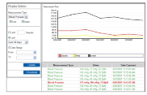
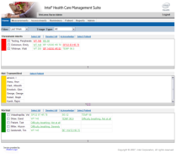
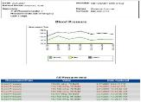
Options from the Home Screen
Measurements
Assessments
Login
Tabs
Reminders
Patient
Reports
Home Screen
10
Notes:
10

Slide 11
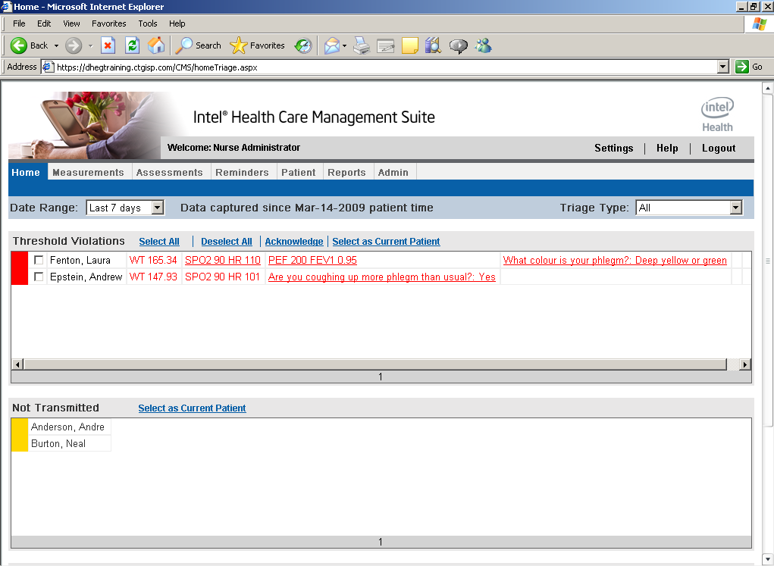
Care Innovations™ Guide Virtual Care Suite
Care Management Suite: Helping Clinicians Make Sense of the Data

Slide 12
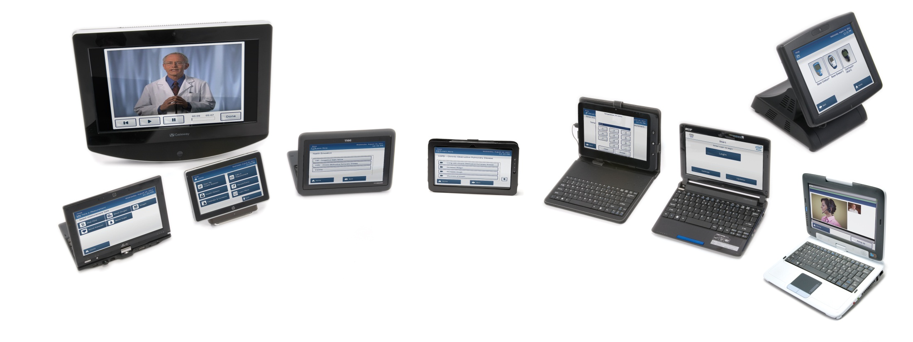
Intel-GE Care Innovations™ Guide
Personal, Portable, Extensible
Touch screen, Bluetooth, USB, Webcam
Standard Platform with Extensibility**
Form-factor Flexibility (Tablet, Netbook, Kiosk)
Cleared to operate on ANY computer meeting the minimum hardware requirements*
*Detailed specification in Intel® Health Guide Setup and Implementation Manual (DHF-1820)
**Not a commitment to deliver additional features

Slide 13
Thank You

Slide 14
Copyright © 2011 Intel-GE Care Innovations LLC. All rights reserved. Care Innovations, the Care Innovations logo, and the Caring Icon logo are trademarks of Intel-GE Care Innovations LLC. QuietCare is a registered trademark of Intel-GE Care Innovations LLC. Intel and the Intel corporate logo are trademarks of Intel Corporation in the United States and/or other countries, used under license. GE and the GE Monogram are trademarks of General Electric Company in the United States and/or other countries, used under license. The Intel-GE Care Innovations™ Guide requires an internet connection to enable communications with the patient’s healthcare team and back-end data hosting. The Care Innovations™ Guide is intended for use by patients under the guidance of a healthcare professional and is not intended for emergency medical communications or real-time patient monitoring. This material uses actors who are not actual patients that have used the Guide. *All other third-party trademarks are the properties of their respective owners.

Slide 15
Intel-GE Care Innovations™ Guide Solution & Services
Project Management
Assess + Plan
Content
Technology
Logistics
Enroll
Install + Train
Monitor
Improve + Scale
Home
Phone line
Internet
3G wireless
Nurse Care Manager
Intel-GE Care Innovations Guide Engage, Educate, Evaluate, Empower
Patient Education
and Protocols
Notes:
http://www.istockphoto.com/stock-photo-3093773-project-plan.php?st=51c81b4

