Slide 1
Early intervention approaches to ageing in a United Kingdom policy context
For IFA – Prague, 31 May 2012
Katrina Ritters and Howard Davis, with Ian Philp, Natalie Byrom and Hanneke Wiltjer

Slide 2
Introduction
The case for early intervention
United Kingdom policy focus
Use of EASY-Care as part of an early intervention project in Warwickshire, UK
The EASY-Care network

Slide 3
The case for early intervention
Inverting the triangle of care
A vision for ageing well:
- older people, agencies and communities working together
- joint working between agencies
a shift in ‘professional’ thinking
- information and advice to support empowerment in accessing services

Slide 4
Source: ADSS/LGA, 2003, All Our Tomorrows – Inverting the Triangle of Care

Slide 5
Source: ADSS/LGA, 2003, All Our Tomorrows – Inverting the Triangle of Care

Slide 6
Early Intervention Benefits
Quality of life
Stronger communities
More positive view of ageing
Cost effective
- Potential benefit for every £1 invested
£1.80 for society
plus an additional £1.40 benefit to the older person
Davis and Ritters, LAP Evaluation; Watt and Blair, The Business Case for LAP, DWP, 2009

Slide 7
UK Policy Context
Ageing population, both in UK and globally
Austerity, austerity, austerity
Government austerity
Individual austerity
Structural changes
Dementia Challenge
Personalisation Agenda
‘No decision about me, without me’
Individual budgets
Choice and control

Slide 8
Choice and Responsibility
Citizen Choice
Decline in moral authority in health and social care
Economic ‘risk’ of growing older population
Moral responsibility for ill health/ frailty
“A new era shimmers on the horizon: patients are attempting to become expert in their chronic illnesses, getting information from the web (using many of the same resources that doctors
do), and arranging their own care with the help of clinicians and hospital services.”
Chris Del Mar

Slide 9
The Warwickshire Project
Aim: To demonstrate the benefits of the EASY-Care Needs Assessment Instrument in identifying & responding to the unmet needs of older people (65+) in Stratford
To digitise the EASY-Care instrument and
Make it available to the public
Test out different access channels
Test EASY-Care as a digitised self assessment
Our project sponsors also wanted to use the project to develop
Joint working
Early intervention approaches

Slide 10
Digitisation

Slide 11
The EASY-Care tool

Slide 12
Target Groups
Triangle of Care
Aimed at:
Older people ‘at risk’ or those in the general population beginning to have concerns about their health and well Being
Acute Services
At-risk
General Population
Frail

Slide 13
Access channels
Self Assessment:
internet application
Accessible from peoples homes
In Stratford Library
In the Stratford District Council Offices (reception)
Available as a kiosk view with signposting to the system by practice staff in Rother House MC
Assisted assessment:
Tesco’s Pharmacist
Bridge Street Practise Nurse
Age UK Stratford Case Workers (Gateway Project)
Events across Stratford-on-Avon

Slide 14
Preliminary Results
Over 80% found it very easy or easy to complete
Over 70% would recommend the assessment to people they know
Over 70% found the information given either very or quite useful
‘‘The business of going through the questionnaire was a useful exercise, made you think about things more. A whole spectrum of possibilities that the questions open up..’
Idealistic assumption that doctors have got time to talk - they have so little time. Being like a log book and updating it from time to time would be useful. Even if only 10 minutes here and there gives a time to focus on your life in a way that doesn't usually happen - good to take stock.

Slide 15
Most useful for…. (% positive)
Helping you understand more about your health and well-being – 87%
As a record of your state of health and well-being that you can go back to over time – 83%
Prompting you to make changes for a more active and healthy life – 79%
To help you talk to family and carers about your overall state of health and well-being – 79%
To help you to talk to your doctor about your overall state of health and well-being – 71%

Slide 16
Responses to computerisation

Slide 17
Ease of Use
Over 80% found it very easy or easy to complete
Mostly took around 10-20 minutes to complete (50%); some more, some less.
For most people (87%), this felt about right
‘I did it at my own pace and there was a discussion at every point - I was able to discuss my answers and I was aware that it was my individual input and that was important.’
‘It gives you an opportunity that people will open up when you've got their confidence. You can't put a time limit because people are different.’

Slide 18
The questions themselves

Slide 19
Current or future need?

Slide 20
Issues of confidence and pride
‘You have to understand that people of my age are afraid they have lost it. Everyone has slight reservations about what might be found out.’
‘Intervention is inclined to mean interference, it sounds like you will interfere, suggest early help or early assistance.‘
‘The term OAP is derogatory, this term means you are nothing, it is a slur. It is not right and is often used in the news. I feel very strongly about the term OAP.’

Slide 21
After the Assessment – Information given

Slide 22
How useful?
Notes:
More than 70% of participants found the information provided as a result of the assessment useful:
No one was able to specify pieces of information they thought would be there but wasn’t. Most useful pieces of information included:
Location of specialist shop
the facility at Tachbrook that the Council have set up that I really didn't know about and I will take my husband along there
Accommodation and Finance
The point about the hearing aid from age uk
Some of the information that you've got was not widely available, eg, the help from Age UK.
Most interested in the NHS resource and the Age UK ID protection advice
Information about community transport.
‘The business of going through the questionnaire was a useful exercise, made you think about things more. A whole spectrum of possibilities that the questions open up. I know myself quite well so if I had a problem I would sought it immediately.’

Slide 23
Follow up study (work in progress) Hanneke Wiltjer and Dr Jackie Sturt, Warwick Medical School
Often no immediate health need, so urgency for follow up was reduced
Main benefit was recognition that help might be available and where they might look for it (once the concept was understood).
Appreciation of contact time in assisted assessments
But low recollection of content and results of assessment

Slide 24
Conclusion
Success in digitising the EASY-Care assessment tool – but internet connectivity was a problem in field trials
Older people response to computerisation more favourable than anticipated
Positive response to ease of use and range of questions
But so far, little follow up in terms of positive lifestyle changes

Slide 25
Next Steps
Develop range of assisted assessment channels
Widen use; build recognition and trust to reach critical mass
Develop supporting information resources in a sustainable way
Work to realise potential of underlying scoring mechanism

Slide 26
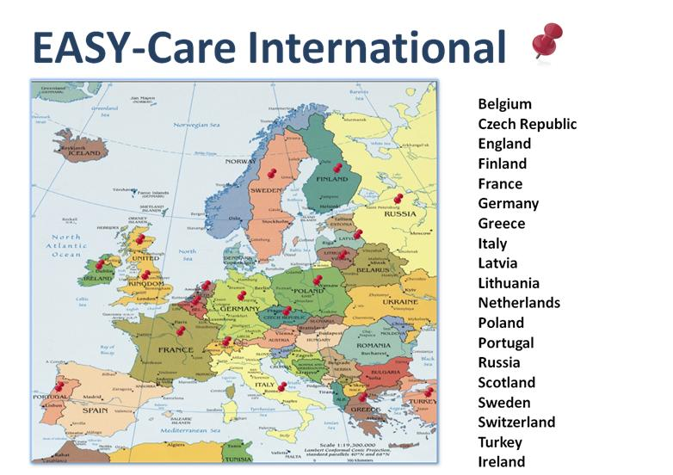

Slide 27
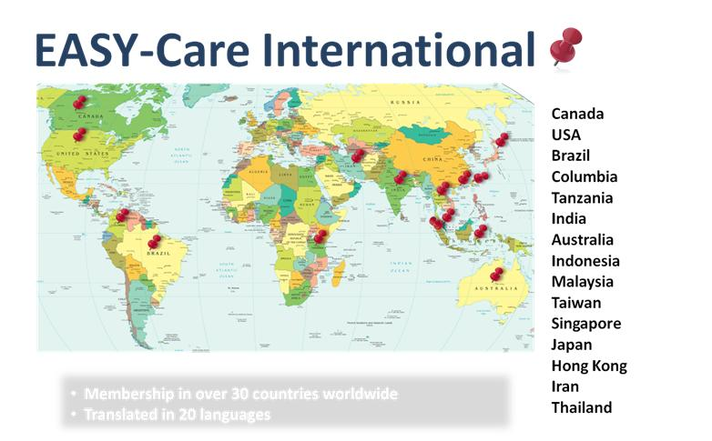

Slide 28
Find out more….
www.easycare.org.uk

Slide 29
Thank You
Katrina Ritters, Researcher
katrinaritters@gmail.com
Howard Davis, Professor of Local and Social Policy, Coventry University
Howard Davis@coventry.ac.uk
Judith Long, EASY-Care Project Co-ordinator,
J.f.long@warwick.ac.uk

